Slide 1


Masterclass
A Framework for Evaluating Interventions to Tackle Loneliness
Associate Professor Antonia Ypsilanti
Professor Andrea Wigfield
Notes:
Andrea

Slide 2


About us
Professor Andrea Wigfield
Expertise in loneliness research
Wider health and social
determinants / implications
Research and programme evaluation
Evidence-based policy and practice.
Associate Professor Antonia Ypsilanti
Psychology of Loneliness and Mental Health
Chronic/harmful loneliness
Research across age groups
Evaluating interventions on loneliness
Notes:
Please add here whatever you want
Both to present ourselves

Slide 3
Centre for Loneliness Studies: Our Mission
To be at the forefront of knowledge, drawing together interdisciplinary and world leading research which is informed by, but can also positively influence, policy and practice to support effective social relationships by using latest evidence on loneliness across the life course.
Notes:
Andrea

Slide 4

Our unique position on loneliness
Moving beyond the individual to understand the wider societal explanations for, and potential solutions to loneliness.
Multi-disciplinary approach (health, sociology, social policy, geography, business, sport, psychology, architecture, landscape, education)
Co-created, mixed methods approach to understanding loneliness
Notes:
Andrea

Slide 5
The Campaign to End Loneliness
Moved to SHU May 2024
Formed in 2011 from a coalition of leaders of charities
A world-leading advocacy group for loneliness
Contributed to the appointment of the world’s first Minister for Loneliness in the UK, and the publication of UK Loneliness Strategy
Informed by an Advisory Group and people with lived experience
Disseminating CFLS and other research evidence and translating into policy and practice
Notes:
Andrea

Slide 6
The Campaign to End Loneliness
Aims
Use research evidence to inform policy and practice
Raise awareness of loneliness amongst individuals and organisations
Collate and disseminate research findings on loneliness website/seminars/policy papers/Tackling Loneliness Hub
Influence politicians and policy – All Party Parliamentary Group (APPG)
Understanding what works, for who across UK– online portal for logging interventions, evaluation findings, training and support
Notes:
Andrea

Slide 7
Objectives
By the end of the Masterclass, you will be able to:
1. Appreciate the complexity of evaluating interventions on
Tackling Loneliness
2. Gain information relevant to your organisation and loneliness services you deliver
3. Understand which loneliness measures are best suited for evaluating interventions and why
4. Have a clearer understanding of what you are “changing” and how.
Notes:
Andrea

Slide 8
Glossary: Monitoring & Evaluation
Monitoring – routine collection of data
Evaluation – using data we collect to make judgements about our projects and services
Inputs – resources we put into projects & services
Outputs – products and services we actually deliver
Outcomes – changes and benefits we achieve
Quantitative – numbers of things that happen
Qualitative – people’s views and perceptions
Indicators – measurements we can use to determine whether outputs and outcomes are being achieved
Reliability: Data that is consistent and trustworthy
Validity: Data which measures what it claims to measure
Notes:
Andrea

Slide 9





Why evaluate?
For learning and development
For accountability
To demonstrate value for money to funders
Motivation of staff and volunteers
To save time and money

Slide 10



Who is measuring impact?
74% of charities say they are investing more in impact measurement
Change in funder requirements and priorities of trustees/senior management are main reasons for increasing impact measurement
BUT main benefits are in improving services and being able to better demonstrate results
Notes:
Andrea

Slide 11

What do we want to find out?
Are we achieving our planned outputs and outcomes? If not, why not?
What has worked well and not so well?
Are we reaching the people and organizations we want to?
What do service users think of our services? How can we improve them?
Notes:
Andrea

Slide 12
What is an evaluation framework and why do we need it?
Notes:
Antonia

Slide 13

Five steps in evaluation framework
Definition and Measurement of Loneliness
  Which scale do I use?
Target Population and Context
  Specific demographics (e.g., urban vs. rural, isolated groups, people with disabilities)
Intervention Design and Delivery
  Type, mode of delivery, duration of delivery
Outcome measures
  Primary/secondary outcomes (how do we know what we are changing?) quant/qual
Scalability
  Required resources
  Can the intervention be replicated in different settings or populations
Cochrane defines PICO: population, intervention, comparison, outcomes
Notes:
Antonia

Slide 14
Example
Let’s say we are evaluating a virtual peer support group intervention for older adults living in rural areas to reduce social isolation.
Notes:
Antonia

Slide 15
Start Building a Framework
Measurement
UCLA? DeJong? Direct Question? ONS?
Population
Older adults (65+), living in rural, isolated areas, with limited access to in-person social opportunities
Are any of these designed to measure change?
Scalability
Assess whether the virtual format reduces geographical barriers while considering digital literacy challenges
Comparison group?
What about after 6 months?
What are we changing?
Intervention
Weekly one-hour virtual peer support groups, facilitated by a trained therapist – Duration 12 weeks
Outcomes
Pre- and post-scores on loneliness, anxiety, and perceived social support collect qualitative feedback via phone interviews on the ease of use, the quality of interactions, and perceived emotional support
Notes:
Antonia

Slide 16

WHO – TACKLING LONELINESS INTERVENTIONS
https://www.who.int/initiatives/decade-of-healthy-ageing/evidence-gap-map/sil-inperson
https://www.who.int/initiatives/decade-of-healthy-ageing/evidence-gap-map/sil-digital
Notes:
Antonia - also allow a bit of time to people to explore these links

Slide 17
Back to our Framework
Measurement
UCLA? DeJong? Direct Question? ONS?
Population
Older adults (65+), living in rural, isolated areas, with limited access to in-person social opportunities
Are any of these designed to measure change?
Scalability
Assess whether the virtual format reduces geographical barriers while considering digital literacy challenges
Comparison group?
What about after 6 months?
What are we changing?
Intervention
Weekly one-hour virtual peer support groups, facilitated by a trained therapist – Duration 12 weeks
Outcomes
Pre- and post-scores on loneliness, anxiety, and perceived social support collect qualitative feedback via phone interviews on the ease of use, the quality of interactions, and perceived emotional support
Notes:
Antonia

Slide 18
How to Evaluate?
Notes:
Antonia

Slide 19
Measuring Loneliness (Quantitatively)
Two main scales to measure loneliness: UCLA and De Jong Gierveld
Youth Loneliness scales
Various single direct questions
Notes:
Antonia

Slide 20
Recommended measures of loneliness for adults (Currently under review)
Source: Office for National Statistics
Government’s Loneliness Strategy favour UCLA and a single item question Scores: 3-5 =Not Lonely; 6-9 =lonely
Measures | Items | Response categories
The three-item UCLA Loneliness scale | 1. How often do you feel that you lack companionship? | Hardly ever or never, Some of the time, Often
 | 2. How often do you feel left out? | Hardly ever or never, Some of the time, Often
 | 3. How often do you feel isolated from others? | Hardly ever or never, Some of the time, Often
The direct measure of loneliness | How often do you feel lonely? | Often/always, Some of the time, Occasionally, Hardly ever, Never
Notes:
Antonia

Slide 21


WHAT ARE THE CHALLENGES TO USING THESE MEASURES?
PLEASE ADD YOUR ANSWERS IN THE CHAT
Notes:
Antonia and Andrea to monitor the chat

Slide 22
Challenges of measuring loneliness (1)
Loneliness is subjective and difficult to measure
Loneliness is complex and cannot always be understood through a quantitative measurement, alone.
Loneliness varies - people often move in and out of feelings of loneliness in a typical week or even day.
Stigma – people don’t want to admit to being lonely (not even to themselves)
Notes:
Antonia

Slide 23
Challenges of measuring loneliness (2)
Evidence from our Centre’s research indicates that many interviewees do not understand some of the questions on the De Jong or UCLA scale questions (e.g. BME and older people)
Lack of understanding about some of terms used on scales e.g. ‘companionship’ and ‘left out’ (they have different meanings in difficult cultures)
Some incompatibility between UCLA scores, De Jong scores, and other qualitative responses by the same individual.
Notes:
Andrea

Slide 24
Measuring wider health implications of reducing loneliness
Lonely people are more likely to suffer from depression. (Cacioppo et al,.2006) e.g., PHQ-8
Being lonely leads to the loss of hope and energy (Bolton 2012)
Improvements in loneliness is closely associated with greater levels of well-being WEMWEBS
Social isolation is independently (negatively) associated with the Health-Related Quality of Life (HRLQ) of older people (Hawton et al. (2011)
WHOQOL: Measuring Quality of Life
Self-efficacy?
Motivation?
Notes:
Antonia

Slide 25




Measuring Loneliness (Qualitatively)
Interviews
Focus groups
Diaries
Sociograms
Notes:
Andrea

Slide 26

Comparison Group?
Notes:
Antonia

Slide 27
RCTs- non-RCTs – Feasibility
Randomized control trials (why are they robust?)
non- Randomized control trials
Feasibility studies (what can they offer?)
Notes:
Antonia

Slide 28

Study Duration
Please add in the chat the length of interventions you are delivering
Notes:
Andrea and Antonia to monitor chat

Slide 29
When do we expect to see a change?
Notes:
Antonia

Slide 30
How long does this change last for?
Notes:
Antonia

Slide 31
What are we changing?
Small group activity – breakout rooms (10 minutes)
First think about what you think you are changing with your interventions.
Then think about what the users think they are changing by participating in your intervention
How do you know?
Notes:
Andrea to introduce while Antonia sets up the breakout rooms

Slide 32
Loneliness Interventions: Challenges of evaluating
Lack of robust evaluations of loneliness initiatives
Difficulty in implementing (e.g., randomized controlled trials)
Inappropriateness of existing loneliness measurement scales for evaluating changes in loneliness as a direct result of interventions
Piecemeal approach to loneliness services - often run by voluntary sector organizations with limited financial resources
Notes:
back from the breakout rooms
Antonia

Slide 33
Top tips for evaluating interventions
Nothing is perfect but what can you do?
Select a standardized quantitative measure supported by qualitative data
Develop a framework for your organization using the example we discussed
Consider a comparison group
Utilize existing resources (e.g., WHO)
Keep it short (minimize burden on participants and service providers)
Focus, focus, focus – you cannot evaluate everything
Remember PICO (population, intervention, comparison, outcomes)
Consult experts – it will save you time and money
Co-create with users (if possible)
Notes:
Andrea add what you want here – Antonia to present

Slide 34
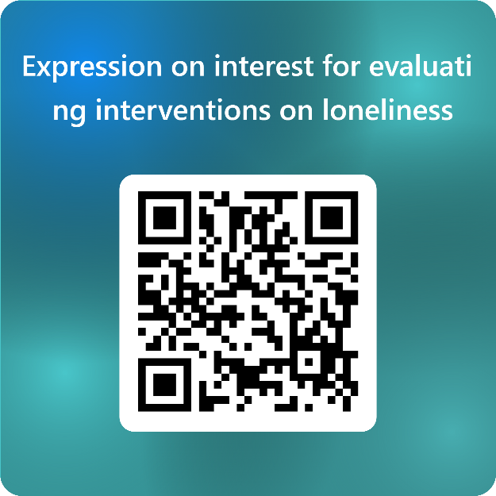
EXRESSIONS OF INTEREST
If you are delivering an intervention/s to tackle loneliness in your organization and would like to evaluate it using internal or external funding, please complete the short survey and we will get in touch.
For queries, please email us:
a.ypsilanti@shu.ac.uk
andrea.wigfield@shu.ac.uk
https://forms.office.com/e/UUbc1YevpU

Slide 35
Thank you for listening
Any Questions?
Contact details: Antonia a.ypsilanti@shu.ac.uk
Andrea andrea.wigfield@shu.ac.uk
Loneliness for Dummies
Loneliness For Dummies: Amazon.co.uk: Wigfield, Andrea: 9781394229321: Books

