Slide 1
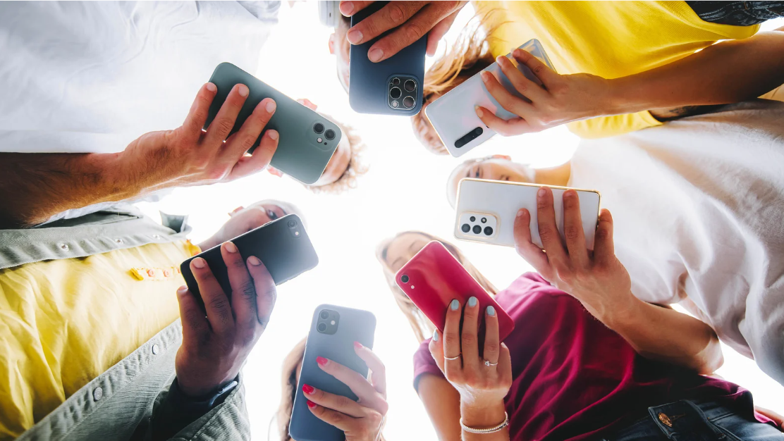

Social Media and Adolescent Well-Being: Connections, Challenges, and Digital media
Laura Marciano, PhD
Harvard T.H. Chan School of Public Health
Boston Children’s Hospital
The Tackling Loneliness Hub
March 6th 2025
Notes:
Gratitudine
Myself

Slide 2
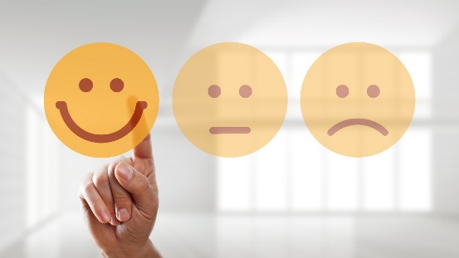

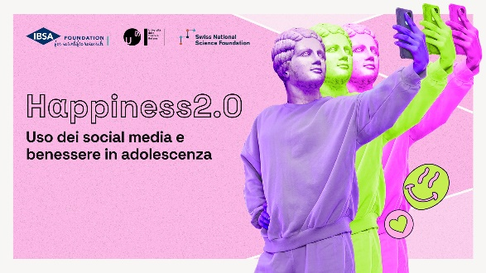
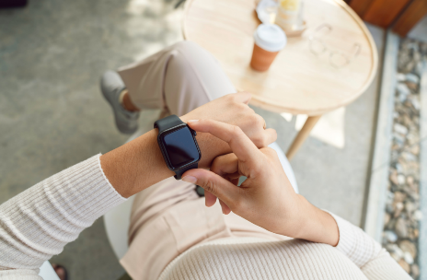


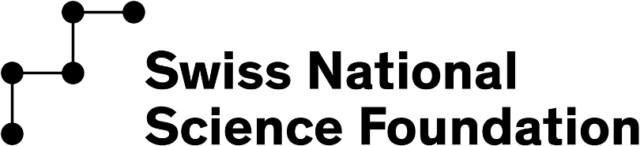
About me
MSc in Psychology and Cognitive Neuroscience
(Milan, Italy)
PhD in Health Communication
(Lugano, Switzerland)
Harvard T.H. Chan School of Public Health (Boston, USA)
Department of Social and Behavioral Sciences –
Lee Kum Sheung Center for Health and Happiness
HappyB
Collab with Digital Wellness Lab
HappyB2.0
Happiness2.0
Health&Happiness
(with Garmin)

Slide 3
Agenda
Defining loneliness
Loneliness and (adolescent) health
Loneliness and social media
HappyB studies: theory and methods
Digital detox
Q&A

Slide 4

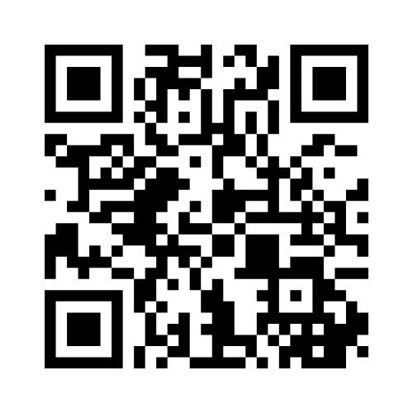
Is this person lonely?
Defining loneliness
Notes:
The role of social media – and digital media in general – in youth health and wellbeing has been highly debated. The ongoing public discussion tends to highlight the negative effects on adolescent well-being, although the picture is more nuanced and complicated than what we think. During two workshops organized by Harvard, of which the second one jointly organized with USI, we concluded our discussion stating that there is no effect of social media use that can apply to everyone, and that the type of the effect (negative, positive, none exhistent) depends on a variety of factors.

Slide 5
Is this person isolated?
Defining loneliness
Notes:
The role of social media – and digital media in general – in youth health and wellbeing has been highly debated. The ongoing public discussion tends to highlight the negative effects on adolescent well-being, although the picture is more nuanced and complicated than what we think. During two workshops organized by Harvard, of which the second one jointly organized with USI, we concluded our discussion stating that there is no effect of social media use that can apply to everyone, and that the type of the effect (negative, positive, none exhistent) depends on a variety of factors.

Slide 6
Is this person lonely?
Loneliness is 100% subjective
Social isolation is objective
Notes:
Loneliness is experienced when there is a gap between the quantity or quality of actual and desired social relationships⁴⁶. Conceptually, loneliness differs from the experience of being alone, solitude, and social isolation¹⁷.

Slide 7

A definition
Loneliness is experienced when there is a gap between the quantity or quality of actual and desired social relationships.
Conceptually, loneliness differs from the experience of being alone, solitude, and social isolation.
Hawkley LC, Cacioppo JT. Loneliness Matters: A Theoretical and Empirical Review of Consequences and Mechanisms. Ann Behav Med Publ Soc Behav Med. 2010;40(2):10.1007/s12160-010-9210-9218. doi:10.1007/s12160-010-9210-8
Notes:
The role of social media – and digital media in general – in youth health and wellbeing has been highly debated. The ongoing public discussion tends to highlight the negative effects on adolescent well-being, although the picture is more nuanced and complicated than what we think. During two workshops organized by Harvard, of which the second one jointly organized with USI, we concluded our discussion stating that there is no effect of social media use that can apply to everyone, and that the type of the effect (negative, positive, none exhistent) depends on a variety of factors.

Slide 8
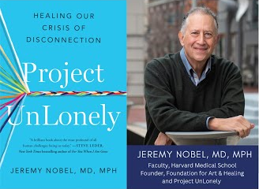
A definition
Loneliness is a natural biological signal, like hunger or thirst. It is a flashing warning light in our mental dashboards that indicates a problem.
According to John Cacioppo “just as physical pain is an aversive signal that evolved to motivate one to take action that minimizes damage to one’s physical body, loneliness is an aversive state that motivates us to take action that minimizes damage to one’s social body”
Nobel J. (2023). Project UnLonely: Healing Our Crisis of Disconnection. Avery.
Notes:
The role of social media – and digital media in general – in youth health and wellbeing has been highly debated. The ongoing public discussion tends to highlight the negative effects on adolescent well-being, although the picture is more nuanced and complicated than what we think. During two workshops organized by Harvard, of which the second one jointly organized with USI, we concluded our discussion stating that there is no effect of social media use that can apply to everyone, and that the type of the effect (negative, positive, none exhistent) depends on a variety of factors.

Slide 9
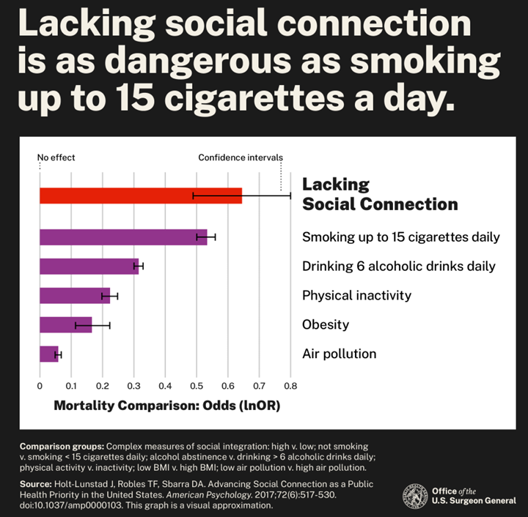
Loneliness and health
All-cause mortality
Cardiovascular disease
Cancer
Renal disease
Various (including neurological disease)
Notes:
The role of social media – and digital media in general – in youth health and wellbeing has been highly debated. The ongoing public discussion tends to highlight the negative effects on adolescent well-being, although the picture is more nuanced and complicated than what we think. During two workshops organized by Harvard, of which the second one jointly organized with USI, we concluded our discussion stating that there is no effect of social media use that can apply to everyone, and that the type of the effect (negative, positive, none exhistent) depends on a variety of factors.

Slide 10
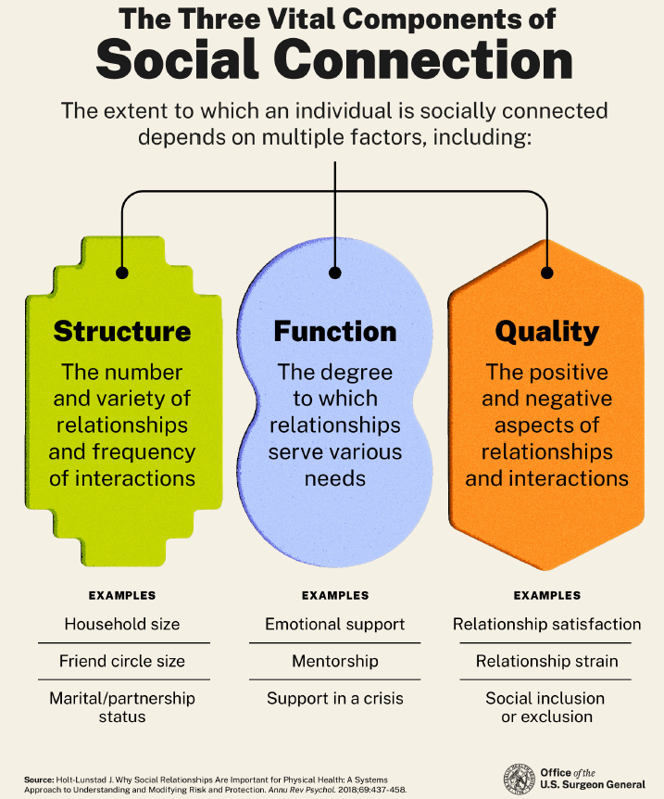
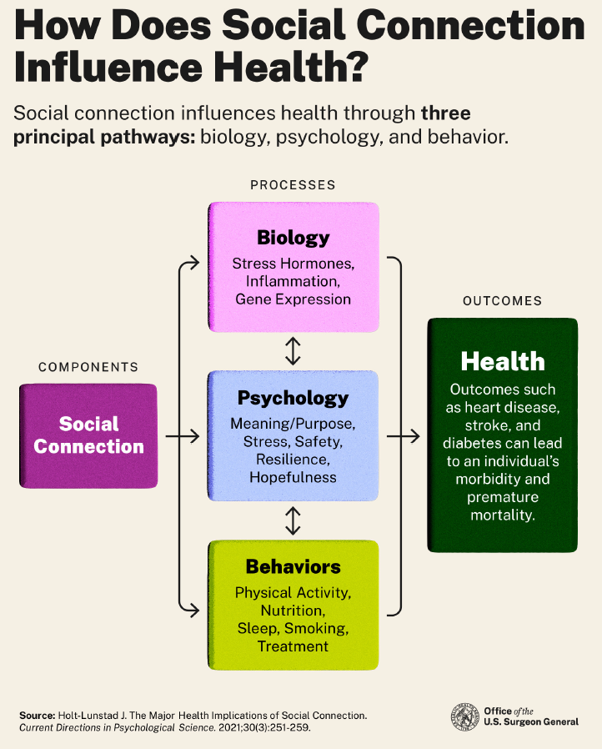
Loneliness vs social connection
Notes:
The role of social media – and digital media in general – in youth health and wellbeing has been highly debated. The ongoing public discussion tends to highlight the negative effects on adolescent well-being, although the picture is more nuanced and complicated than what we think. During two workshops organized by Harvard, of which the second one jointly organized with USI, we concluded our discussion stating that there is no effect of social media use that can apply to everyone, and that the type of the effect (negative, positive, none exhistent) depends on a variety of factors.

Slide 11

Loneliness is a stress factor for our brain/body
Adolescent loneliness is a risk factor for:
Mental health problems
Psychiatric symptoms
Poor health
Previous studies showed that, in adolescents, poor social relationships showed comparable effects to physical inactivity on inflammation risk, a by-product of high cortisol levels.
Poor relationship patterns initiate stress response cascades that persist later in life
Protective effects of good social connections against stress are larger in adolescence: “adolescent social connections differentiate health risks in young adults, long before symptoms or overt signs of disease emerge”
Loneliness and (adolescent) health
Slavich GM, Irwin MR. From stress to inflammation and major depressive disorder: A social signal transduction theory of depression. Psychol Bull. 2014;140(3):774-815. doi:10.1037/a0035302
Holt-Lunstad J. Social Connection as a Public Health Issue: The Evidence and a Systemic Framework for Prioritizing the “Social” in Social Determinants of Health. Annu Rev Public Health. 2022;43(1):193-213. doi:10.1146/annurev-publhealth-052020-110732
Yang YC, Boen C, Gerken K, Li T, Schorpp K, Harris KM. Social relationships and physiological determinants of longevity across the human life span. Proc Natl Acad Sci. 2016;113(3):578-583. doi:10.1073/pnas.1511085112
Notes:
Half of the mental health disorders with long-lasting effects start in mid-adolescence^{19–22},

Slide 12

Loneliness and teen health
Why studying loneliness and social media use in adolescence?
During adolescence, the most relevant social context for well-being shifts from family to peer relationships
The adolescent brain reacts differently to social interactions with peers than children and adults, and it is highly susceptible to the experience of stress.
Adolescent loneliness (as a source of stress) and mental well-being (a fundamental element of resilience) critically depend on the quality of social connections with strong ties, like peers and friends
How peer relationships have been transformed by the social media context is a vitally important matter that needs further understanding
Loneliness and (adolescent) health
Nesi J, Choukas-Bradley S, Prinstein MJ. Transformation of Adolescent Peer Relations in the Social Media Context: Part 1—A Theoretical Framework and Application to Dyadic Peer Relationships. Clin Child Fam Psychol Rev. 2018;21(3):267-294. doi:10.1007/s10567-018-0261-x
Holt-Lunstad J. Why Social Relationships Are Important for Physical Health: A Systems Approach to Understanding and Modifying Risk and Protection. Published online 2017:22.
Kikusui T, Winslow JT, Mori Y. Social buffering: relief from stress and anxiety. Philos Trans R Soc B Biol Sci. 2006;361(1476):2215-2228. doi:10.1098/rstb.2006.1941
Cohen S. Social Relationships and Health. Am Psychol. 2004;59(8):676-684. doi:10.1037/0003-066X.59.8.676

Slide 13
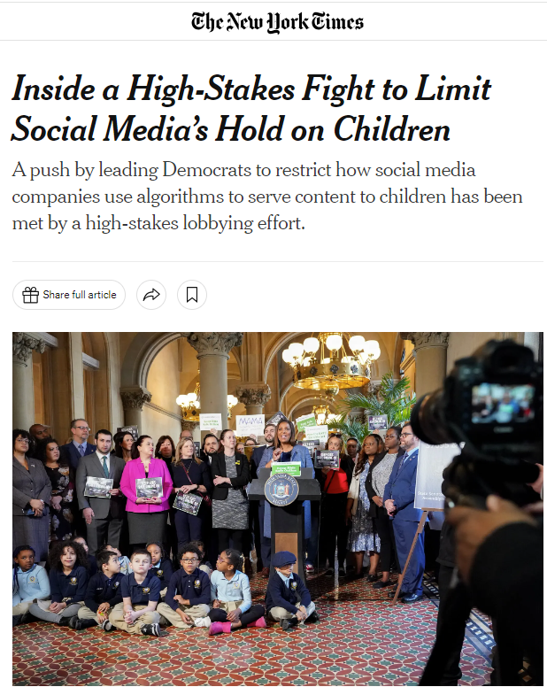
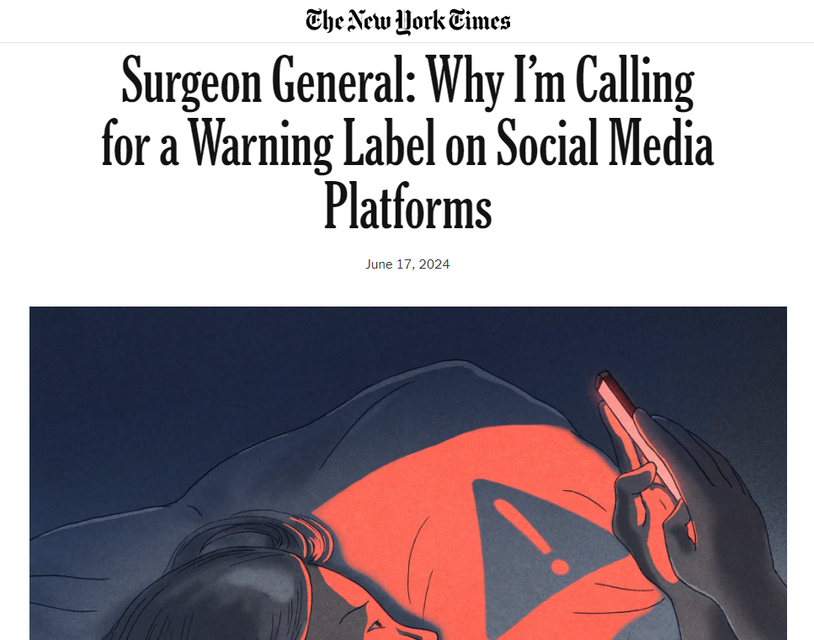
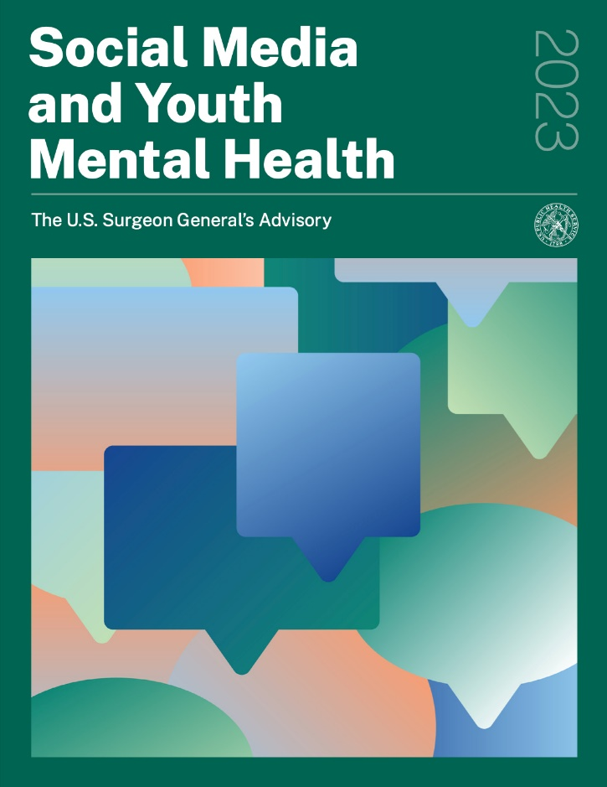
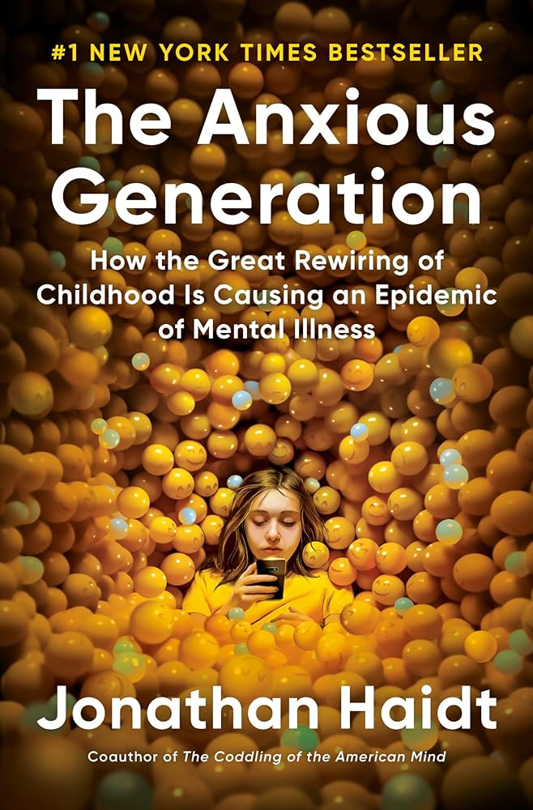
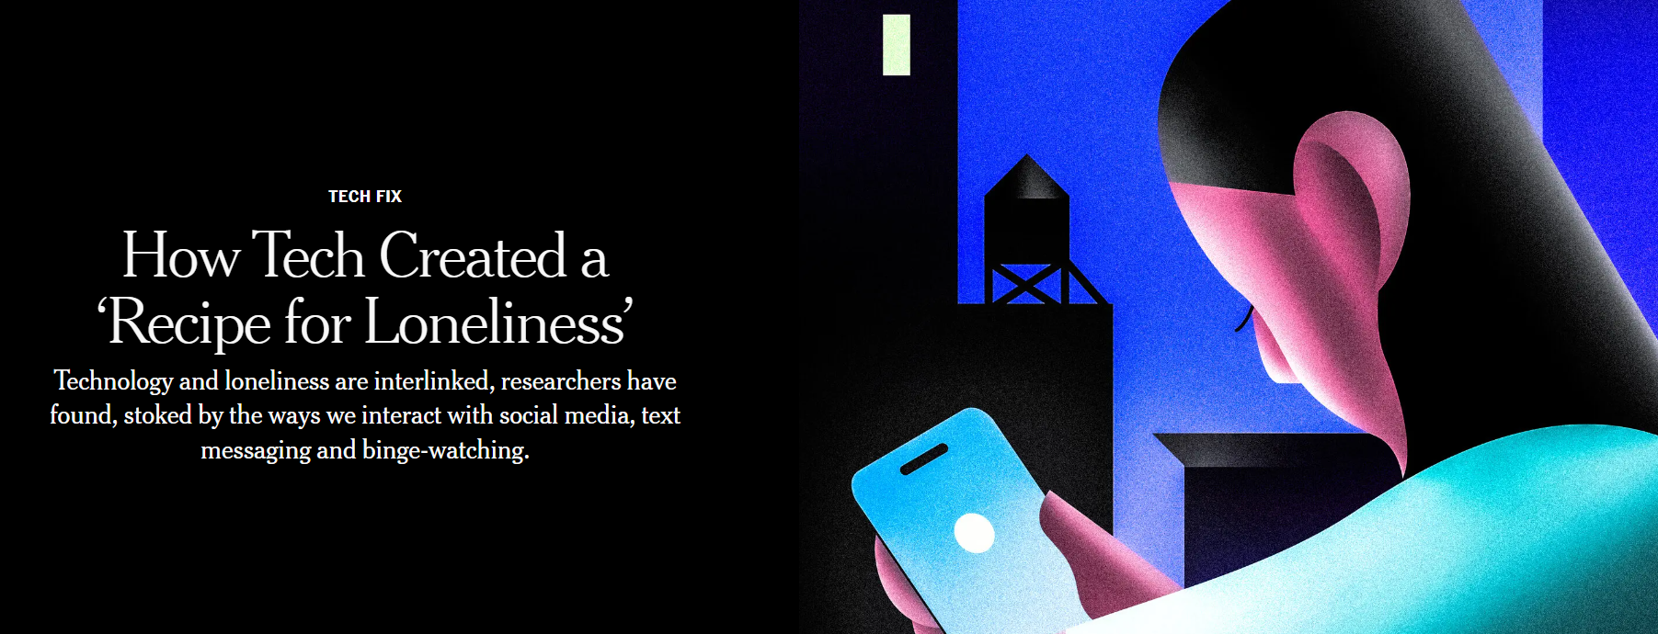
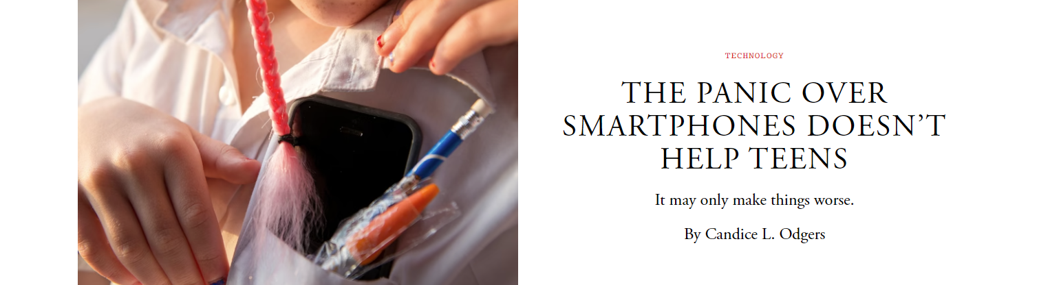
A debated topic
Loneliness and social media
Montag, C., Schulz, P. J., Marciano, L., Roman-Urrestarazu, A., Rumpf, H.-J., & Becker, B. (2024). Safeguarding young users on social media through academic oversight. Nature Reviews Psychology, 3(6), 368–369. https://doi.org/10.1038/s44159-024-00311-2
Notes:
The role of social media – and digital media in general – in youth health and wellbeing has been highly debated. The ongoing public discussion tends to highlight the negative effects on adolescent well-being, although the picture is more nuanced and complicated than what we think. During two workshops organized by Harvard, of which the second one jointly organized with USI, we concluded our discussion stating that there is no effect of social media use that can apply to everyone, and that the type of the effect (negative, positive, none exhistent) depends on a variety of factors.

Slide 14
Why is it important to study
digital media use and well-being in youth?
Digital technologies’ greater availability and exposure
Adolescents’ mental health described as diminished
Large scale studies showed that “The rapid adoption of smartphone technology in the early 2010s may have had a marked negative impact on adolescents’ psychological well-being” (Twenge & Campbell, 2018)
“The average person who receives a smartphone at 10 years of age. is going to spend over 10 years of his/her life on a smartphone.
Young people reach their smartphones every 5 minutes and start an interaction, also without any notifications in it”
(Heitmayer & Lahlou, 2021)
Loneliness and social media
Vulnerability during the adolescent age
“…if you really wanted to understand how we develop into the people we ultimately become, you have got to know something about adolescence...’’ (Steinberg, 2016)
Notes:
In Chile, over 20% of adolescents experience mental health problems such as anxiety, depression, and stress, with many going untreated
During COVID-19, the prevalence of mental health problems was higher: depression (37.1%), anxiety (37.9%), and stress (54.6%).
Why is it important….?
As a starting point I report the words of a teenager to the NYT:….. Great availability but also low awareness of its effects
In Switzerland, 99% of 12- to 19-years-old adolescents owned a smartphone in 2020, which was also the year with the highest increment in its use of the last ten years.
More than 3 and 5 hours/day on week and weekend days, respectively
According to a study using real-time data, young people reach their smartphones every 5 minutes – internalized and unconscious habit - and start an interaction, also without any notifications in it
The average person who receives a smartphone at 10-year old is going to spend about 8.74 years of his/her life on a smartphone
These data are impressive ! → digital technologies are not only part of our everyday lives, but they are also shaping our health
2) When we think to the adolescents’ health, researchers started to say that….
This statement comes from data collected in more than 1 million adolescents in the United States showing an increased in depressive symptoms from 2012 (the year during which more than a half of young population owned a smartphone) to 2018;
This result was mirrored in lower levels of happiness reported in similar large-scale studies;
According to a recent review, 1 out of 4 adolescents reports symptoms of problematic smartphone use.
Hence, researchers started to ask if (problematic) digital media use was associated with mental well-being in youth. HOWEVER, this question raised some controversy. Although the two trends augmented together, this does not necessarily imply that one causeed the other. Additionally, relationships among the two variables may not be so straightforward.
3) Third reason: the importance of the adolescent age for the rest of a person’s life. According to a well-known professor and investigator of the adolescent age….
Adolescence is defined as the transition from childhood to adulthood. A period of Big changes, big Developmental challenges including the research of own identity, establishing a sense of independence, the formation of close relations, and the achievement of important goals for the future
Adolescents are propense to carry out risky and reward-oriented behaviours, especially if a social component is involved. Although their self- regulating skills are still under development
Additionally, adolescence is the period of the onset of many mental health problems and psychological difficulties, including externalizing and internalizing problems. Indeed, half of the mental health disorders with long-lasting effects start in mid-adolescence, which overlaps with the age of the heaviest smartphone use.
This vulnerability during the adolescent age is even more pronounced in young people with high levels in one particular personality trait. That leads me to introduce you the concept of…

Slide 15


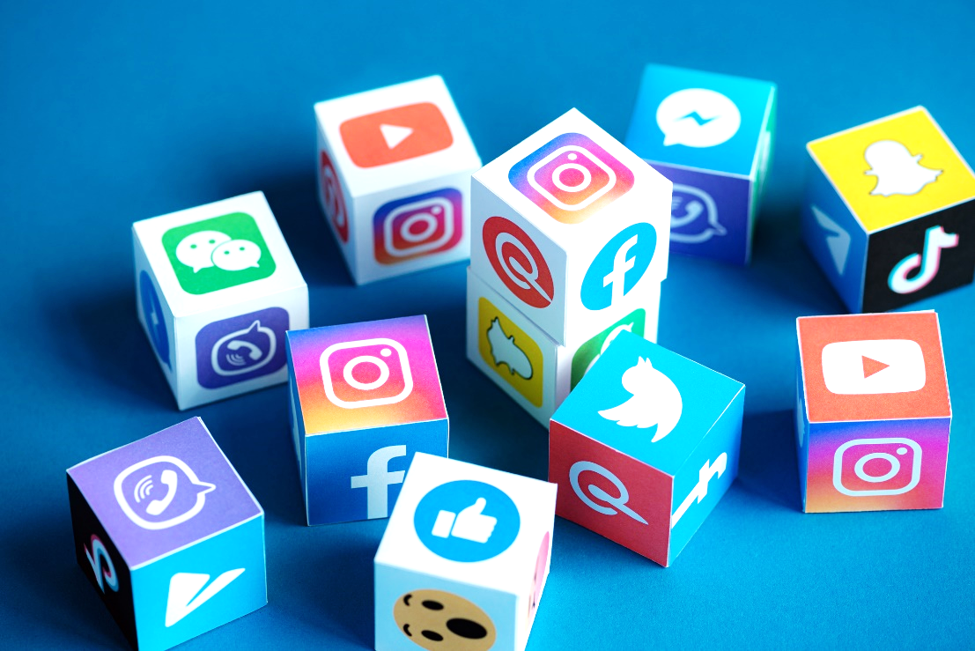
Increased adolescent loneliness have run parallel to increased social media use
In 2022, adolescents reported being constantly online twice as often compared to 2014-15
95 % of U.S. teens use YouTube, 67% TikTok, 62% Instagram, and 59% Snapchat
Adolescents’ levels of loneliness doubled from 2012 to 2018, while in-person interactions with peers diminished by 42%
Loneliness further increased after the COVID-19 pandemic
Now, about half of adolescents report feeling lonely
Loneliness and social media
Notes:
In the U.S., increased levels of adolescent loneliness have run parallel to increased social media use

Slide 16
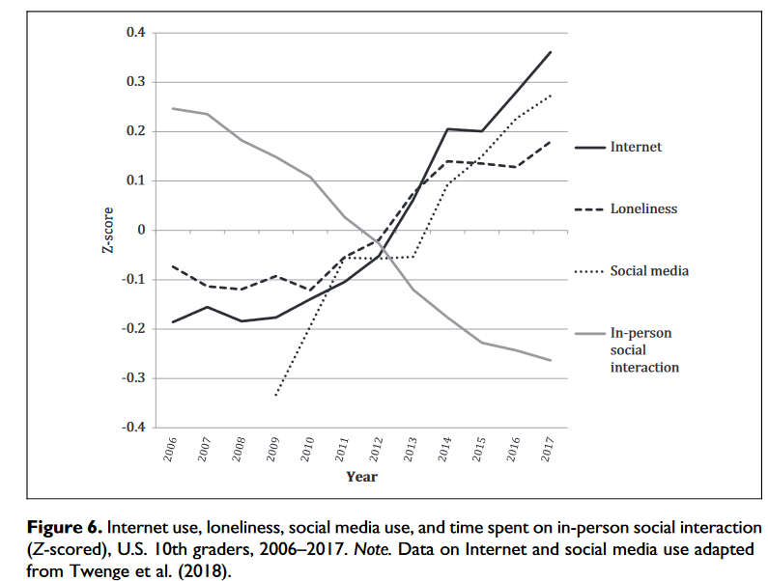
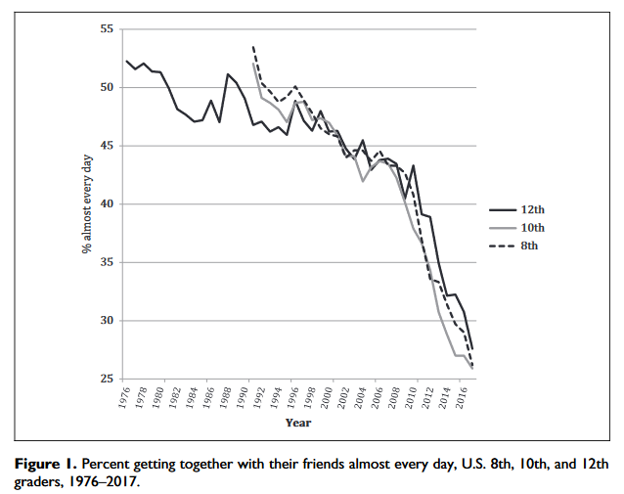
How social media changed social interactions
Loneliness and social media
Twenge, J. M., Spitzberg, B. H., & Campbell, W. K. (2019). Less in-person social interaction with peers among U.S. adolescents in the 21st century and links to loneliness. Journal of Social and Personal Relationships, 36(6), 1892–1913. https://doi.org/10.1177/0265407519836170
Notes:
The role of social media – and digital media in general – in youth health and wellbeing has been highly debated. The ongoing public discussion tends to highlight the negative effects on adolescent well-being, although the picture is more nuanced and complicated than what we think. During two workshops organized by Harvard, of which the second one jointly organized with USI, we concluded our discussion stating that there is no effect of social media use that can apply to everyone, and that the type of the effect (negative, positive, none exhistent) depends on a variety of factors.

Slide 17
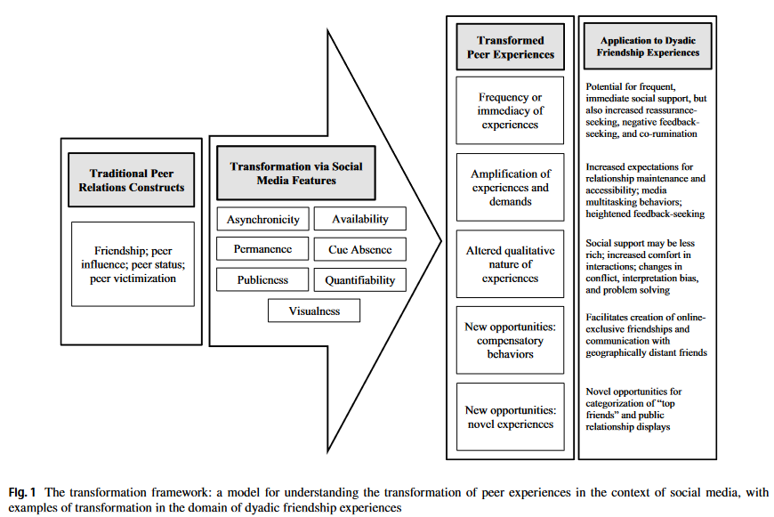
How social media changed social interactions
New socialization contexts with different features.
Loneliness and social media
Nesi J, Choukas-Bradley S, Prinstein MJ. Transformation of Adolescent Peer Relations in the Social Media Context: Part 1—A Theoretical Framework and Application to Dyadic Peer Relationships. Clin Child Fam Psychol Rev. 2018;21(3):267-294. doi:10.1007/s10567-018-0261-x
Notes:
The role of social media – and digital media in general – in youth health and wellbeing has been highly debated. The ongoing public discussion tends to highlight the negative effects on adolescent well-being, although the picture is more nuanced and complicated than what we think. During two workshops organized by Harvard, of which the second one jointly organized with USI, we concluded our discussion stating that there is no effect of social media use that can apply to everyone, and that the type of the effect (negative, positive, none exhistent) depends on a variety of factors.

Slide 18
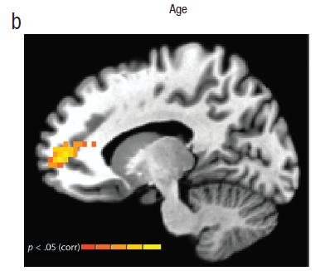

Teen brain and the social world
The experiment:
“A peer is observing you”
Loneliness and (adolescent) health
MPFC recruitment while participants believe they are being watched
by a peer peaks during adolescence and partially subsides into adulthood.
Somerville, L. H. (2013). The Teenage Brain: Sensitivity to Social Evaluation. Current Directions in Psychological Science, 22(2), 121-127. https://doi.org/10.1177/0963721413476512
Notes:
Two cognitive control systems in the PFC, Reward system in the Striatum and close areas, which mature at different times

Slide 19
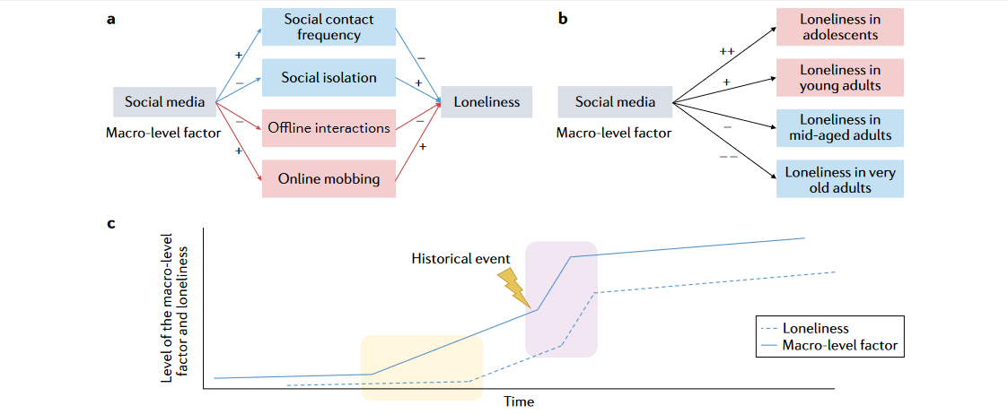
Loneliness and social media landscape
Loneliness and social media
Luhmann, M., Buecker, S., & Rüsberg, M. (2023). Loneliness across time and space. Nature Reviews Psychology, 2(1), Article 1. https://doi.org/10.1038/s44159-022-00124-1
Notes:
The role of social media – and digital media in general – in youth health and wellbeing has been highly debated. The ongoing public discussion tends to highlight the negative effects on adolescent well-being, although the picture is more nuanced and complicated than what we think. During two workshops organized by Harvard, of which the second one jointly organized with USI, we concluded our discussion stating that there is no effect of social media use that can apply to everyone, and that the type of the effect (negative, positive, none exhistent) depends on a variety of factors.

Slide 20
Depression, social connection, and Internet use
Competitive theoretical models
Internet-enhanced self-disclosure hypothesis | Evolutionary mismatch model
Richness of communication Self-disclosure Increased frequency/quality of relationships Teens socially “poor” and “rich” would get “richer” Extended space for socialization Compensation for lack of offline social connections Increased well-being | Crucial processes that promote intimacy, security, trust, and cooperation have been altered by online communication “Mismatch” Superficial disclosure followed by a superficial response Displacing/poor time with friends Decreased well-being
Loneliness and social media
Marciano, L., Schulz, P. J., & Camerini, A.-L. (2022). How do depression, duration of internet use and social connection in adolescence influence each other over time? An extension of the RI-CLPM including contextual factors. Computers in Human Behavior, 136, 107390. https://doi.org/10.1016/j.chb.2022.107390
Valkenburg, P. M., & Peter, J. (2009). Social consequences of the internet for adolescents: A decade of research. Current Directions in Psychological Science, 18(1), 1–5. https://doi.org/10.1111/j.1467-8721.2009.01595.x
Sbarra, D. A., Briskin, J. L., & Slatcher, R. B. (2019). Smartphones and close relationships: The case for an evolutionary mismatch. Perspectives on Psychological Science, 14(4), 596–618. https://doi.org/10.1177/1745691619826535
Notes:
The role of social media – and digital media in general – in youth health and wellbeing has been highly debated. The ongoing public discussion tends to highlight the negative effects on adolescent well-being, although the picture is more nuanced and complicated than what we think. During two workshops organized by Harvard, of which the second one jointly organized with USI, we concluded our discussion stating that there is no effect of social media use that can apply to everyone, and that the type of the effect (negative, positive, none exhistent) depends on a variety of factors.

Slide 21
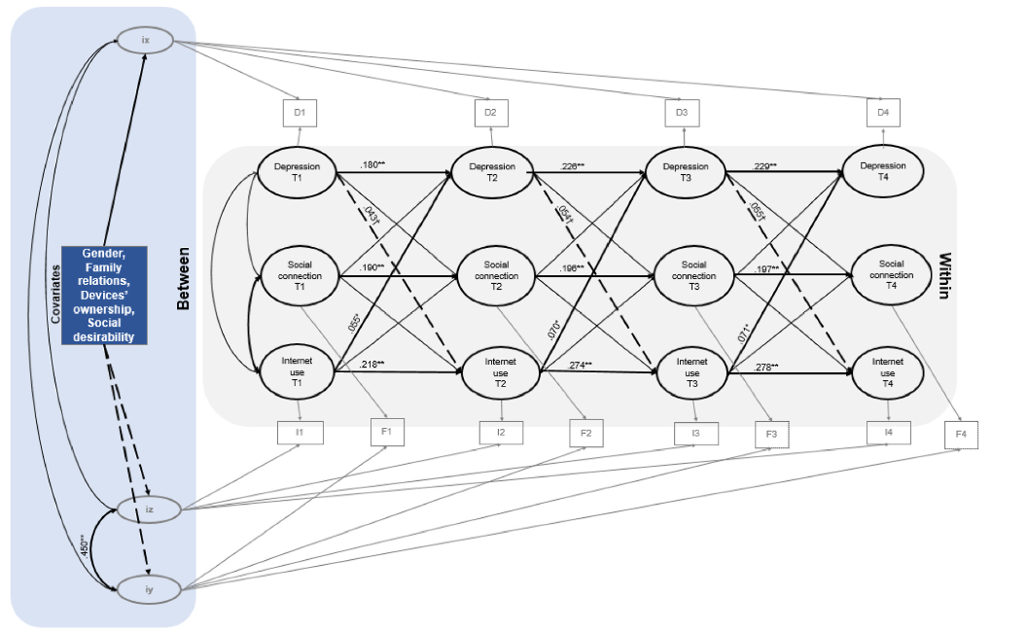
Depression, social connection, and Internet use
At the within-person level, a higher duration of Internet use increased depression, and, to a lower extent, higher depression levels increased the duration of Internet use.
These effects were not mediated by more offline time spent with peers.
At the between-person level, heavier Internet users reported higher levels of social connections with friends.
Being female and possessing Internet-enabled mobile devices contributed to higher levels of initial depressive symptoms, whereas having a good family relationship was a protective factor.
Loneliness and social media
N=981 early adolescents (Mage = 11.37, SD = 0.55)
Marciano, L., Schulz, P. J., & Camerini, A.-L. (2022). How do depression, duration of internet use and social connection in adolescence influence each other over time? An extension of the RI-CLPM including contextual factors. Computers in Human Behavior, 136, 107390. https://doi.org/10.1016/j.chb.2022.107390
Notes:
The role of social media – and digital media in general – in youth health and wellbeing has been highly debated. The ongoing public discussion tends to highlight the negative effects on adolescent well-being, although the picture is more nuanced and complicated than what we think. During two workshops organized by Harvard, of which the second one jointly organized with USI, we concluded our discussion stating that there is no effect of social media use that can apply to everyone, and that the type of the effect (negative, positive, none exhistent) depends on a variety of factors.

Slide 22
The missing points
Quality of social relationships
Well-being versus ill-being
Biological correlates
More detailed measures and objective data
Loneliness and social media
Notes:
The role of social media – and digital media in general – in youth health and wellbeing has been highly debated. The ongoing public discussion tends to highlight the negative effects on adolescent well-being, although the picture is more nuanced and complicated than what we think. During two workshops organized by Harvard, of which the second one jointly organized with USI, we concluded our discussion stating that there is no effect of social media use that can apply to everyone, and that the type of the effect (negative, positive, none exhistent) depends on a variety of factors.

Slide 23
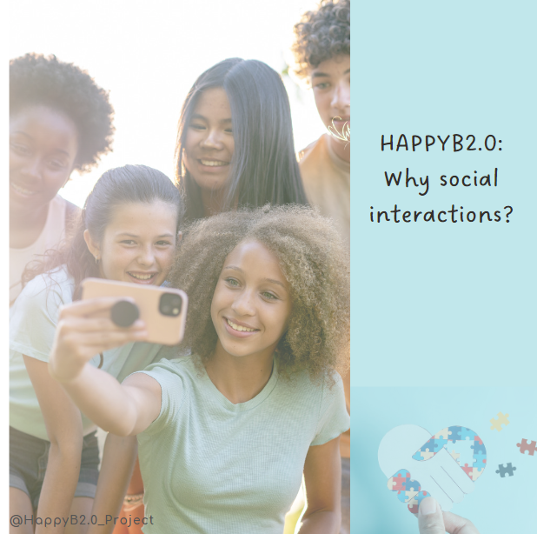



HappyB
HappyB studies: theory and methods
HappyB2.0

Slide 24
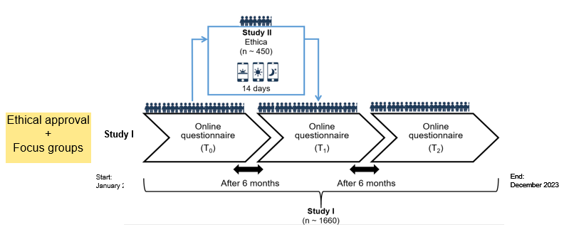
HappyB
HappyB studies: theory and methods

Slide 25
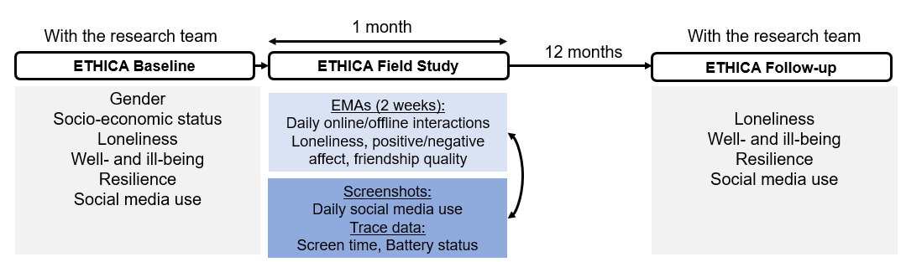

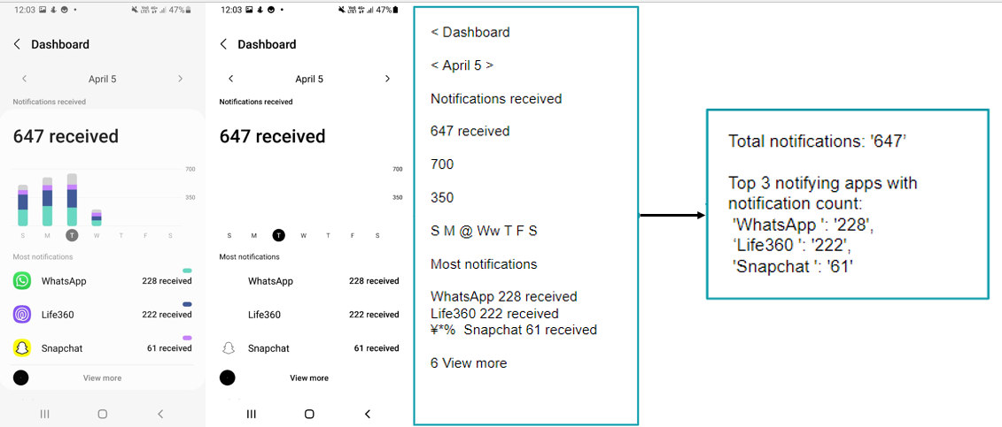
HappyB2.0
HappyB studies: theory and methods

Slide 26

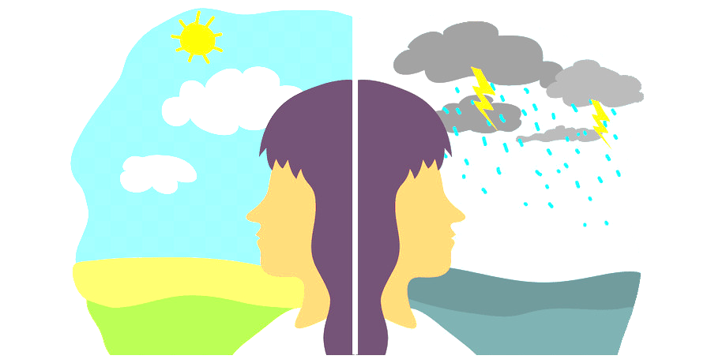
Beyond ill-being
Mental health is more than the absence of mental disorders.
It exists on a complex continuum (WHO)
HappyB studies: theory and methods
“Positive” well-being
Hedonic well-being (subjective), eudaimonic well-being (psychological), flourishing, thriving, social well-being
(Ryan & Deci, 2001)
Ill-being perspective
Psychopathological symptoms
Languishing
Notes:
At minimum: wellbeing is beyond illbeing
Ill-being already received a lot of attention

Slide 27
HappyB: Wellbeing
Philosophical conceptualization of well-being
Hedonic (from ἡδονή “pleasure”)
Eudaimonic (from εὐ “well”+‎ δαίμων “daemon”) well-being:
Defining loneliness
Hedonic well-being:
Positive emotions
Absence of negative emotions
Life satisfaction
Happiness
Eudaimonic well-being:
Autonomy
Personal growth
Self-acceptance
Meaning of life
Competence
Social connection
Flourishing
Thriving
Notes:
We know more about why people do not feel well (especially young) rather than what can help to make them feeling better (especially in the digital domain)

Slide 28

What’s next: The biology of well-being
Well-being (especially eudaimonic well-being - personal growth, sense of social connection) predicts:
Healthier lifestyle habits (more motivation to take care of yourself)
Less stress
Positive regulation of the neuroendrocrine, cardiovascular, inflammatory and microbiome systems (e.g. lower levels of cortisol, inflammatory markers, and more “good” cholesterol)
Reduces the onset of physical and mental illnesses
It predicts a sustained positive response to positive experience in the brain
Predicts better emotional regulation
Even in the presence of socio-economic inequalities
HappyB studies: theory and methods
Ryff, C. D., Singer, B. H., & Dienberg Love, G. (2004). Positive health: Connecting well-being with biology. Philosophical Transactions of the Royal Society B: Biological Sciences, 359(1449), 1383–1394. https://doi.org/10.1098/rstb.2004.1521
Notes:
Garden? Orchestra?

Slide 29

HappyB: What limits Thriving and Flourishing
The pervasiveness of smartphone use:
Using smartphones while studying, at night, during meals, and as soon as they wake up is more associated with lower well-being.
Problematic social media use, especially:
Using social media to avoid/escape from negative emotions
Social comparison:
Looking at others with better living conditions
Sleep:
Looking at the phone as first thing in the morning, during the night if awake
HappyB studies: theory and methods

Slide 30
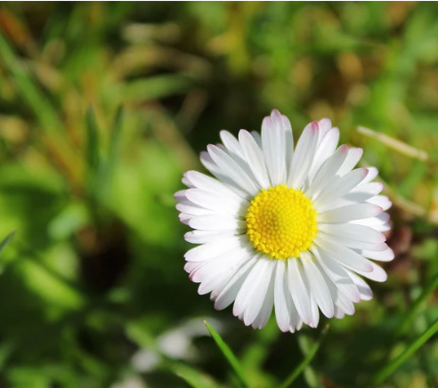
HappyB: Flourishing
Well-being cannot just be defined bi-dimensionally on a continuum, but it is multifaceted, like a “garden” or an “orchestra” (Lomas and Vanderweele, 2022)
Flourishing as “a state in which all aspects of a person’s life are good” and includes 6 broad domains (VanderWeele et al., 2019)
HappyB studies: theory and methods
          1. Happiness and life satisfaction (hedonic well-being)
          2. Meaning and purpose (eudaimonic well-being)
          3. Physical and mental health
          4. Character and virtue
          5. Close social relationships (social well-being)
          6. Financial stability
Marciano, L., & Viswanath, K. (2023). Social media use and adolescents’ well-being: A note on flourishing. Frontiers in Psychology, 14. https://www.frontiersin.org/articles/10.3389/fpsyg.2023.1092109
Notes:
The sample consisted of 1,429 participants (86%) attending the first or second year of high school in Switzerland. Participants completed self-report measures assessing their social media use (including inspiration from others, being an inspiration for others, self-expression, and social comparison) and flourishing (including six sub-domains such as positive relationships with others). Regression analyses were conducted to explore the relationship between social media use and flourishing.

Slide 31
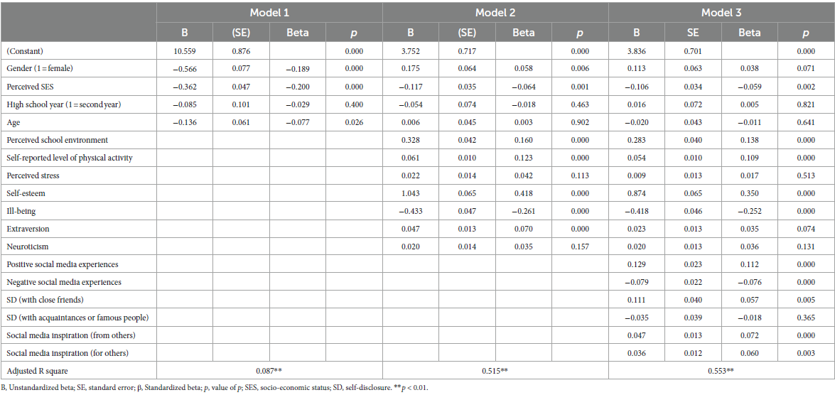
HappyB: Flourishing
HappyB studies: theory and methods
Bonferroni’s correction (p < .003)
N=1’429 participants of the HappyB study (Mage=15.84, SD =.83)
Marciano, L., & Viswanath, K. (2023). Social media use and adolescents’ well-being: A note on flourishing. Frontiers in Psychology, 14. https://www.frontiersin.org/articles/10.3389/fpsyg.2023.1092109
Notes:
The sample consisted of 1,429 participants (86%) attending the first or second year of high school in Switzerland. Participants completed self-report measures assessing their social media use (including inspiration from others, being an inspiration for others, self-expression, and social comparison) and flourishing (including six sub-domains such as positive relationships with others). Regression analyses were conducted to explore the relationship between social media use and flourishing.

Slide 32
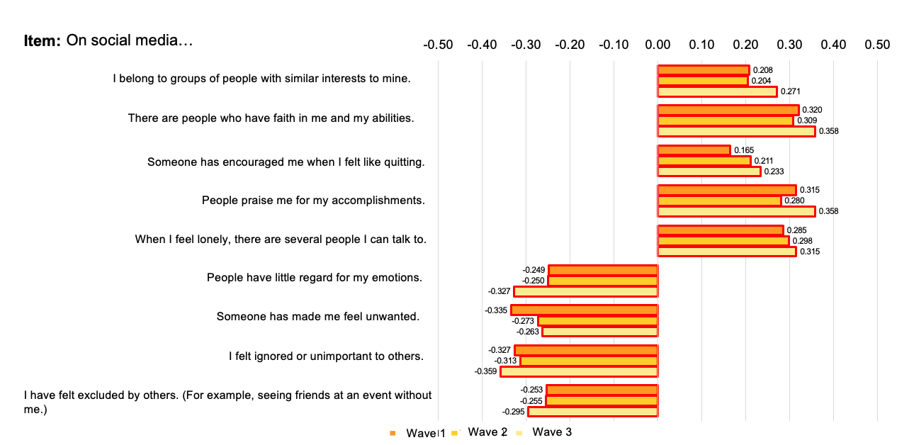
HappyB: Flourishing
HappyB studies: theory and methods
Social experiences on social media

Slide 33
HappyB: Flourishing
          Self-Determination Theory (Ryan & Deci 2002; Huppert 2013)
Need for relatedness
Frequency and quality of social relationships → social capital as extension of offline relationships
Need for autonomy
Authentic self-expression and coherent self-narrative (creating a narrative which is coherent with the social identity one has built and shared)
Need for competence
Improvement in abilities and existent competences (e.g. creativity)
Inspiration and success stories sharing (i.e. positive envy)
HappyB studies: theory and methods
Marciano, L., & Viswanath, K. (2023). Social media use and adolescents’ well-being: A note on flourishing. Frontiers in Psychology, 14. https://www.frontiersin.org/articles/10.3389/fpsyg.2023.1092109
Notes:
Social anxiety (disorder): fear or anxiety of social situations in which the individual is exposed to possible scrutiny by others (e.g., social interactions, being observed, performing in front of others)
It typically emerges during early adolescence, together with a growing emphasis on social interactions with peers.
Social anxiety → social media use
Socially anxious individuals perceive the internet as a more comfortable medium for interaction (Social compensation theory)
Greater ability to control their self-presentation when using this medium
Conduct anonymous interactions
Reduced non-verbal cues
Socially anxious individuals are more vulnerable to problematic internet use
Social media use → social anxiety
‘Compare and despair’ attitude.
The unrealistic expectations set by social media may leave young people with feelings of self-consciousness, low self-esteem and the pursuit of perfectionism which can manifest as anxiety disorders.

Slide 34
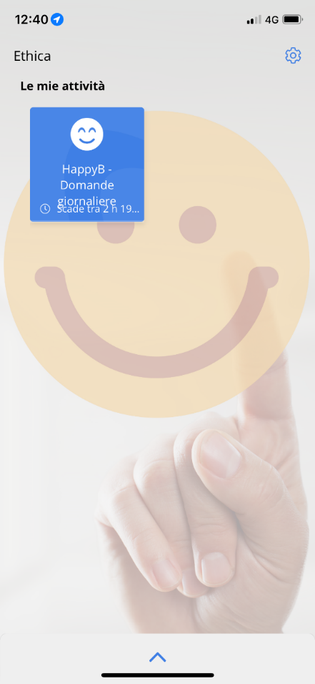
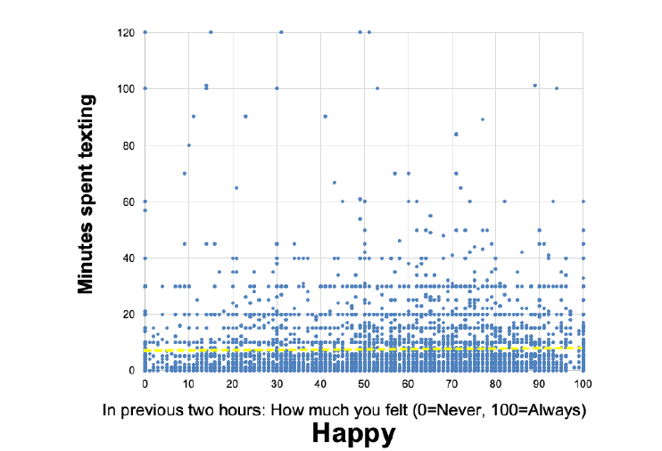
HappyB: Daily surveys through smartphones
HappyB studies: theory and methods

Slide 35
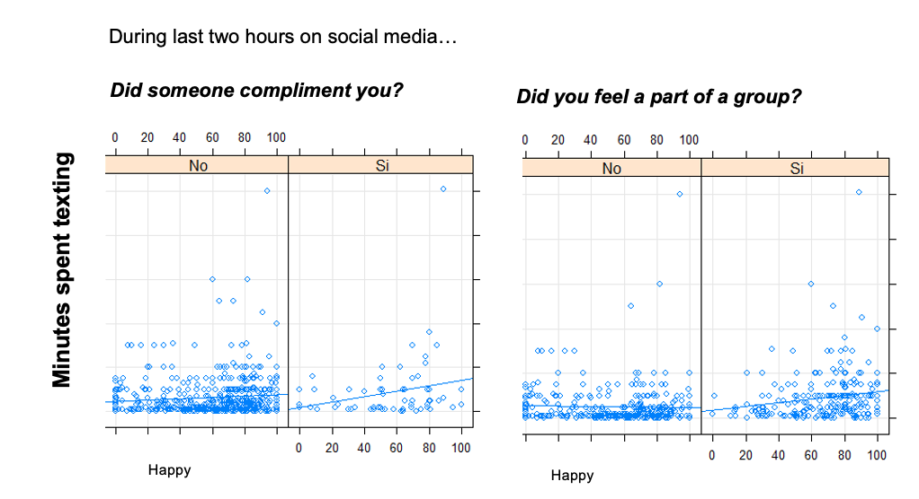

HappyB: Daily surveys through smartphones
HappyB studies: theory and methods

Slide 36
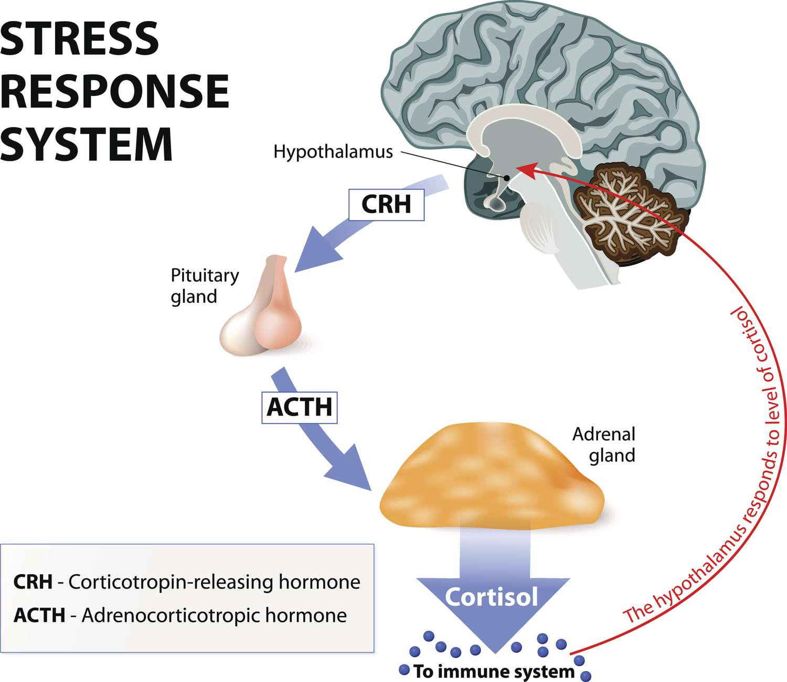
Back to biology: Loneliness and cortisol
Stress
Cortisol is the hormone released by the hypothalamic–pituitary–adrenal (HPA) axis
In adolescents, aberrant HCC has been with perceived stress, emotional and behavioral problems, including internalizing and externalizing symptoms, being victimized, symptoms of depression and neuroticism, and obesity.
Four studies investigated the effect of digital media on adolescents’ cortisol levels, but they used saliva specimens, small sample sizes, and self-reported digital media use.
HCC provides retrospective information on cumulative cortisol levels over periods of several weeks or months
HappyB studies: theory and methods

Slide 37
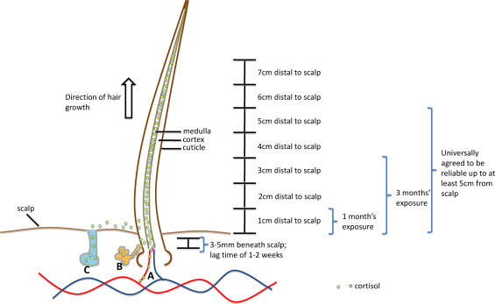
Hair cortisol concentration (HCC)
HappyB studies: theory and methods

Slide 38
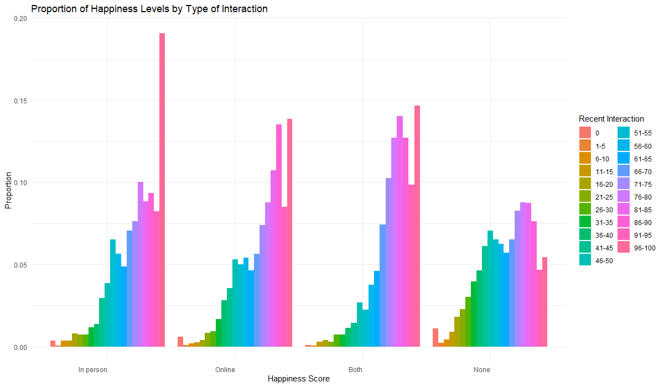
HappyB2.0 Project
HappyB studies: theory and methods
N>500 (data collection still ongoing)

Slide 39

Social media and Happiness
Background
Mixed results obtained in reviews of reviews (Meier & Reinecke, 2021; Odgers & Jensen, 2020; Orben, 2020; Valkenburg et al., 2022)
          Weak and inconsistent associations, explaining less than 1% of variance in well-being (Orben & Przybylski, 2019)
          Most of the literature focused on ill-being outcomes
          “Well-being” defined as the combination of ill-being and well-being or the opposite of ill-being, or as the presence of self-esteem and life satisfaction
          Attempts to summarize the effects of calls and texting, self-disclosure, number of friends, active and passive social media use on ill-being and well-being (Verduyn et al., 2017; Liu et al., 2019; Huang et al., 2021; Chu et al., 2022; Valkenburg et al., 2022)
          Flourishing and social media activities framework (Gudka et al., 2021)
          No review considered well-being in all its nuances
HappyB studies: theory and methods
Marciano, L., Lin, J., Sato, T., Saboor, S., & Viswanath, K. (2024). Does social media use make us happy? A meta-analysis on social media and positive well-being outcomes. SSM - Mental Health, 6, 100331. https://doi.org/10.1016/j.ssmmh.2024.100331
Marciano L. Bekalu M, Lin J., Sato T; Saboor S., Viswanath K (2023). Does social media use make us happy? A meta-analysis on social media and positive well-being outcomes. Conference proceedings. 73rd Annual Conference of the International Communication Association (ICA). Toronto, Canada. 25th-29th May 2023.
Notes:
Gender: all differences are significant, larger effects for happiness and unhappiness
Chi frequenta il secondo anno ha livelli maggiori di tristeza e minori di felicità, ma con differenze più lievi

Slide 40
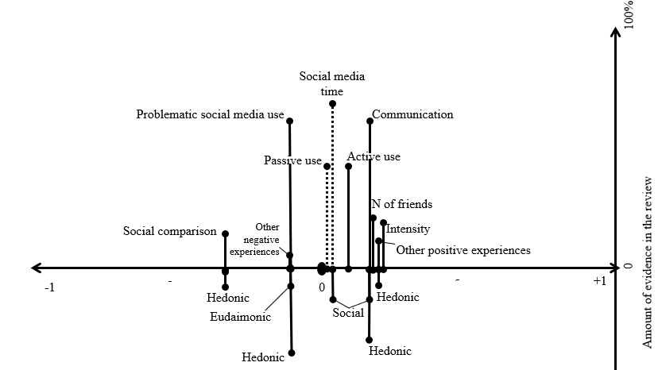
Literature review
Meta-analysis of 78 studies using positive well-being indicators
HappyB studies: theory and methods
Effect size
Marciano, L., Lin, J., Sato, T., Saboor, S., & Viswanath, K. (2024). Does social media use make us happy? A meta-analysis on social media and positive well-being outcomes. SSM - Mental Health, 6, 100331. https://doi.org/10.1016/j.ssmmh.2024.100331
Marciano L. Bekalu M, Lin J., Sato T; Saboor S., Viswanath K (2023). Does social media use make us happy? A meta-analysis on social media and positive well-being outcomes. Conference proceedings. 73rd Annual Conference of the International Communication Association (ICA). Toronto, Canada. 25th-29th May 2023.
Notes:
Gender: all differences are significant, larger effects for happiness and unhappiness
Chi frequenta il secondo anno ha livelli maggiori di tristeza e minori di felicità, ma con differenze più lievi

Slide 41
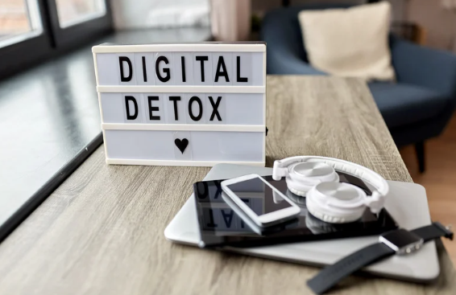
Digital Detox: Yes or No?
Digital detox
Marciano, L., Jindal, S., & Viswanath, K. (2024). Digital Detox and Well-Being. Pediatrics, e2024066142. https://publications.aap.org/pediatrics/article/doi/10.1542/peds.2024-066142/199412

Slide 42
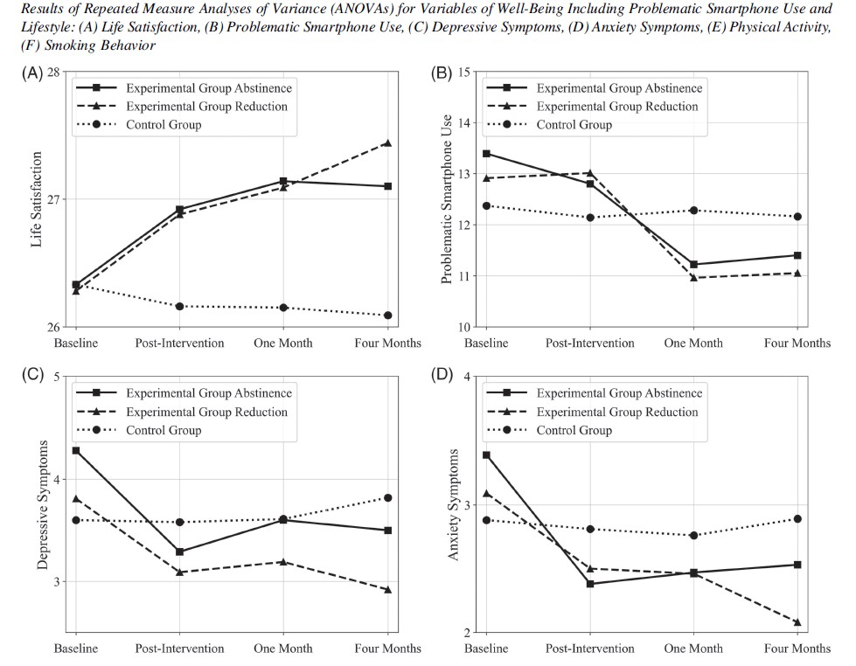
Digital Detox: Yes or No?
We summarized the key points of reviews and articles published between 2013 and 2023, including 139 articles in total. Main findings:
1. there is no clear definition of digital detox: «voluntary and intentional abstinence from using the smartphone and/or social media either completely or abstaining from using specific subsets of apps»
No consistency in the assessment of interventions’ effectiveness
Reducing social media/smartphone time rather than promoting total abstinence showed more beneficial effects on well-being
The effect of the interventions and their duration varies depending on the type of outcome
The effects are influenced by gender, age, and contextual factors
Digital detox
Marciano, L., Jindal, S., & Viswanath, K. (2024). Digital Detox and Well-Being. Pediatrics, e2024066142. https://publications.aap.org/pediatrics/article/doi/10.1542/peds.2024-066142/199412

Slide 43
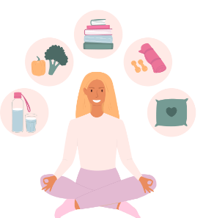

Conclusion
Together with a range of good habits, including
“healthy eating, exercising, rest and sleep, optimism, managing stress, making autonomous decisions, variety and challenge, learning new things, and repetition” also using social media in a way that promotes rather than diminishes well-being
should be included

Slide 44

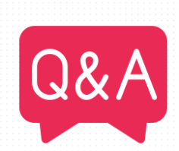
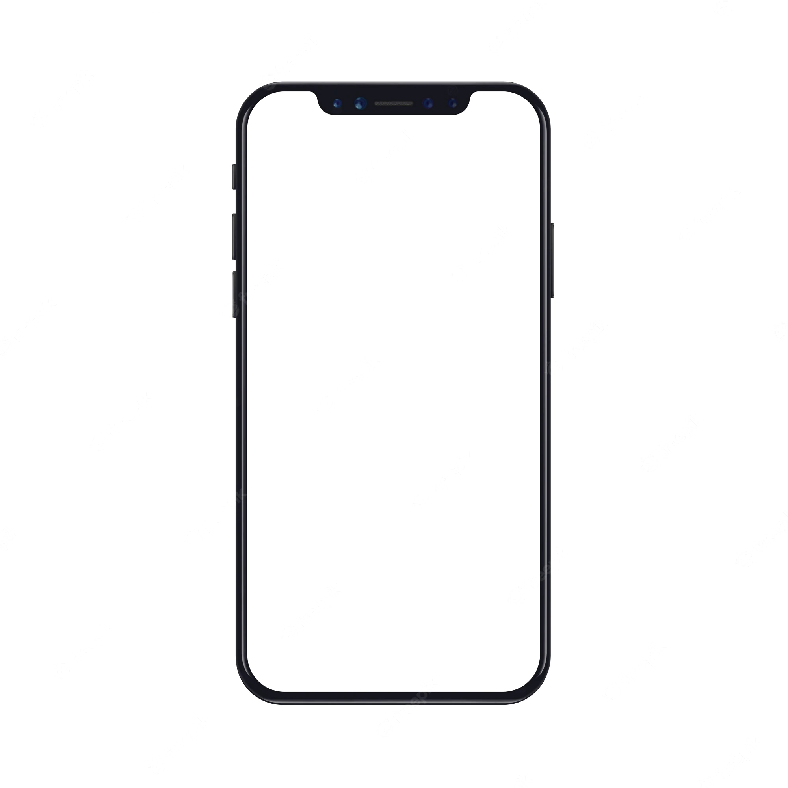
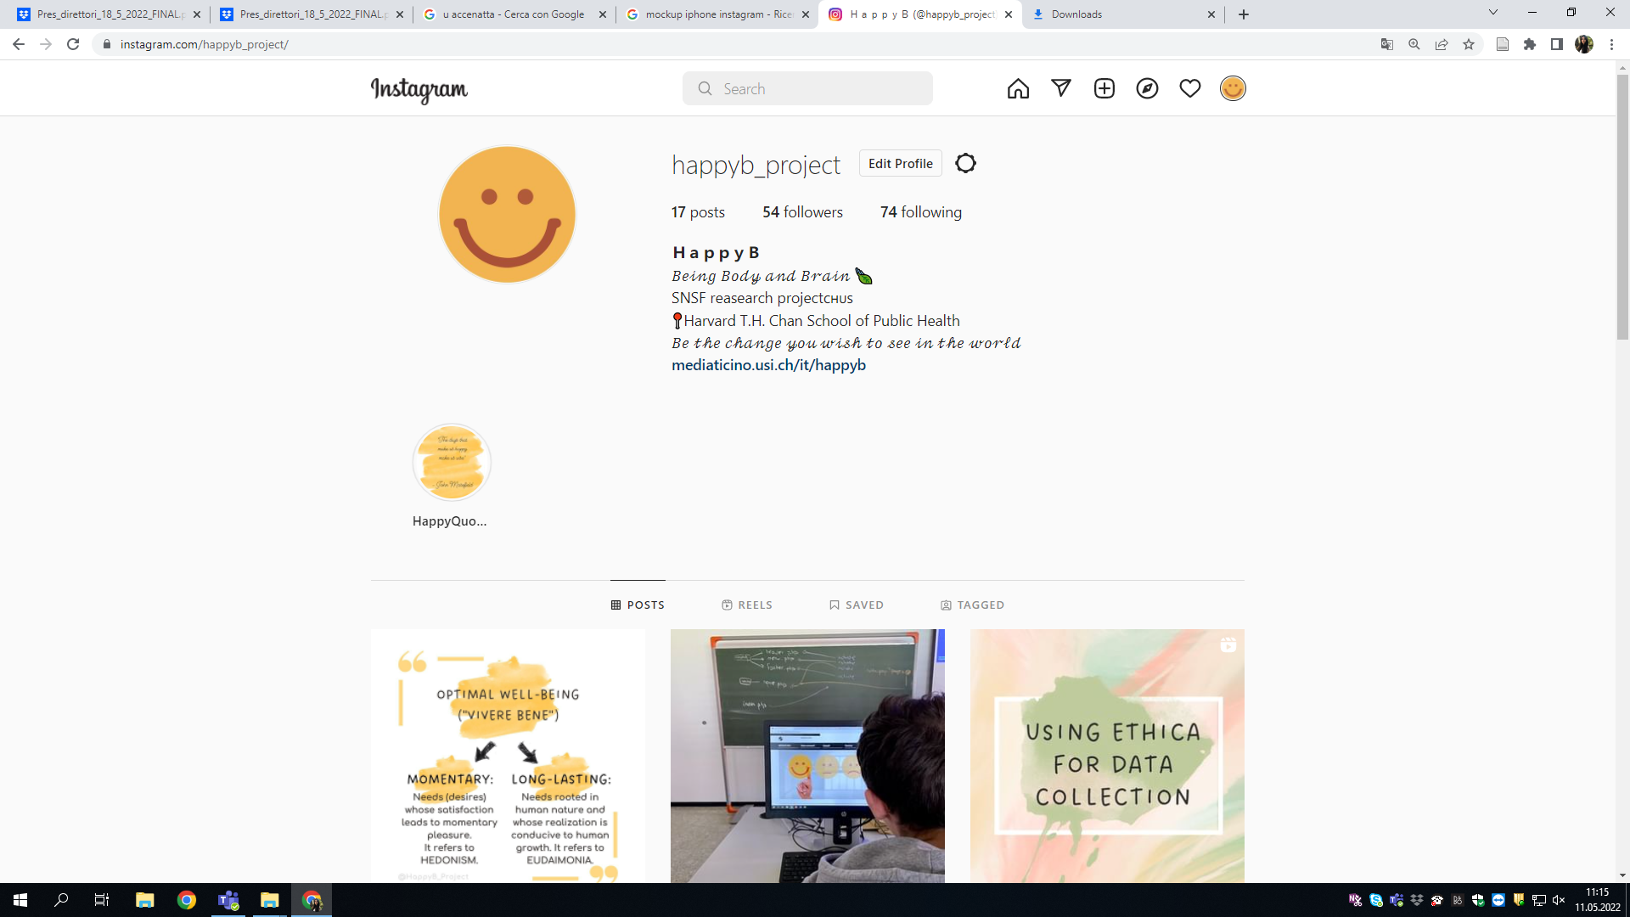
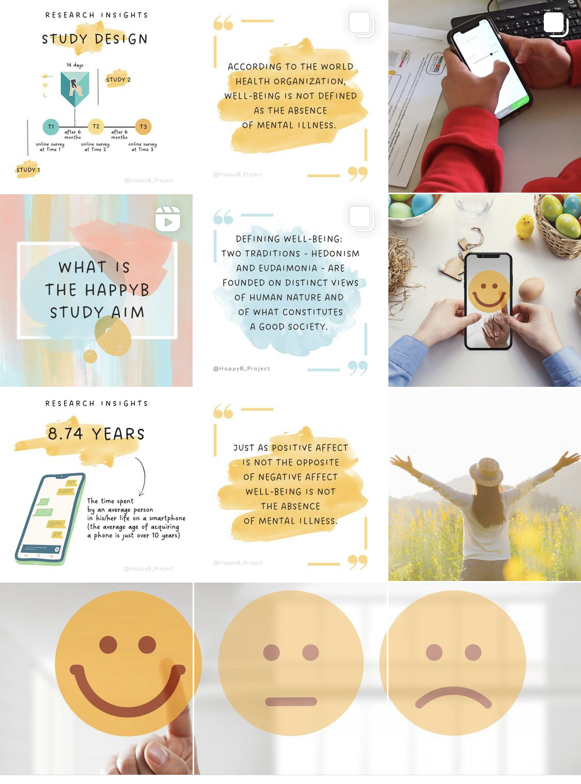
THANK YOU!
Instagram
@HappyB_project
(e): lmarciano@hsph.harvard.edu

