Slide 1



Tackling Loneliness
We found a way to connect in Westminster, Kensington and Chelsea

Slide 2
Loneliness – Who is at risk?
Londoners are more at risk of loneliness than the rest of the UK
~700,000 people in London are experiencing severe loneliness¹
Young people (16 to 34 years old) have over five times greater odds of chronic loneliness than those aged 65 or older.²
Of the 700,000 lonely people in London:
60%
50%
41%
59%
83%
[1] Reconceptualising Loneliness in London, May 22. [2] Belonging Forum, 2024

Slide 3
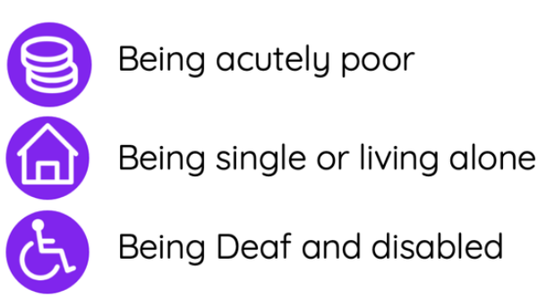
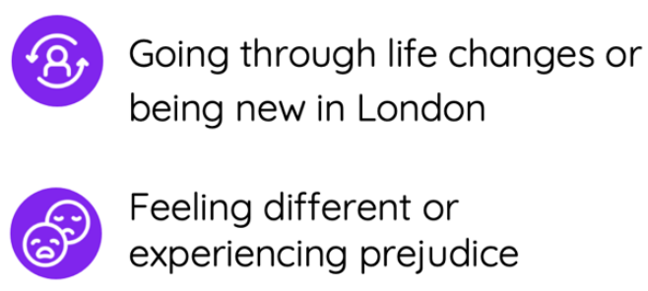
Loneliness – Who is at risk?
Who is at risk in London?
[1] Reconceptualising Loneliness in London, May 22

Slide 4



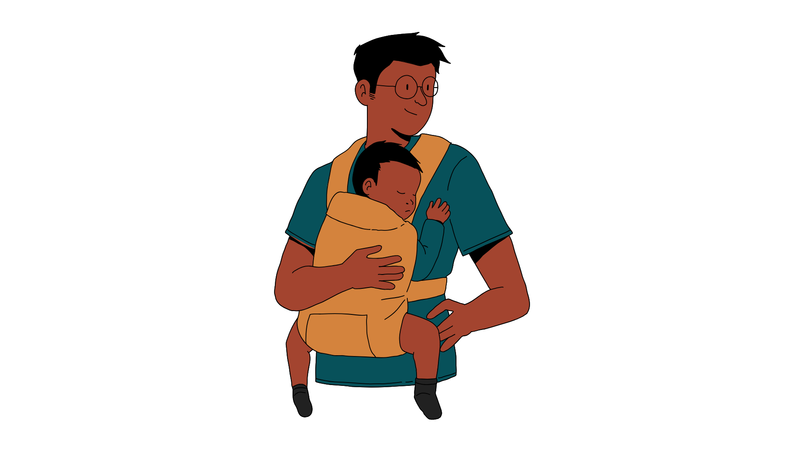

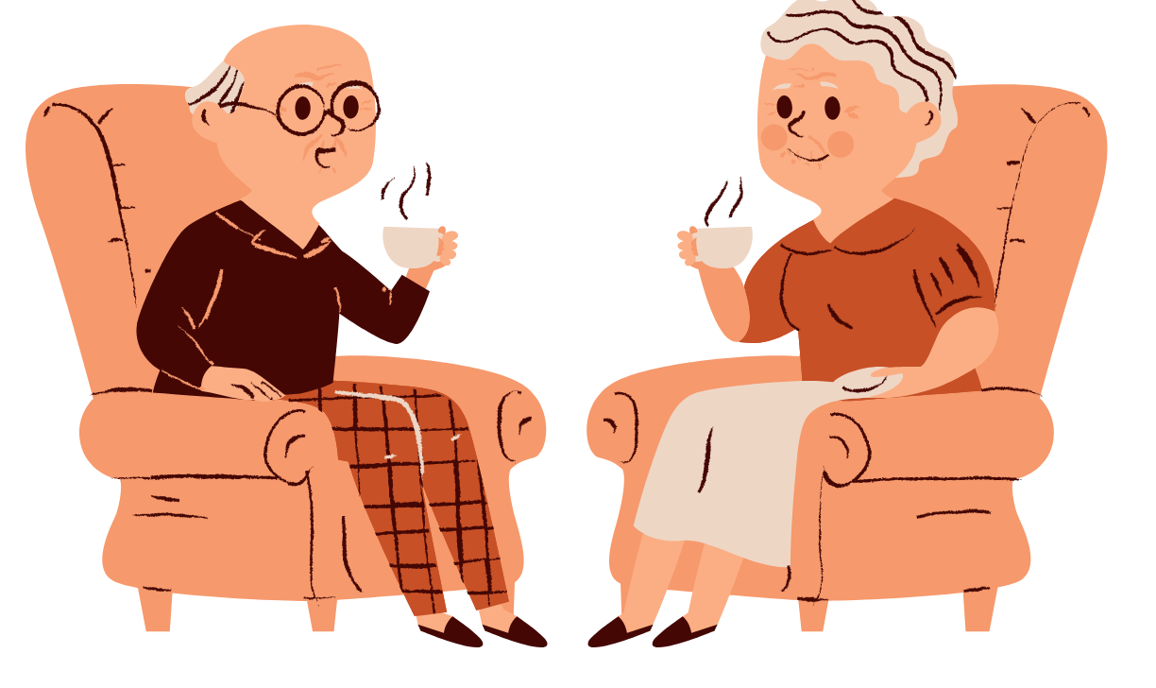
Loneliness – being new in the city
Going to university
Children living home
Bereavement
Changing school
Becoming a parent
Retirement
Life transitions can disrupt social connections, psychological stability and reduce availability of a supportive network of friends and family.
Transience (not being in a place for long), transition (changes of circumstance), and low sense of belonging = higher risk of loneliness
Barriers: Language, lack of awareness, financial constraints, traumatic experiences, education and skill recognition, digital literacy
Source: Reconceptualising Loneliness in London, May 22

Slide 5
Loneliness Locally
Source: Sport England (SE), Active Lives Adult Survey (ALAS), Reconceptualising Loneliness

Slide 6

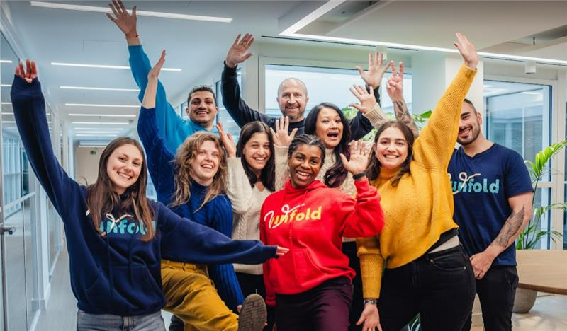
Unfold
Unfold has been supporting young people and families in Westminster, Kensington & Chelsea, and surrounding boroughs since 1989. Unfold offers mentoring programmes to empower families and children and young people to get where they want to be. The organisation is powered by passionate and dedicated volunteers.
Target groups: Refugees, asylum seekers, young people excluded from mainstream education, and those with lived experience of the care system.
Key programmes:
  Broadening Horizons: For young people aged 10-25.
  Mentoring for Mums: For women with children aged 5+.
Mentoring approach: Person-centred mentoring, with weekly meetings for 1-2 hours over 3-6 months.
Peer support groups: Safe, welcoming spaces for making friends and accessing support, available at no cost.
Impact:​
  Mentored 246 young people and women between 2024 and 2025.​
  Provided peer support to an additional 214 individuals.​
    58% of participants grew in confidence at the end of their mentoring​
    53% of participants felt more positive about the future​
    At the start of mentoring, 3 out of 10 of the young people say that they never or rarely felt positive about their future. By the end of mentoring, this has fallen to zero. ​
    39% of participants report feeling less lonely by the end of their mentoring​

Slide 7
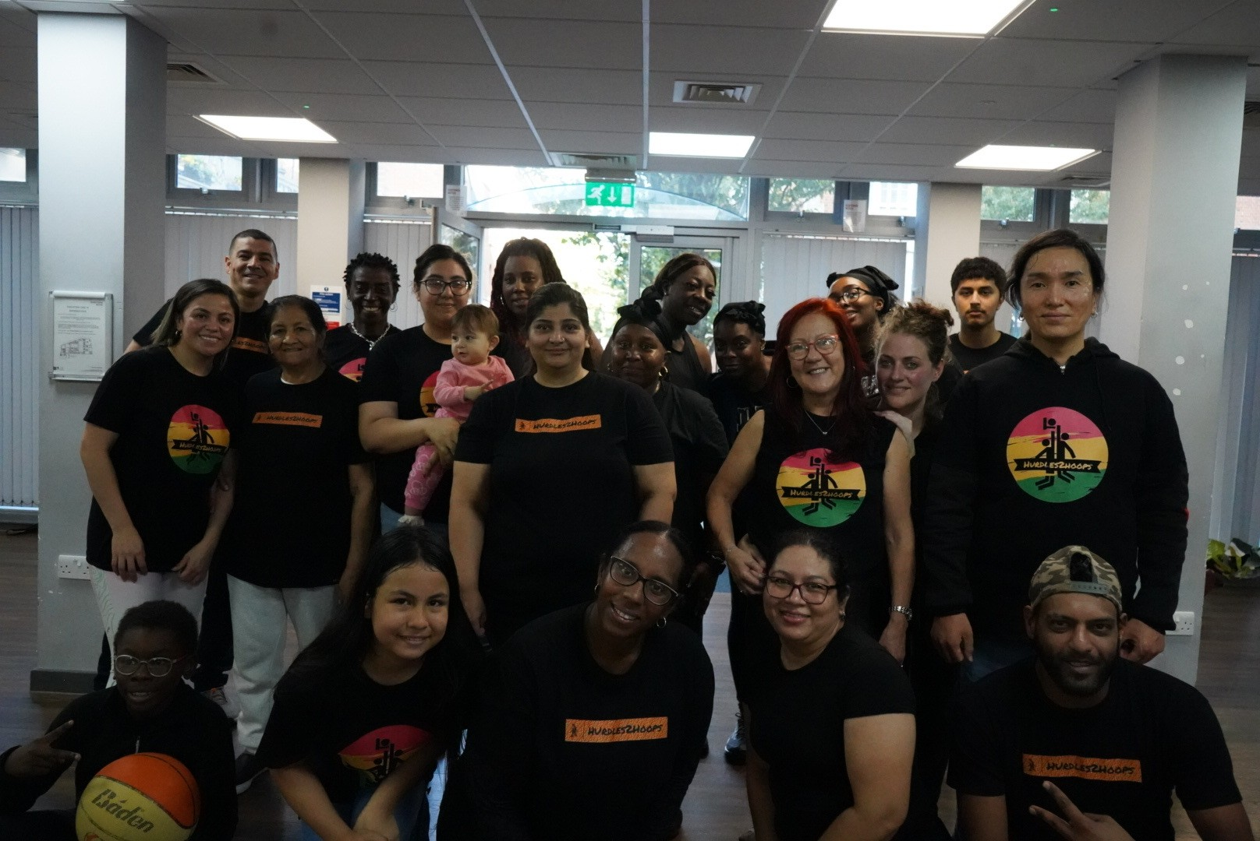
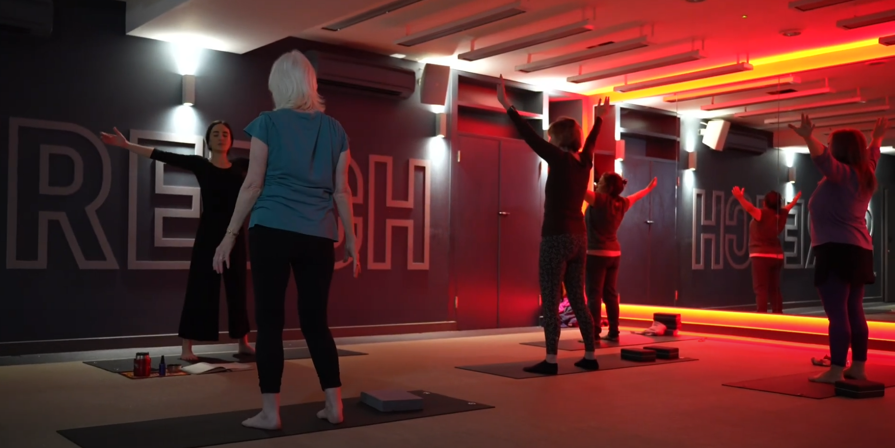
Hurdles2hoops
Working with asylum seekers and refugees offering free physical activity and education sessions to help tackle loneliness and promote health and wellbeing. The offer is also open to other children and low-income families or those receiving universal credit.
Activities
Football Sessions:
  High demand among kids overseen by the organisation
  Weekly sessions
  Provides opportunities for kids to make friends outside school, have fun, and potentially move towards clubs or professional pathways
Group Counselling / One-to-One Sessions:
  Many are going through financial hardships and experience emotional and mental health challenges
  Help individuals open up and feel they have a safe space to talk
Art Classes:
  Create a community where people can express themselves in different ways and enjoy doing so
Impact: The sessions have allowed many participants to experience activities they wouldn't usually have access to, with art therapy being particularly popular.
Somatic therapy class

Slide 8
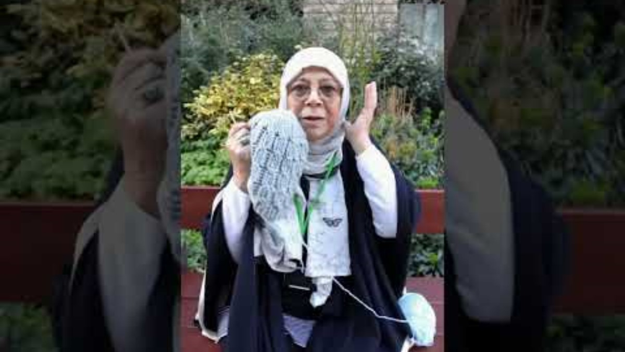
Hurdles2hoops
https://youtu.be/ttU3wj8Vkvw?t=1

Slide 9
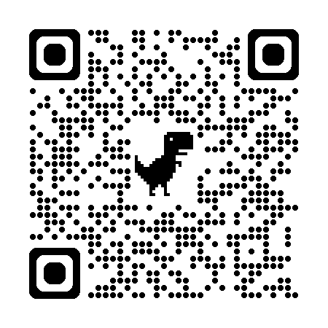

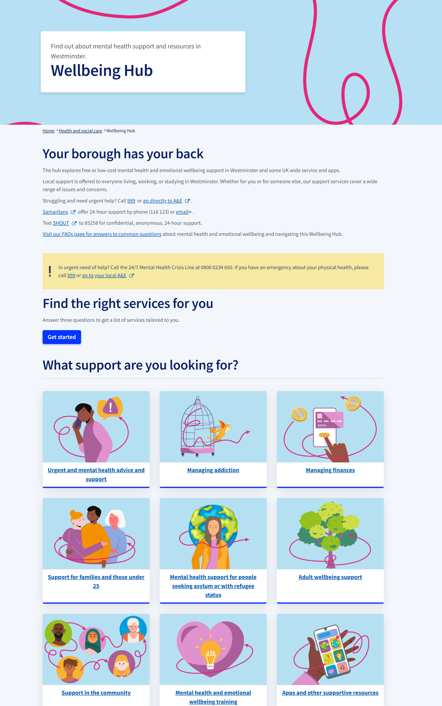
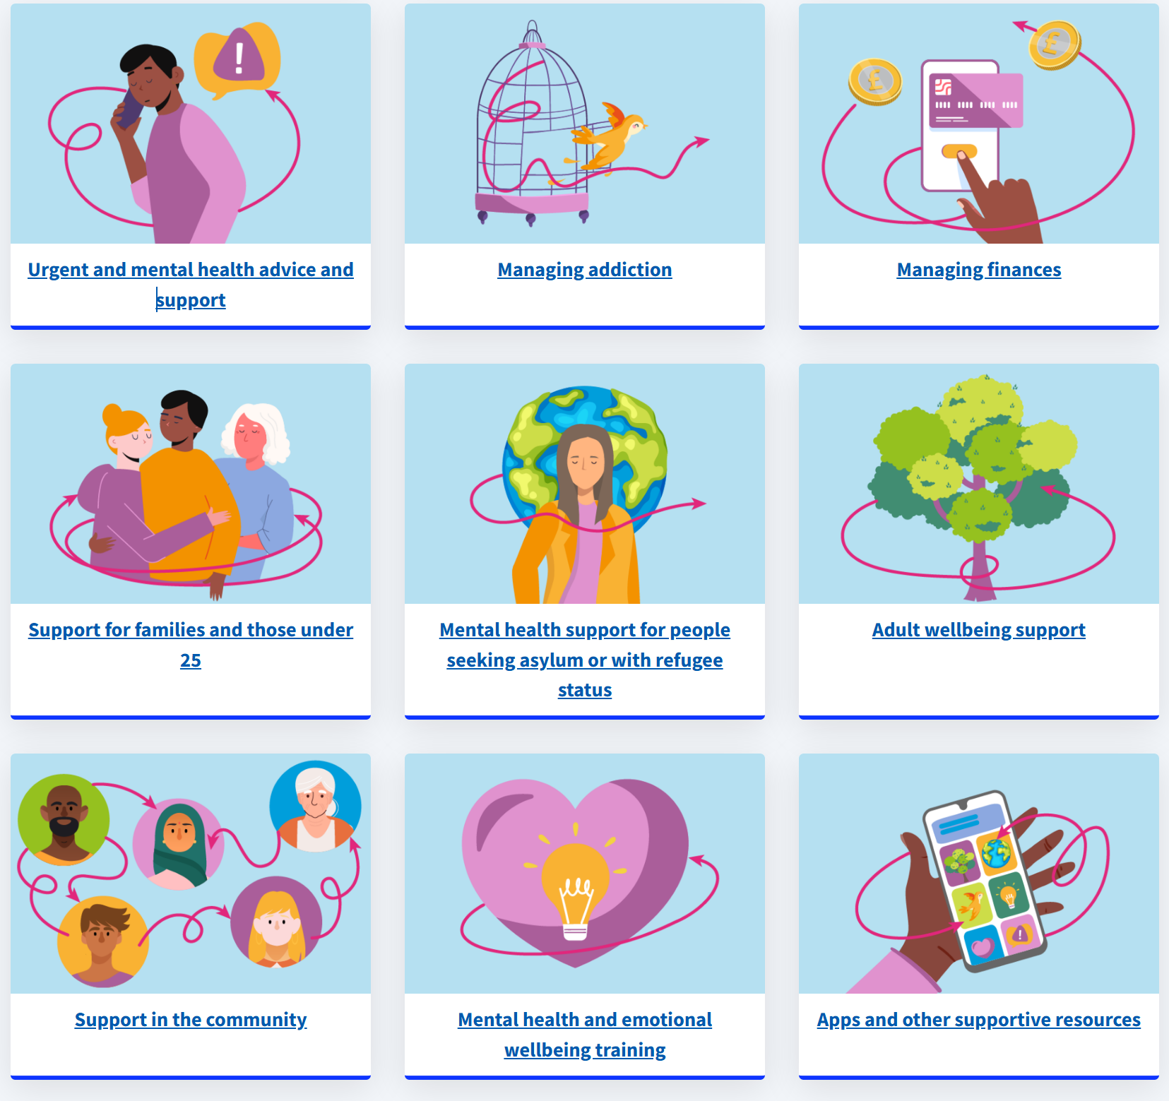
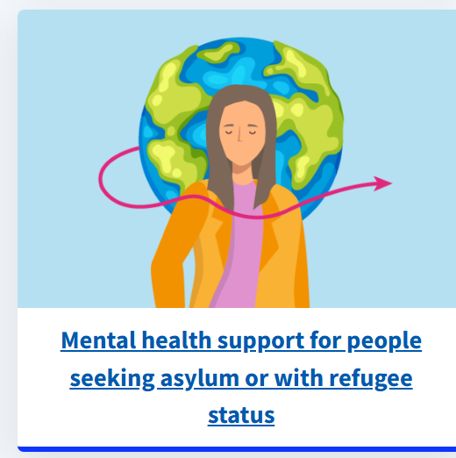
Wellbeing Hub
Scan QR code

Slide 10
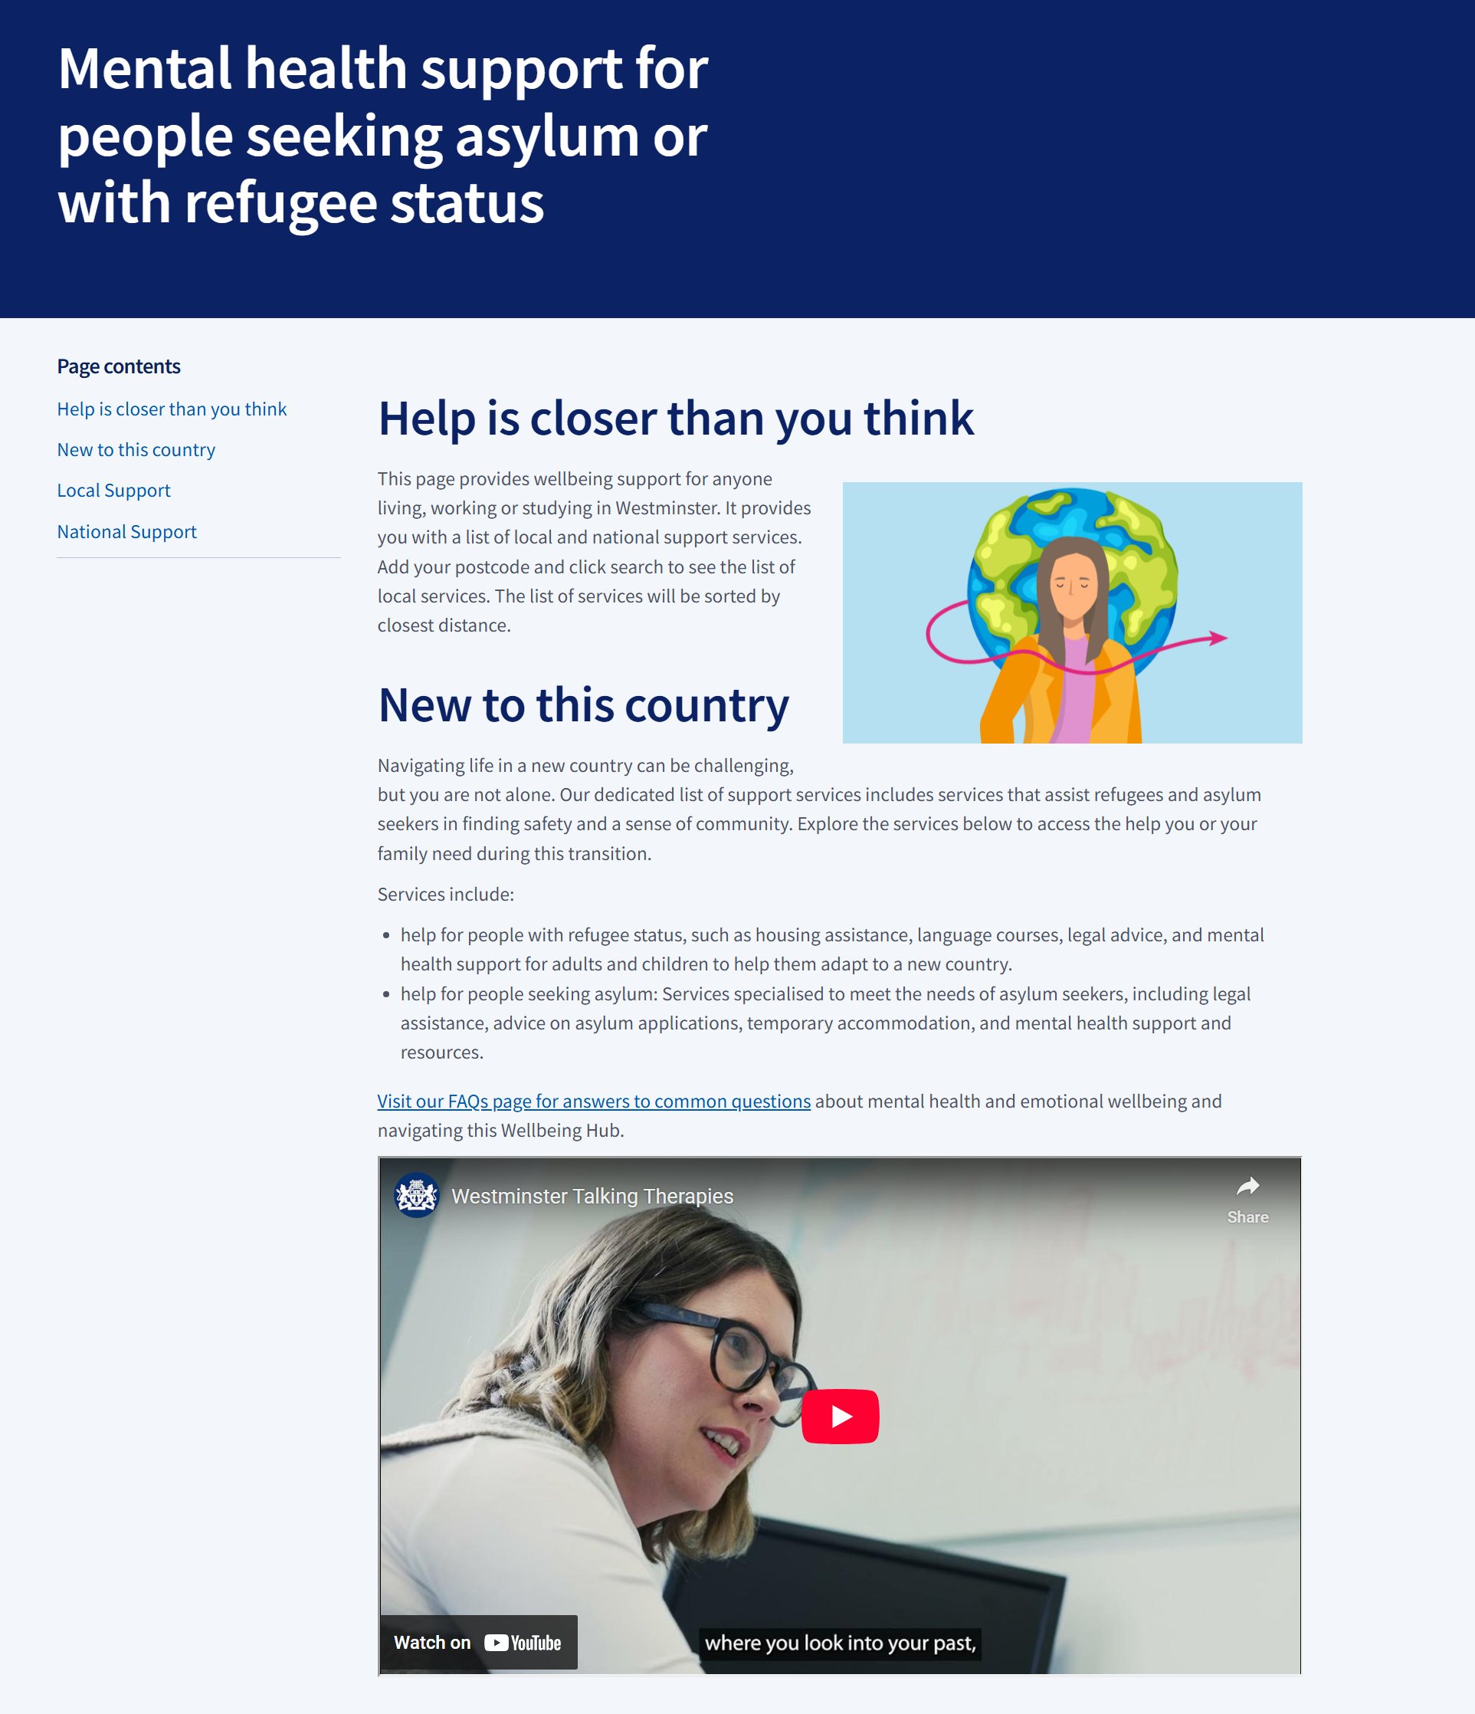
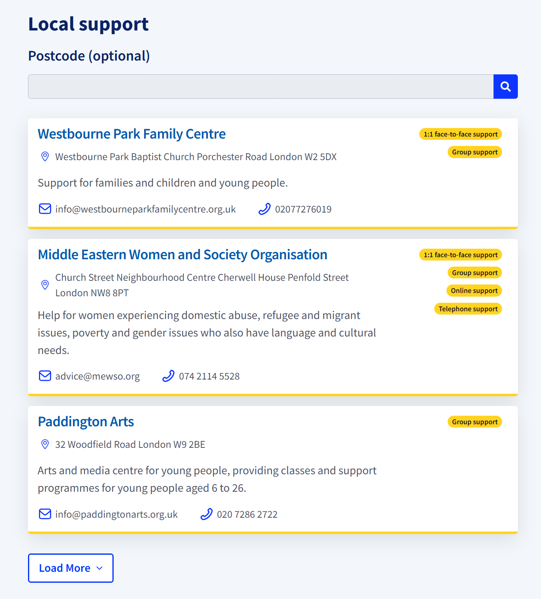
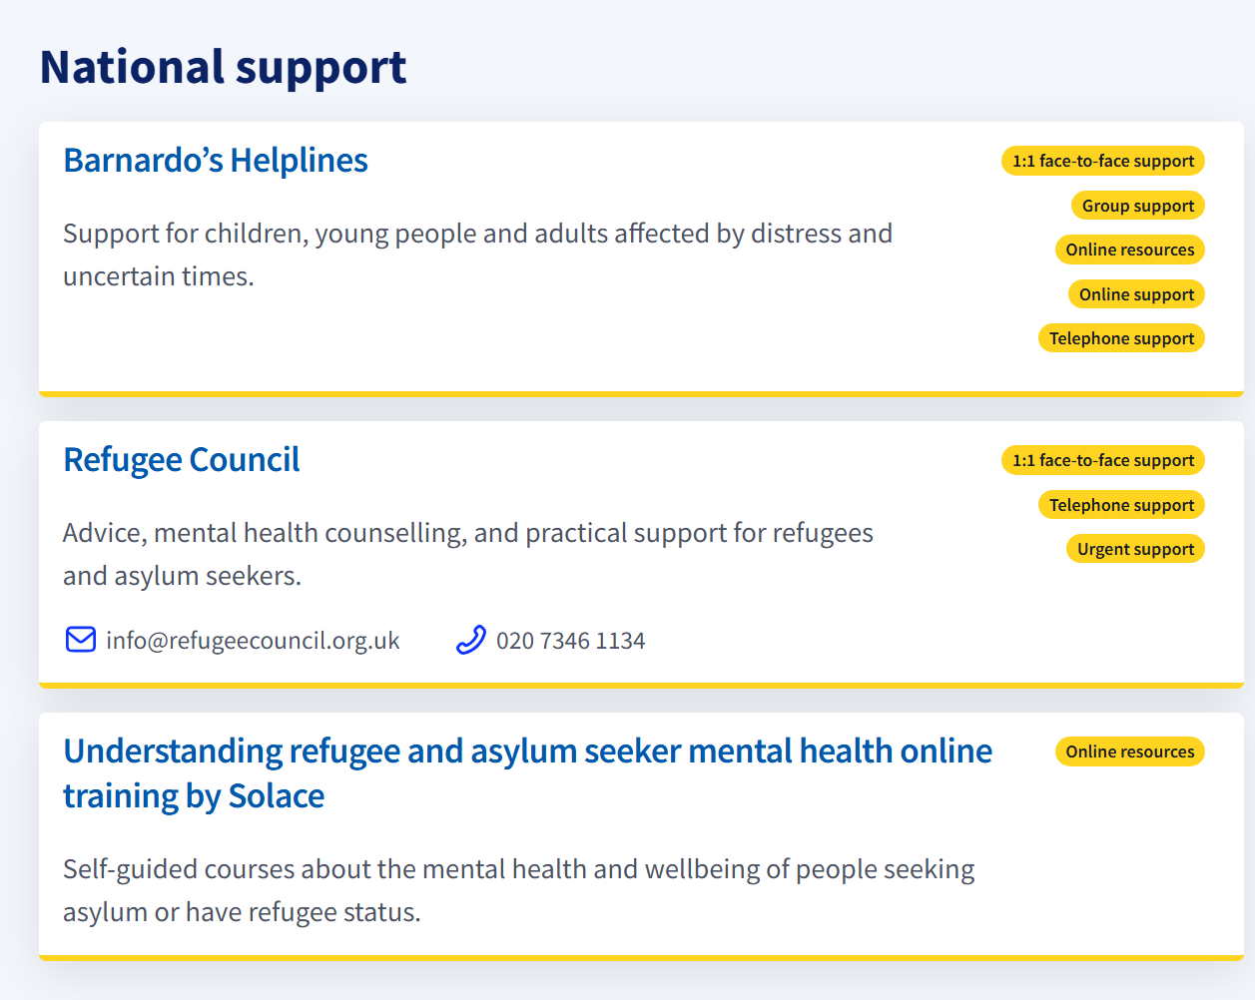
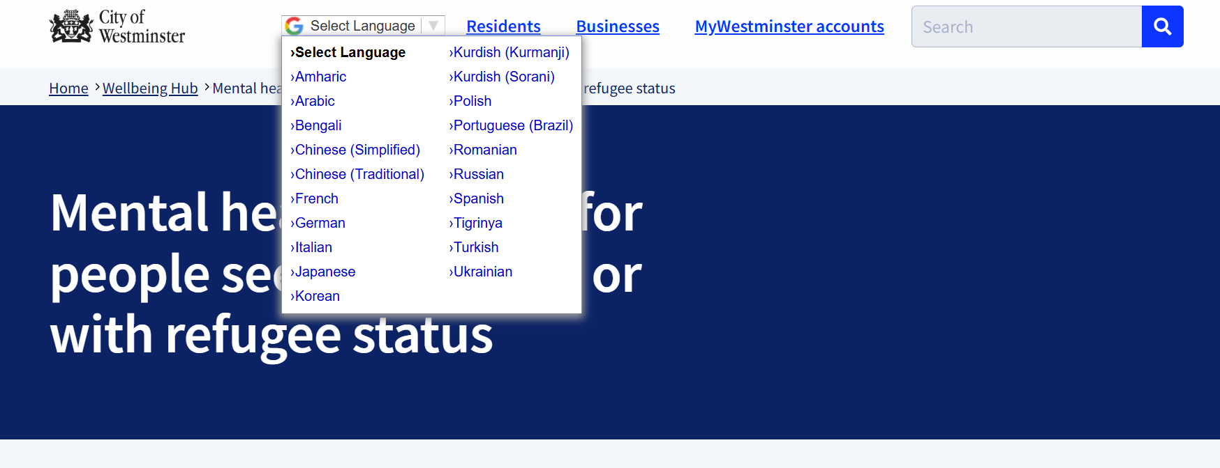
Wellbeing Hub
postcode search option
website translation feature

Slide 11
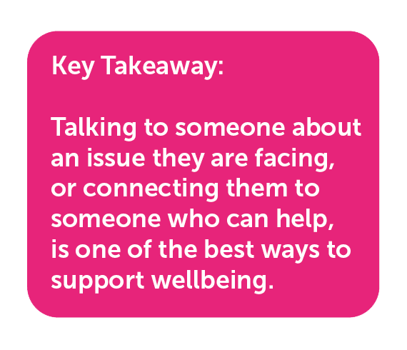


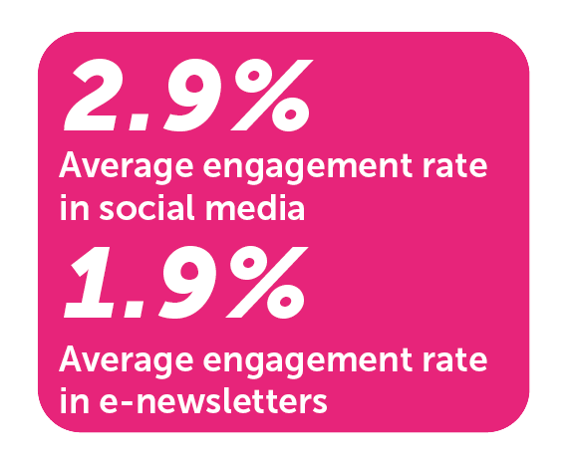



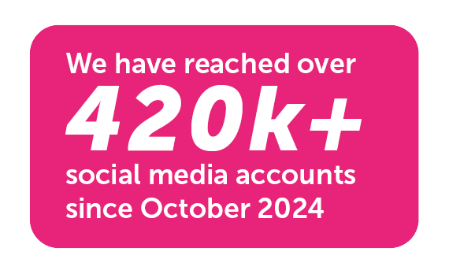

Way to Wellbeing Campaign
Between October 2024 and February 2025:

Slide 12



Action plan 2025-2026
Objective 1
Build Awareness
Objective 2
Connect Sectors
Objective 3
Evidence-Based Action
Reduce stigma, enable individuals to identify loneliness in themselves and others and to navigate to local help.
Connect existing assets and frontline services to address loneliness across all life stages.
Use data-driven insights from academic collaboration to map loneliness and inform targeted interventions

Slide 13
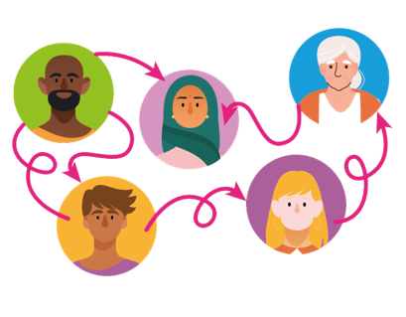

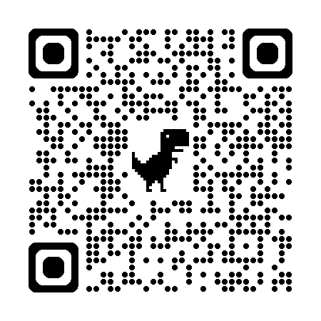
Connect with us
Hurdles2hoops
Charlotte Rowe
Email: hurdles2hoops@gmail.com
Tel: WhatsApp +44 7591 215808
Unfold
Email: hello@unfold.org.uk
Tel: 020 7828 2765
Website: www.unfold.org.uk
WCC & RBKC Public Health
Mariana Covalenco,
mcovalenco@westminster.gov.uk

