Slide 1
Tower Hamlets Council
Children and young people and loneliness
What is the Public Health Team doing?

Slide 2
The issue
National data (BBC Loneliness Experiment, 2018):
40% of young adults (16-24) report feeling lonely often or very often
London data (Greater Local Assembly’s report Reconceptualising Loneliness, 2022)
12% of young Londoners suffering from severe loneliness ​
UK statistics (YouGov, 2019):
24% of young adults (18-24) experience loneliness regularly
Health impacts of loneliness:
Physical: weaker immune system, poorer sleep, increased stress
Mental: higher risk of depression, anxiety, low life satisfaction
Lonely young adults are more likely to engage in risky behaviours and negative coping mechanisms

Slide 3
What works? Whole systems approach
Coordinated initiatives: a collaborative approach across the council, health, and social care.
Promoting initiatives that tackle loneliness, focusing on the most vulnerable groups (disabled people, those in poverty, and protected groups).
Community-centered approaches: increasing co-produced programs, enhancing volunteering and peer support, and fostering community participation.
Targeted commissioning: resourcing voluntary and community organizations that serve residents facing health inequalities, particularly marginalised groups.
Data & monitoring: developing a shared database to track residents' usage of community services, with routine reporting. Monitoring impact through shared metrics.

Slide 4
Coordinated initiatives
MECC loneliness training for staff and VCS, including info on referrals for 16-24 years old
Free events for NHS, Council and VCS staff: next event loneliness and mental health, lived in experience from young unpaid carer, themed table for staff interested in 16-24 demographic
Just Say Hello Tower Hamlets campaign (young people strand)
Communication campaign inviting local residents to connect to local activities.
Just Say Hello campaign in warm hubs with student volunteers
40 young people involved, mostly first year medical students
Students are well known demographic affected by loneliness
Just Say Hello young ambassadors (20 young people) over Dec- March, through a commissioned provider

Slide 5
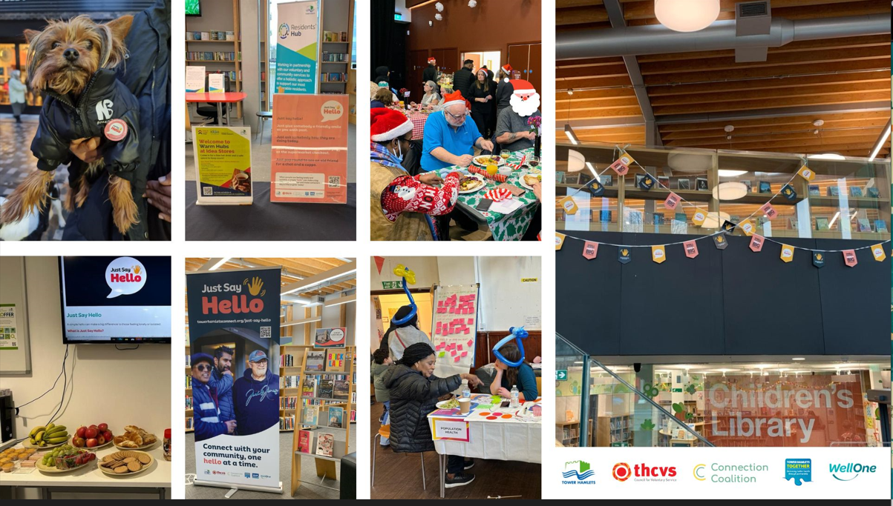

Slide 6
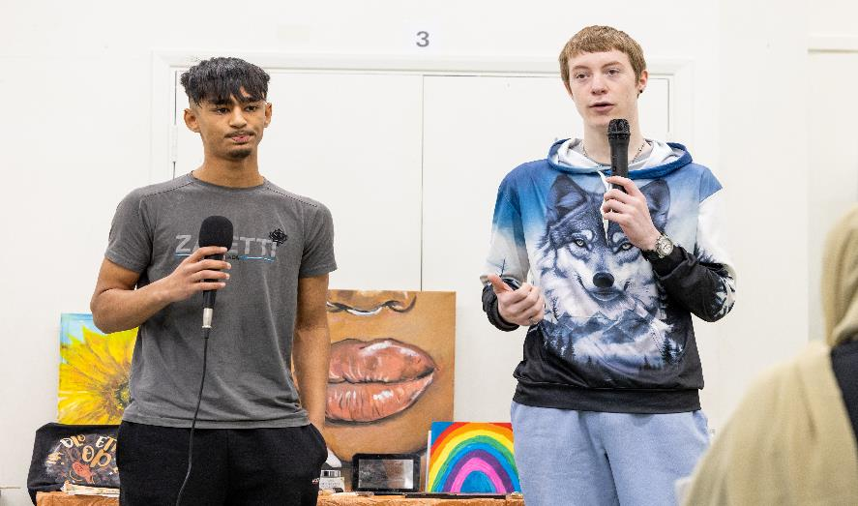
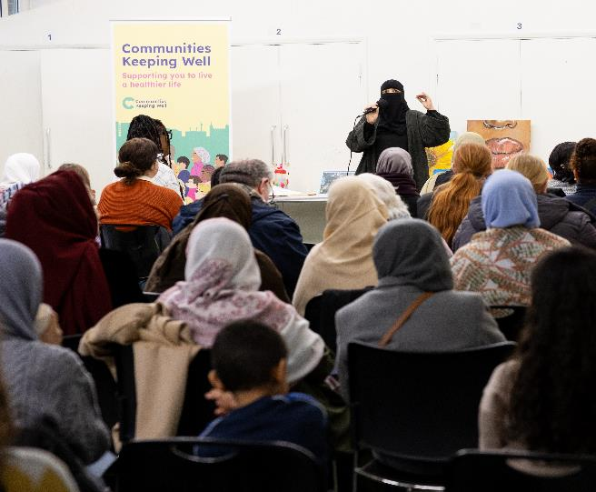

Communities centered approach: Communities Keeping Well
850+ residents engaged across 8 communities
200+ stakeholders engaged
Community health and wellbeing priorities and actions identified in 8 communities
8 Community Voting Days held with 115+ applications submitted and 65 projects funded, including 11 projects for children and young people

Slide 7
Targeted commissioning
Commission youth provider for targeted SEN provision after school/ holidays
Commission learning disability provider for work with young adults over the summer
Independent evaluation- provision is underfunded and much needed
Shared metrics
Broader PH work: new social prescribing app for TH, better data
How to measure loneliness across all programmes: UCLA scale for children
Measuring loneliness: guidance for use of the national indicators on surveys - Office for National Statistics

Slide 8
What you can do
If you have no to limited budget:
Online network- free, you have database of VCS organisations delivering social connection work through your community/grants team, youth services. VCS, NHS and Council staff working in tackling loneliness really want to share information and know what services are available, who are the Council leads, what providers are offering.
Helping your youth projects go further (funded by other teams)
Work with a university on one project to recruit student volunteers, warm hubs are the perfect opportunity to do this
Shared metrics: PH commissions, integrated commissioning, grants team
Targeted mailouts informing residents of what is available (using LIFT dashboard)

Slide 9
What you can do
If you have some budget:
Consider commissioning projects for young people with disabilities/young people with learning disabilities in areas of high deprivation (more likely to be lonely)- huge need

