Slide 1
Norfolk’s Story
Building greater social connection for young and old in a rural county.
Perspectives from a County Council

Slide 2
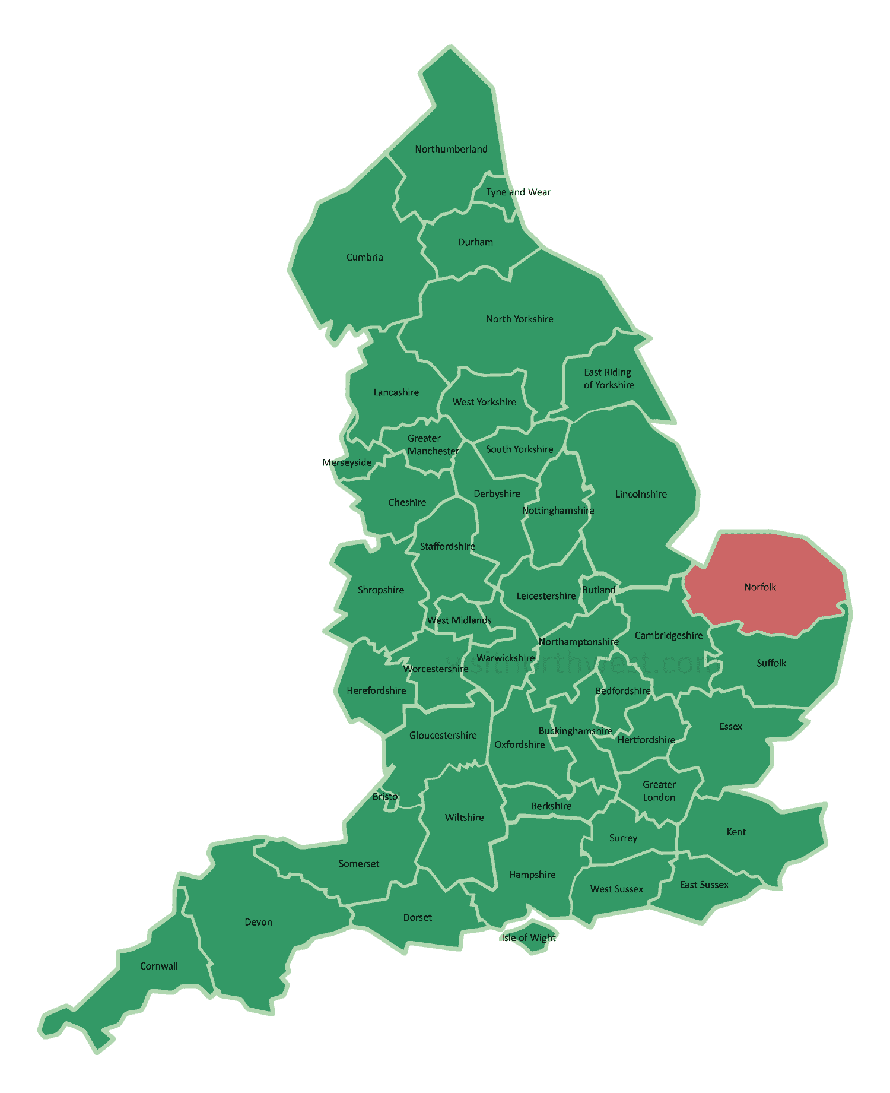
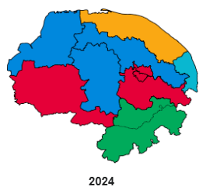
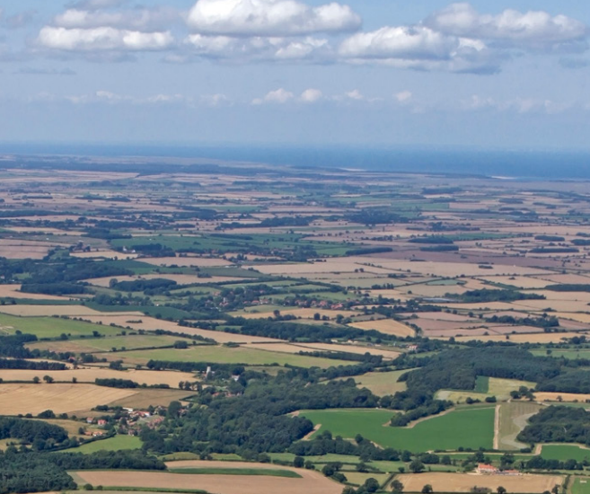
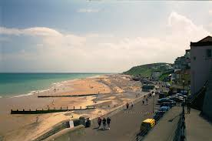
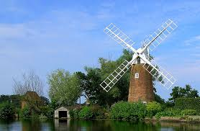
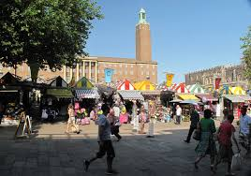
What's it like to live in Norfolk?
Norwich
Great Yarmouth
King’s Lynn
“Perfect for the urban lifestyle we like, car not necessary”​
“The people who live there and have strong family ties with the area are kind, caring”
“Adore GY in the sunlight, uplifting, Sing your heart out at the unitarian church”​
Thetford
“The forest, brilliant for walking and connecting to nature”​
Health life expectancy: Big inequalities with a 12-year life expectancy between some areas. On average resident are living with around 20 years in poor health
Digital Exclusion: Hi levels of digital exclusion and particularly poor broadband connectivity in North Norfolk
Transport: Rural and coastal areas face transport constraints. Leads to high car dependency for 2/3s of the East’s rural residents living in ‘transport deserts’.
Notes:
References
State of Norfolk and Waveney health report 2022
North Norfolk ranked among worst areas for UK broadband – reaction to Point Topic report - County Broadband
RURAL CONNECTIONS Transport challenges and opportunities for communities in the East
Good
big skies, wide horizons, sweeping beaches, windswept marshes and meandering inland waterways. Our countryside includes vibrant villages, beautiful market towns, seaside towns and the Broads National Park. At its heart lies the cosmopolitan, historic city of Norwich
Bad
Isolation
Transport issues
Healthcare access
Infrastructure issues (and digital connectivity)
Limited amenities and activities
Inequalities

Slide 3
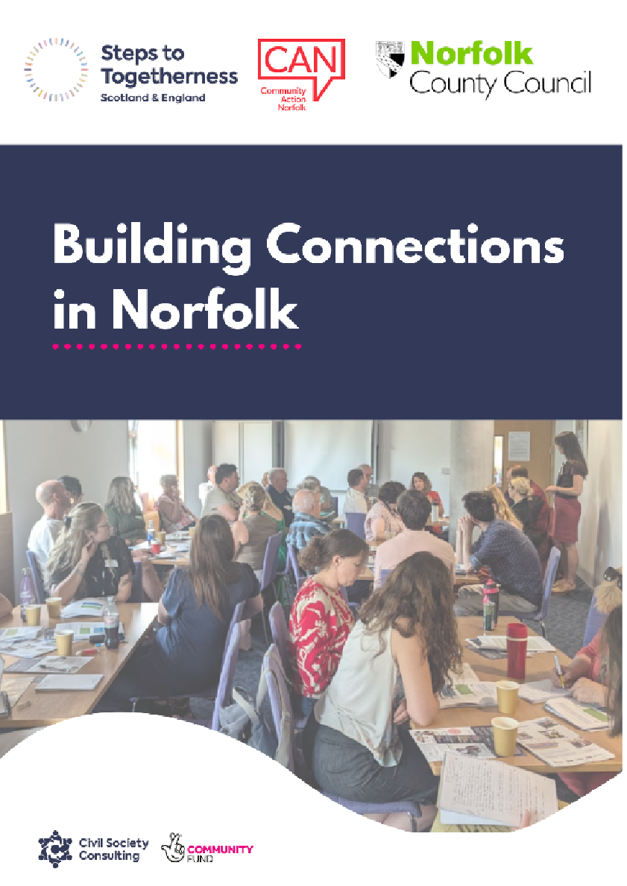
Building Connections | What We’ve Learned
Reflection of the views, experience and ideas of 35 Norfolk based VCS & statutory professionals led in partnership with Civil Society Consulting
Picking out a few themes…
Impact of pandemic: Loss of confidence, social anxiety, staying indoors. Closure of initiatives inc. day centres.
Community leadership: Lack of strong community leadership and decreasing volunteer levels
Late identification: Not picking up issues early and supporting people before they become intrenched
Statutory challenges: Medicalised approach to loneliness, less focus on underlying issues, referral issues and low trust
Funding: Under/patchwork funding impacting vsce. Lack of smaller pots to reach small but impactful initiatives

Slide 4
Building Connections | Direction of Travel
A reflection of the views, experience and ideas of 35 Norfolk based VCS & statutory professionals
1. Deepen our understanding of SI&L
2. Nurture the network and enable collaboration
3. Enhance community life & Asset Based Community Development
4. Visible and accessible provision
5. Support at critical life stages
6. Mobility and community transport
7. Person centred
8. Home based options

Slide 5
Building Connections | What We’re Doing
Goal: To transform the way in which we offer support to residents, to move from reactive, formal support towards more proactive, targeted, and preventative support.
Early identification, support at critical life stages, improved referrals
Deep dive into who, how and why people make first contact with Adult Social Services and their onward journey
Transforming our services to deliver a more local and ‘Human Learning Systems’ approach
‘Proactive Interventions & Prevention’ Programme for early identification, with novel use of data and AI
Outcomes-based community commissioning model weaving in more opportunities for learning and collaboration
Video making workshops and Social Media Campaign with Civil Society Consulting
Support activities that are working and grow new ones
Development workers focus on asset-based community development
Increase visibility and accessibility of activities
Exploring how smaller pots of grant funding might be administered
Home based options:
‘Tech Skills for Life’ programme
More intentional person-centred approach

Slide 6
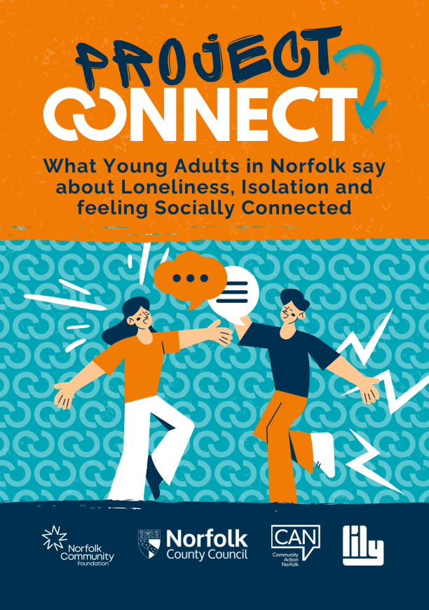
Project Connect | What We’ve Learned
Loneliness and social isolation among young people is increasing with 16–24-year-olds now reporting the highest levels of loneliness of any age group in the UK
Young people in Norfolk have different experiences form older adults.
How do young people connect?
Texting and talking online rates the top option
Preference for spontaneous / unorganised socialising over organised events.
Top themes:
‘An anxious generation’
‘Very online’
Getting around
Hanging out

Slide 7
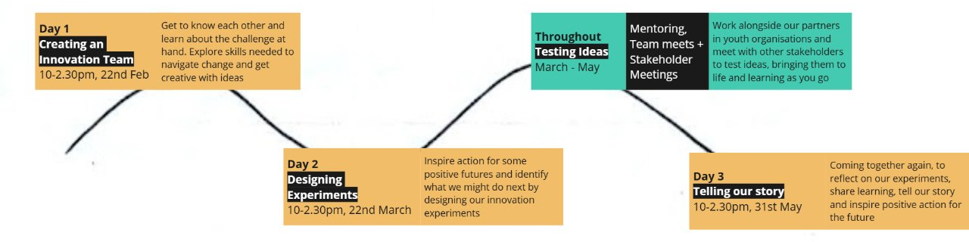
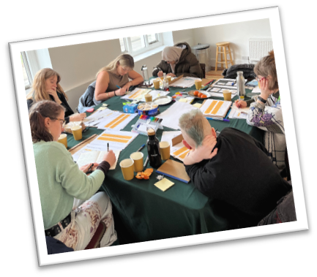
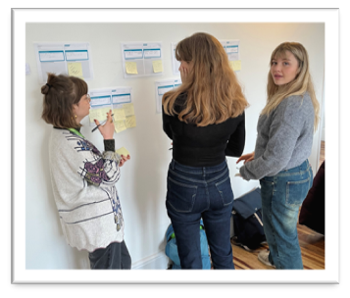
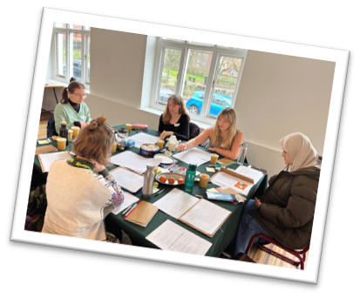
Project Connect | Our Young Innovation Team

