Slide 1
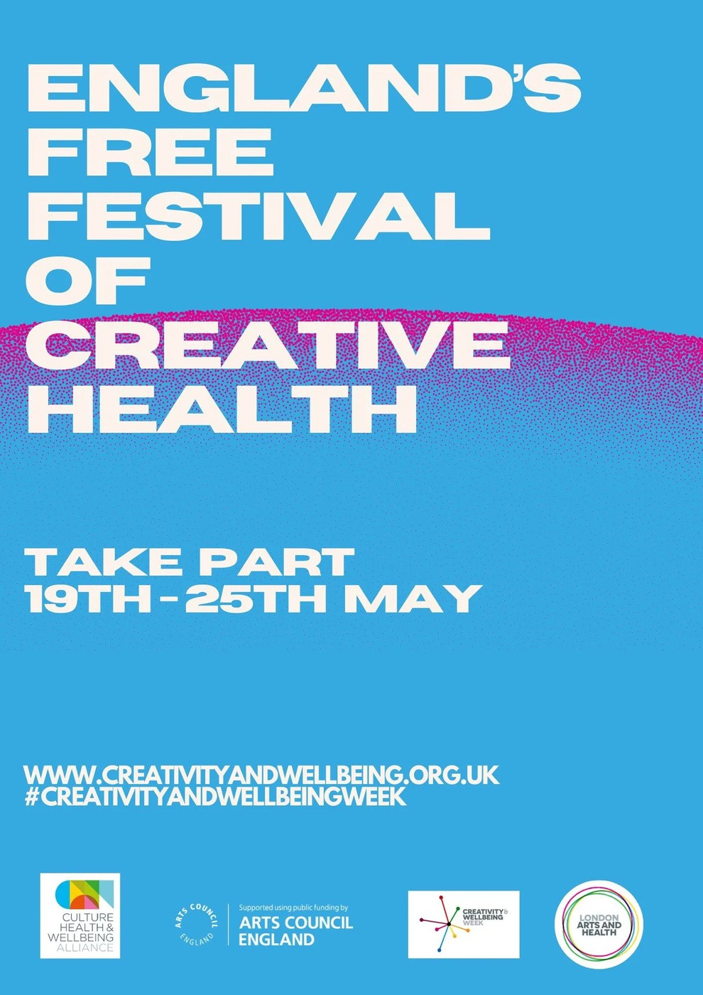

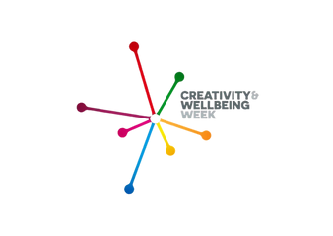


How the Arts can tackle Loneliness?
Victoria Hume - Executive Director CHWA Anna Woolf - CEO LAH
www.culturehealthandwellbeing.org.uk www.londonartsandhealth.org.uk www.creativityandwellbeing.org.uk

Slide 2


London Arts and Health
Join us for free and
become a LAH member to receive sector updates about jobs, trainings and funding.
info@londonartsandhealth.org.uk www.londonartsandhealth.org.uk
London Arts and Health is free membership sector support organisation that supports artists, creative practitioners and health professionals across the whole of London and beyond.
News
Events
Funding
Jobs

Slide 3


Culture, Health & Wellbeing Alliance
Join for free to receive the monthly bulletin and other updates from national organisations in Creative Health.
info@culturehealthandwellbeing.org.uk www.culturehealthandwellbeing.org.uk
The Culture, Health & Wellbeing Alliance is a free-to- join membership organisation for creative health across England. We provide networked, collaborative advocacy, support and resources, supporting health and wellbeing for all through creative and cultural practice. We are based in Barnsley, South Yorkshire.
News
Training
Policy
Quality Framework

Slide 4

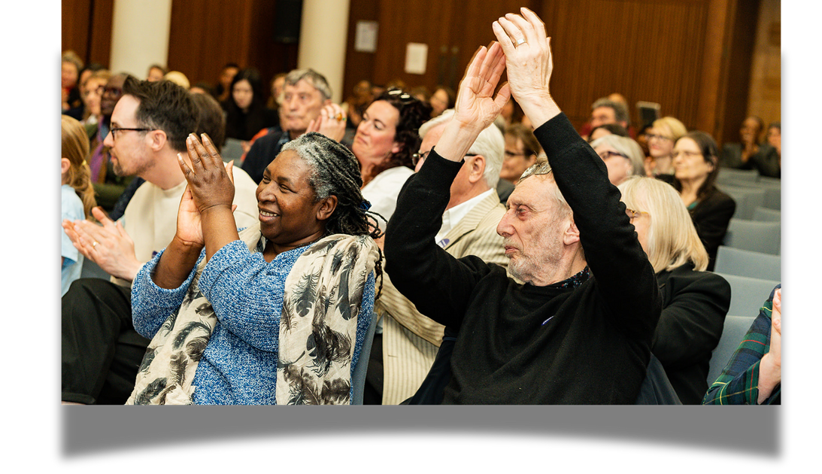
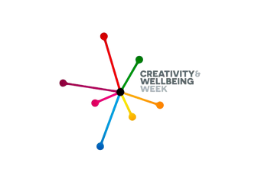


Creativity and Wellbeing Week
England’s FREE National Festival of Creative Health.
www.creativityandwellbeing.org.uk
19th - 25th May 2025
300+ events nationally and growing 100K + mentions of hashtag
50% said festival improved MH Link to 2024 evaluation
How many people are invisible to us?
What skills and experiences are hidden away in flats and houses, prisons and on the streets?
Clive Parkinson

Slide 5

A catalyst for Creative Health
Topics covered:
Creativity in a health crisis; Creative health and AI; Representation and creative health; Hospital Arts ‘Let’s Get Clinical’
Platforming grass-roots organisations
50% said the festival positively impacted their mental health
55% of attendees to C&WW were new, suggesting that our festival reach is widening
“We see Creativity & Wellbeing Week as part of our strategic approach. We’ve supported it for 3 years, we feel it’s important that it provides a platform to engage wider audiences, which helps shine a light on creative health achievements throughout the year.”
42% of attendees identified as having a non-white background
300+ events were added to the C&WW website
Julie Tolhurst,
Barnsley Council Public Health

Slide 6
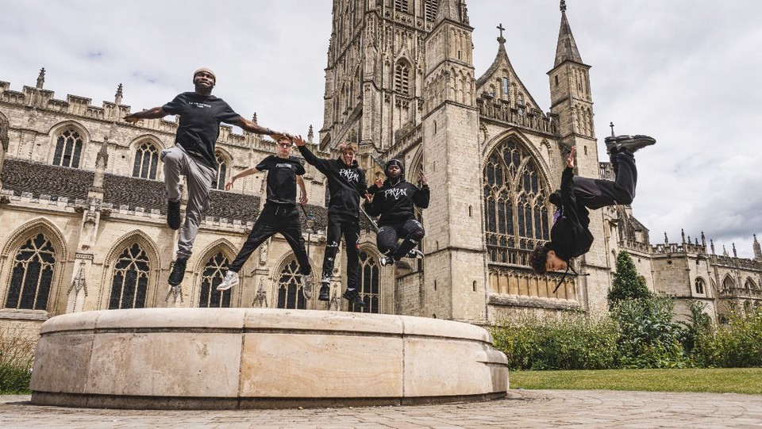
Loneliness, creativity and culture
Creativity and culture can address the causes of loneliness (including the social determinants) as well as symptoms (eg depression)
The two groups most vulnerable to
loneliness are older people and young
people - with young people reportedly
loneliest of all. The ONS Community Life
Survey 2023/4 found adults aged 16-24
reported feeling lonely more often than
other age groups
Loneliness also aligns with structural
inequities and increases in groups who
experience discrimination, whether
through age, class, heritage, gender or
sexuality.
Lonely people are more likely to suffer
from dementia, heart disease and
depression (Valtorta et al, 2016; James et
al, 2011; Cacioppo et al, 2006).
Loneliness is likely to increase your risk of death by 29% (Holt-Lunstad, 2015).
The Knife Angel (CHWA Award Winner 2025)
photo by Lasalo Elia
The Knife Angel project shows the power of community collaboration in addressing serious challenges to youth health and wellbeing.... The project's success led to a year-long engagement, evolving into an album launch, series of performances, professional development and peer advocacy.

Slide 7
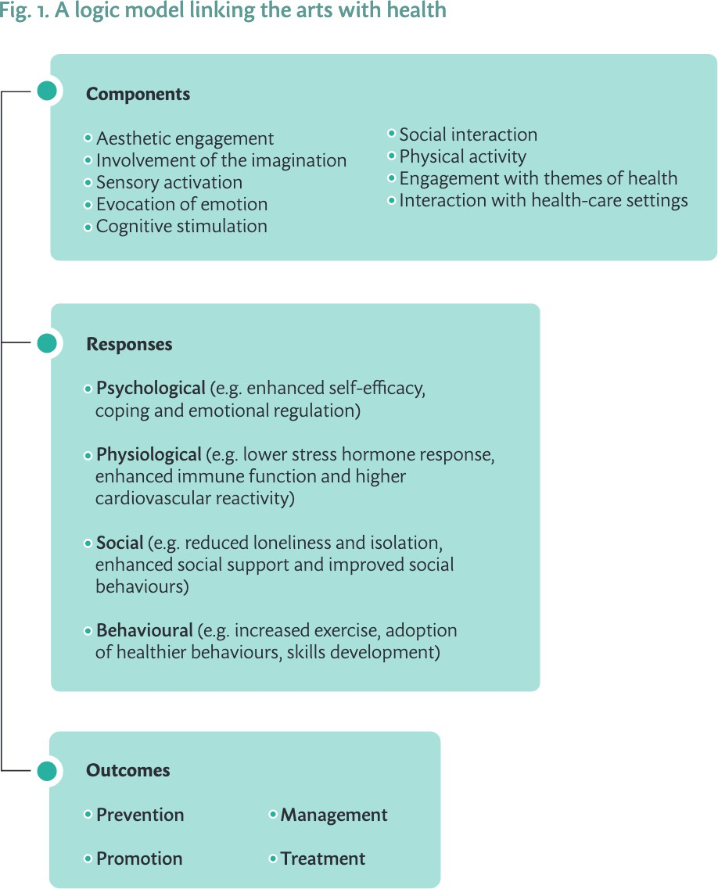
Loneliness, creativity and culture
“The arts... provide a recognised way of reducing loneliness and social isolation, particularly among people living in rural or disadvantaged areas.”
What is the evidence on the role of the arts in improving health and well-being? A scoping review, Daisy Fancourt & Saoirse Finn, World Health Organization 2019

Slide 8
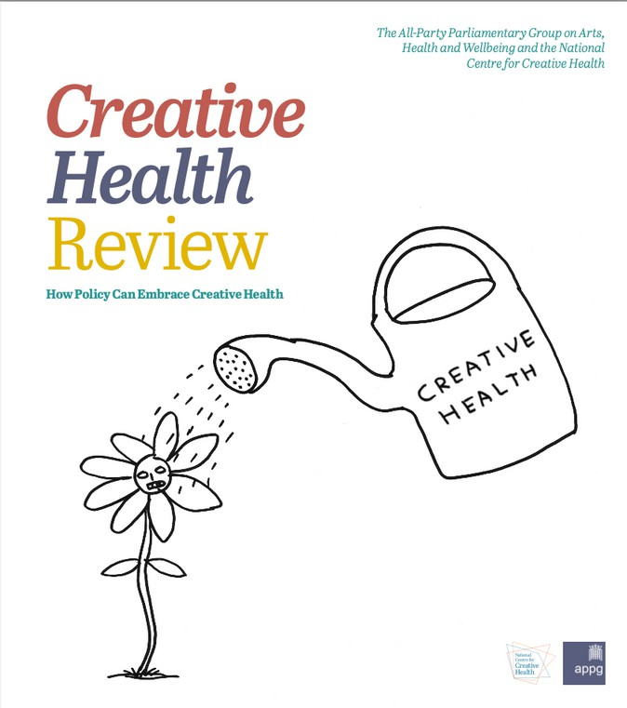
Loneliness, creativity and culture
“Creativity is so much more than just doing arts. For some it helps rescue them from their darkest days. For me, it helped me be part of a community, helped me to be heard, helped give me my voice back, and I’m proud to say I’m now a community organiser”
Kelly Mclaughlin, Community Organiser, East Marsh, Health Inequalities Roundtable
“Creative health is an integral part of community and place-based approaches to reducing health inequalities. .... Creative activities build social capital and connection, and provide individuals with a sense of agency, meaning and purpose.
Through creative health people and communities can be empowered to make positive changes and improve quality of life.”
Creative Health Review, All Party Parliamentary Group for Arts, Health & Wellbeing / National Centre for Creative Health, December 2023

Slide 9
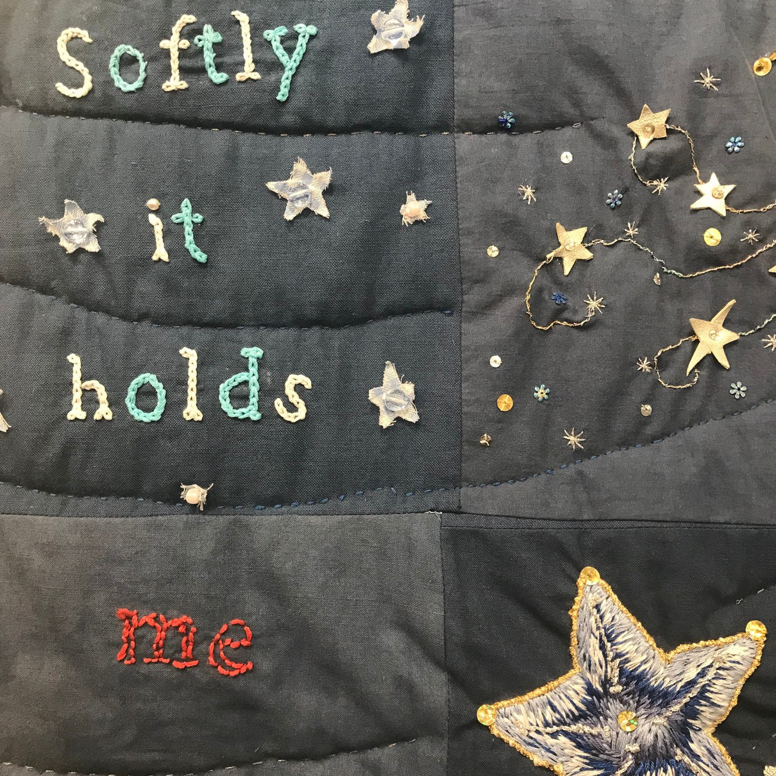
The influence of lockdowns...
50 case studies across arts, culture & heritage organisations targeting people shielding or vulnerable at home during covid
total reach over 100,000 phone / post / online
overwhelmingly aimed to address loneliness and isolation influenced practice across the sector in the longer term.
94% conducted in partnership - with VCSE, NHS and local authorities - a huge boost to partnership work in the sector.
‘A Necklace of Stars’, arthur+martha and Arts Derbyshire.
Artwork, creative writing & song passed between tellers, each building on previous contributions to add to the whole, a technique arthur+martha had used successfully in hospitals: combating isolation, constructing group narratives, reflecting many voices. Originally conceived to engage with isolated housebound people aged 65+ in rural Derbyshire, its reach expanded during lockdowns.
Credit: Lois Blackburn.
“I think it’s helped me deal with lockdown. It’s helped me sound out what I’m thinking … Trying to think and digest and let it filter in.
Or else you drown in your own thoughts, don’t you? If you’re left alone with them too long.”

Slide 10

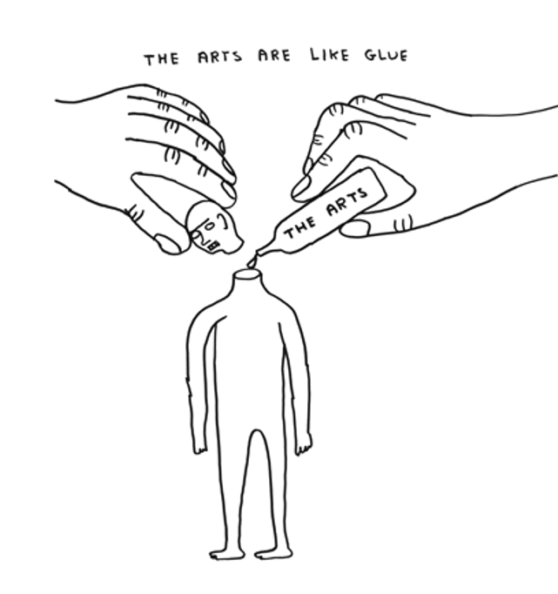
How does creative health tackle loneliness?
Creative health refers to creative activities and approaches which have benefits for our health and wellbeing.
Activities can include visual and performing arts, crafts, film, literature, cooking and creative activities in nature, such as gardening.
Approaches may involve creative and innovative ways to approach health and care services, co- production, education and workforce development.
Creative health can be applied in homes, communities, cultural institutions and heritage sites or healthcare settings.
(Source: National Centre for Creative Health)

Slide 11
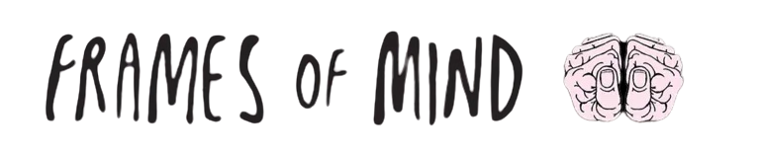
Case Study: Frame of Mind
Frames of Mind work in partnership with Newham Council, Community Neighbourhoods, community link
workers and social prescribers enabling us to reach and support residents experiencing, social isolation, anxiety and health inequalities.
50% of the steering group were referred by their GP or Community Link worker and experienced mental health issues, long term health conditions, and social isolation.
90% of the steering group live alone and are adversely impacted by cost-of-living-crisis.
OUTCOMES
Improved health and mental wellbeing through engagement in meaningful creative and practical digital life-skills, enabling positive life changes and self-advocacy.
Reduced social isolation and loneliness with examples of new
friendships made and a peer support network. PNP Whats App group keep participants connected and provides an information sharing platform.
Participants connected to vital services with increased
understanding of local pathways, supporting services and materials – mitigating impact of cost-of-living crisis.
Transferrable skills learnt providing stepping-stone to
volunteering, further education, training, and the pursuit of new interests.
Frames of Mind staff trained, informed, and connected with
other Newham organisations.
People Need People (PNP) is a free, welcoming, creative digital inclusion and friendship club based in Stratford Library, where participants can meet new people and discover the potential of their smart devices, as tools for personal enablement and recovery.
Funded by Newhams’ community funding initiative – ‘People Powered Places’, People Need People is a collaborative approach to health and mental wellbeing, supporting people to help themselves and each other.

Slide 12

Case Study: Meet me at the Albany
An award-winning programme of creative and social activities for over 65s at the Albany and across Lewisham, with partners Entelechy Arts.
At the heart of the programme is Meet Me at the Albany – a weekly arts and social club at the Albany – Members are just as likely to be suspended on silks in a circus workshop, enjoying a performance of jazz, creating sculpture, writing poetry or singing in the weekly choir.
Since 2013 the project has grown far beyond the weekly club. We host a regular film club: Meet Me at the Movies, where we have cinema screenings for and chosen by older people. For cultural destinations there is Meet Me on the Move: monthly trips across London, from the Houses of Parliament to the Royal Festival Hall. And we love to come together to perform and share our work with Entelechy Arts at the very special 21st Century Tea Dances.
Meet Me… grew out of a simple question shared by the Albany, Entelechy Arts and Lewisham Council: ‘What if isolated and lonely older people had the
opportunity to go to an arts centre instead of a day centre?’
Meet Me… brings formerly lonely or isolated older people together to work with artists to learn or rediscover creative skills, make friends and have agency over their social lives. We offer a space for people to meet, to celebrate, to experience each other and the world, a space to inspire our individual and collective imagination.
We believe the arts are an essential component
in healthy and resilient lives and in transforming communities.

Slide 13
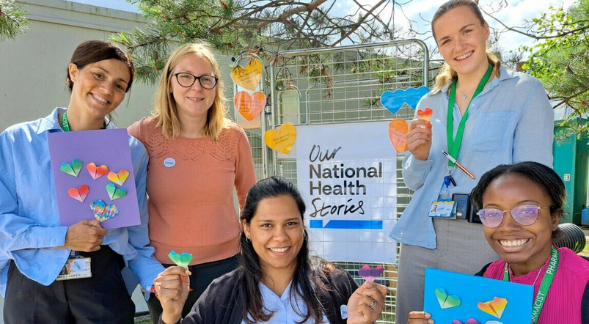
Building an NHS fit for the future: The shift to prevention
A response to Lord Darzi’s Independent Investigation of the NHS in England -
National Centre for Creative Health (linked here)
Creative health offers a holistic and person- centred approach which can improve quality of life and empower people to manage their health, reducing pressures on health and social care services and supporting people to remain in employment.
effective and cost-effective way to manage and recover from poor mental health
supports people with social care needs to live independently for longer and improves quality of life
“Creative health offers a different approach to health and wellbeing – one which mobilises creative, cultural and community assets, supporting people to live well for longer.
Embedding creative health in systems will benefit individuals, communities and public services, ultimately leading to a healthier population and more prosperous society.”
A shift to prevention A shift to communities
re-engaging staff and re-empowering patients Integrated care systems
Our NHS Stories, National Arts in Hospitals Network: A collaboration between 19 hospital trusts and a creative team led by Kwame Kwei-Armah

Slide 14
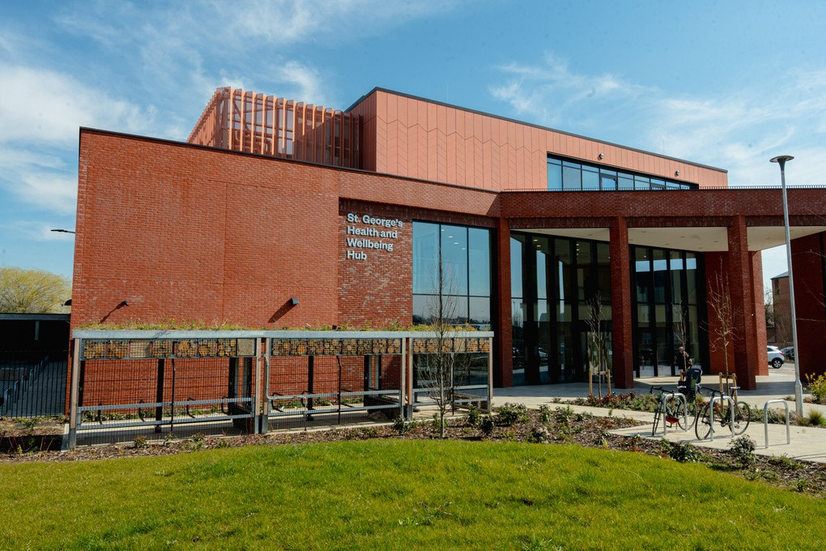
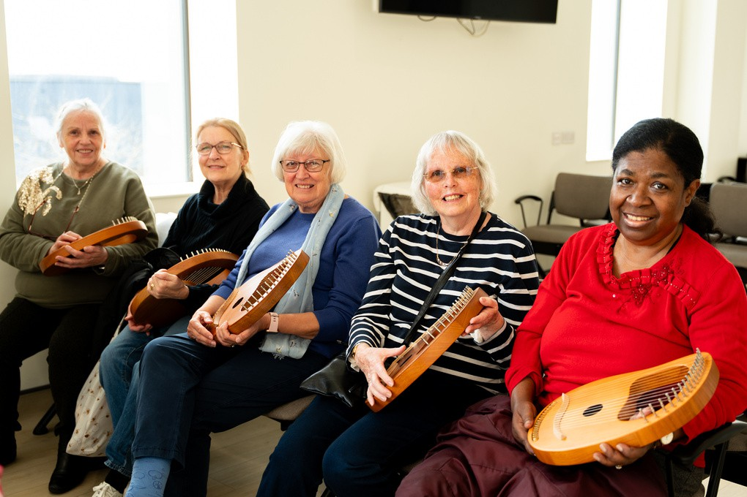
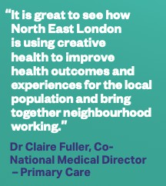
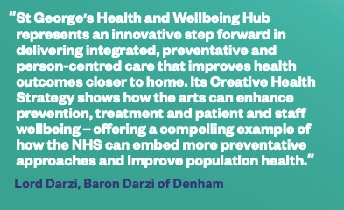

St. George’s Health and Wellbeing Hub
Opened by NHS North East London Health and Care Partnership in November 2024, St George’s Health and Wellbeing Hub is a future-orientated model of integrated care. The hub works across social, health and voluntary sectors to encourage, develop and maintain physical, mental and social health, wellbeing and independence.
The hub aims to utilise CH to address loneliness and isolation through a planned programme of CH activities, woven into the SP offer alongside partners such as Havering Music School and Creative Health Havering. Havering has the oldest population in London. Almost half (48%) of one-person households in Havering are occupied by people over 65.
The hub has community gardening space, corridor and meeting spaces and a cafe in which to offer a programme of activities offering a whole person approach to care, connection and community.

Slide 15

Thank you
anna@londonartsandhealth.org.uk victoria@culturehealthandwellbeing.org.uk

