Slide 1
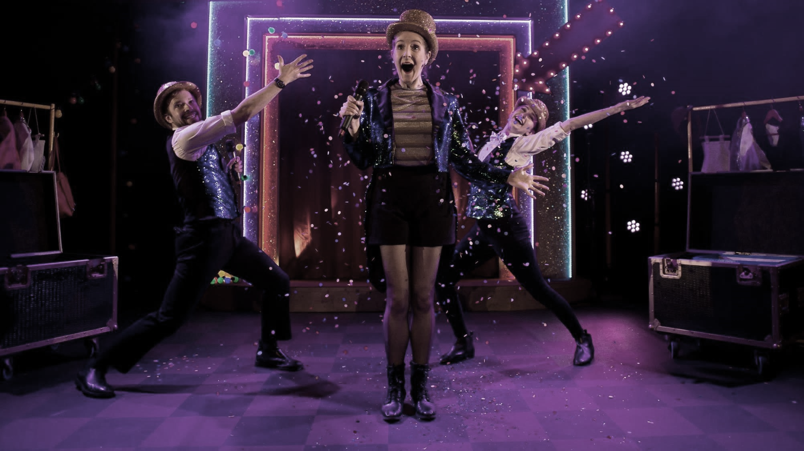

Creative Health and Loneliness
Jemma Channing
Senior Manager Creative Health & Change, Arts Council England
Silent Uproar - Photo © Sam Taylor

Slide 2
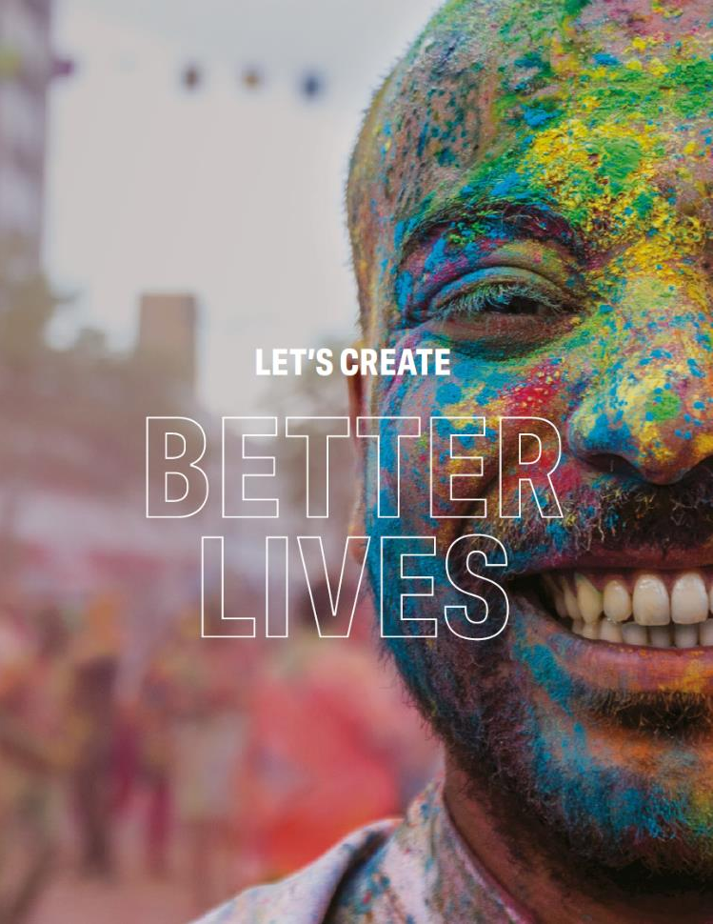


Tutti Frutti - The Snow Queen - © Brian Slater
Arts Council England
Development agency for creativity and culture in England
Invest money from Dept for Culture, Media & Sport (DCMS), Dept for Education (DoE) and the National Lottery
Let’s Create is our 10-year vision for
  “…a country in which the creativity of each of us is valued and given the chance to flourish
  …where every one of us has access to high-quality cultural experiences.
  A country transformed by culture and creativity, in which people live happier, healthier lives.”
Antonik Bell Square © Vipul Sangoi

Slide 3
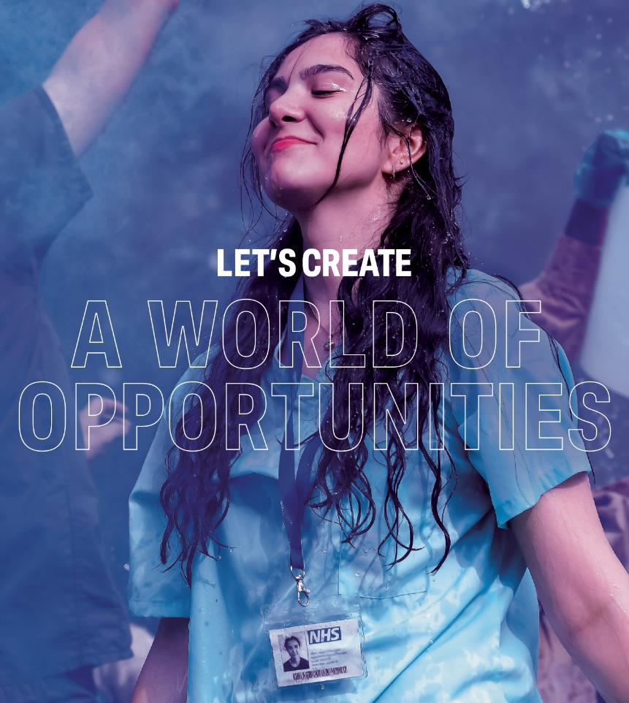

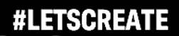
Tutti Frutti - The Snow Queen - © Brian Slater
Let’s Create
In Let’s Create, we set out our vision for a country transformed by culture and creativity, in which people live happier, healthier lives.
“By 2030, we want England to be a country in which the creativity of each of us is valued and given the chance to flourish. A country where every one of us has access to a remarkable range of high-quality cultural experiences.”
Let’s Create mentions “health” 15 times!
Links with our role as a development agency (convene, advocate, invest, progress etc)
National Youth Theatre of Great Britain – Summer Courses © Alessandra Davids

Slide 4

Creative Health Plan
Partnerships – working strategically with the health and social care sectors, including local authorities (public health / population health)
Practitioners – focusing on skills development and wellbeing of creative practitioners
Place – embedding the work in our place–based approach
https://www.artscouncil.org.uk/creative-health-wellbeing
Notes:
PARTNERSHIPS – At national level, strengthening our partnership with NHS, public health and other national health and social care partners, including NASP. Develop understanding of the health benefits of creative activity, including addressing the social and economic determinants of health. Growing focus on personalised care, prevention and social prescribing. NHS looking at work that can tackle their most pressing issues and work at scale – appetite for more ‘top down’, integrated, national approaches.
PRACTITIONERS: Build a skills development and wellbeing offer for creative practitioners working in health and social care settings. Grow ambition for creative health through DYCP and NLPG programmes, eg by supporting practitioners through CHWA’s new Quality Framework which will help practitioners nationally understand what ‘good’ looks like – this will also be helpful we hope for ACE teams assessing grants.
Also NB: The National Portfolio is a huge resource, core funded for three years (so this isn’t all short-term project funding, despite what some people say!) Comprises nearly 1,000 organisations, a third of whom are delivering work in creative health.
PLACE: In the CHW plan we say we want creative health to be “at the core of multi-agency conversations and collective action to address health outcomes and shared priorities”. Want to ensure creative health supports Let’s Create and our focus on place. A fundamental shift away from ‘health projects’ as additional activity and moves Arts Council toward viewing health and wellbeing as an integral delivery outcome for our sector

Slide 5
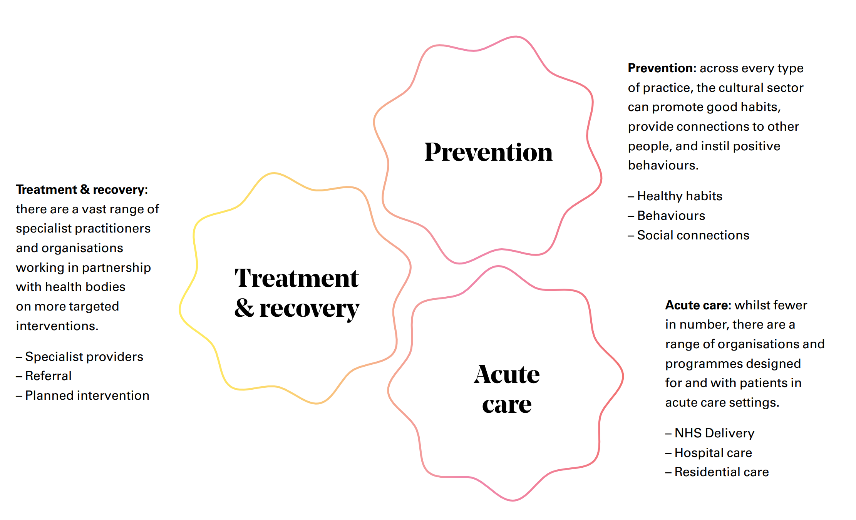
What do we mean by creative health?
Notes:
Creative health covers a wide range of people, practice and partnerships. ACE Creative Health & Wellbeing Plan views Creative Health from 3 viewpoints:
(London/national examples)
Prevention e.g. Magic Me, Dance for falls prevention
Treatment and Recovery e.g. UCL hospital arts programme, Hospital Rooms (new NPO), Reading Agency’s Books on Prescription
Acute Care e.g. Breathe Arts Health Research
[Also within: primary / secondary / tertiary care]

Slide 6
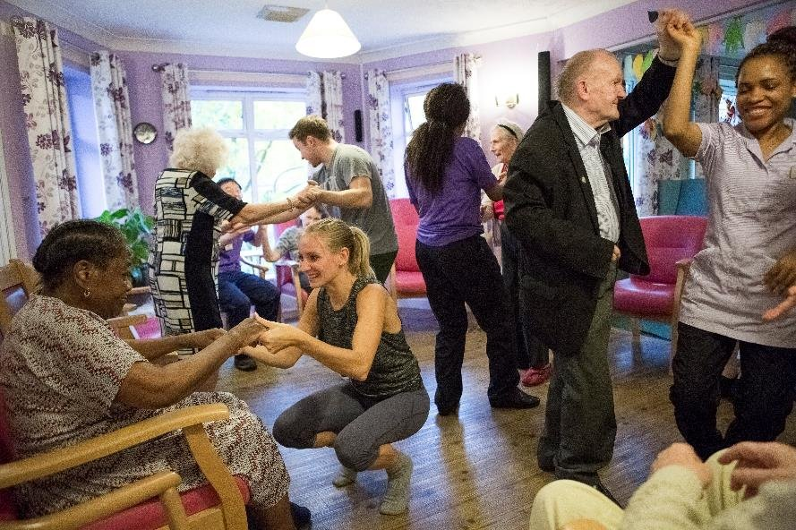
Know Your Neighbourhood Fund
To tackle chronic loneliness and increase volunteer opportunities, specifically through engagement in arts, heritage, and creative activities at a local level.
ACE delivered funding to arts and culture organisations across 27 areas through partnership working with three delivery bodies: the Association of Independent Museums, Creative Lives, and Libraries
Evaluate the impact that engaging in creative activities and volunteering opportunities had on peoples experiences of loneliness
About the Know Your Neighbourhood Fund - GOV.UK
Dance for Life Photo by Alicia Clarke

Slide 7
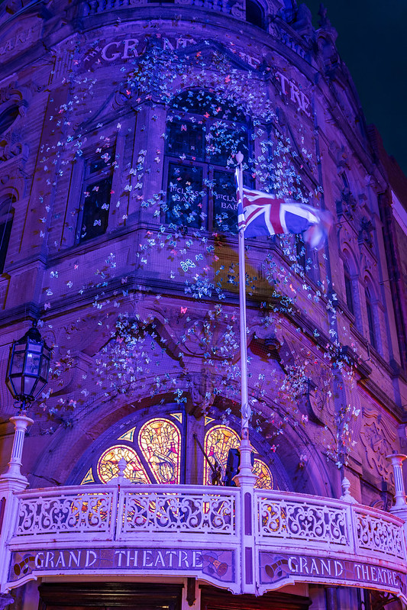
Electric Voices Blackpool
Electric Pink Voices is a friendly and welcoming new LGBTQ+ choir based in Blackpool. Reaching isolated members of the community through consultation, workshops, and creative projects.
Their sessions aim to build confidence, self-esteem, resilience, and strong friendships through shared creative experiences.
Members have co-produced a personal music set to perform at Blackpool Pride and the Hand in Hand Queer Choir Festival.
Credit: LightPool Blackpool Butteflies LUTN SHINE artist

Slide 8
The friendships I have formed in the group have helped me through some bad places mentally. The songs, the learning, and the group mean a lot to me, and the future is looking rosy.’ - Bryan, EPV participant

Slide 9
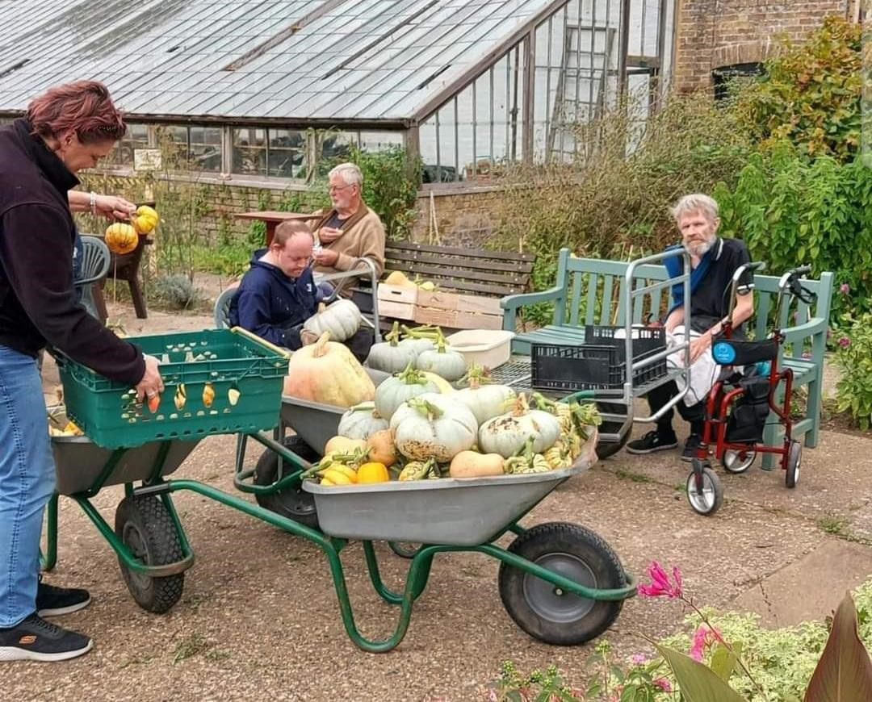
The Sunshine Project, Thanet
A programme activities in the grounds of Powell-Cotton Museum, Thanet.
Creating a supportive and nurturing environment for those with learning disabilities and/or mental health conditions, through a dedicated community engagement member of staff.
Artist-Led Workshops: A new program of artist-led workshops provided participants with creative opportunities for self-expression and personal growth.
The collaborative interventions and installations are displayed within the gardens of the museum.
Included engagement with Thrive – The gardening for health charity to offer social and therapeutic horticultural activities, promoting overall well-being.
Credit: Powell Cotton museum

Slide 10
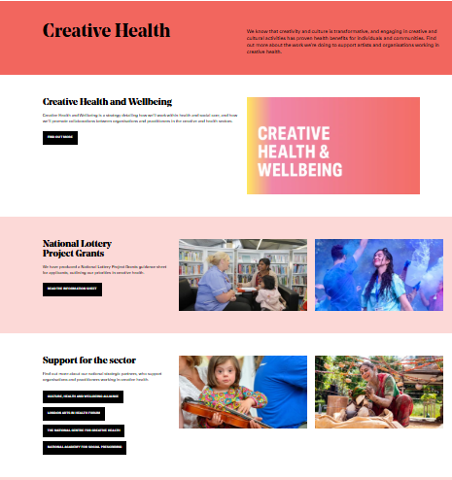
Further Info
Creative Health | Arts Council England
The Creative Health plan
Case studies
Funding information
Resources
Blog posts

