Slide 1

champions the right for artists, creatives and other curious people to follow hunches, explore dreams and probe problems through creativity to inspire positive change.​

Slide 2
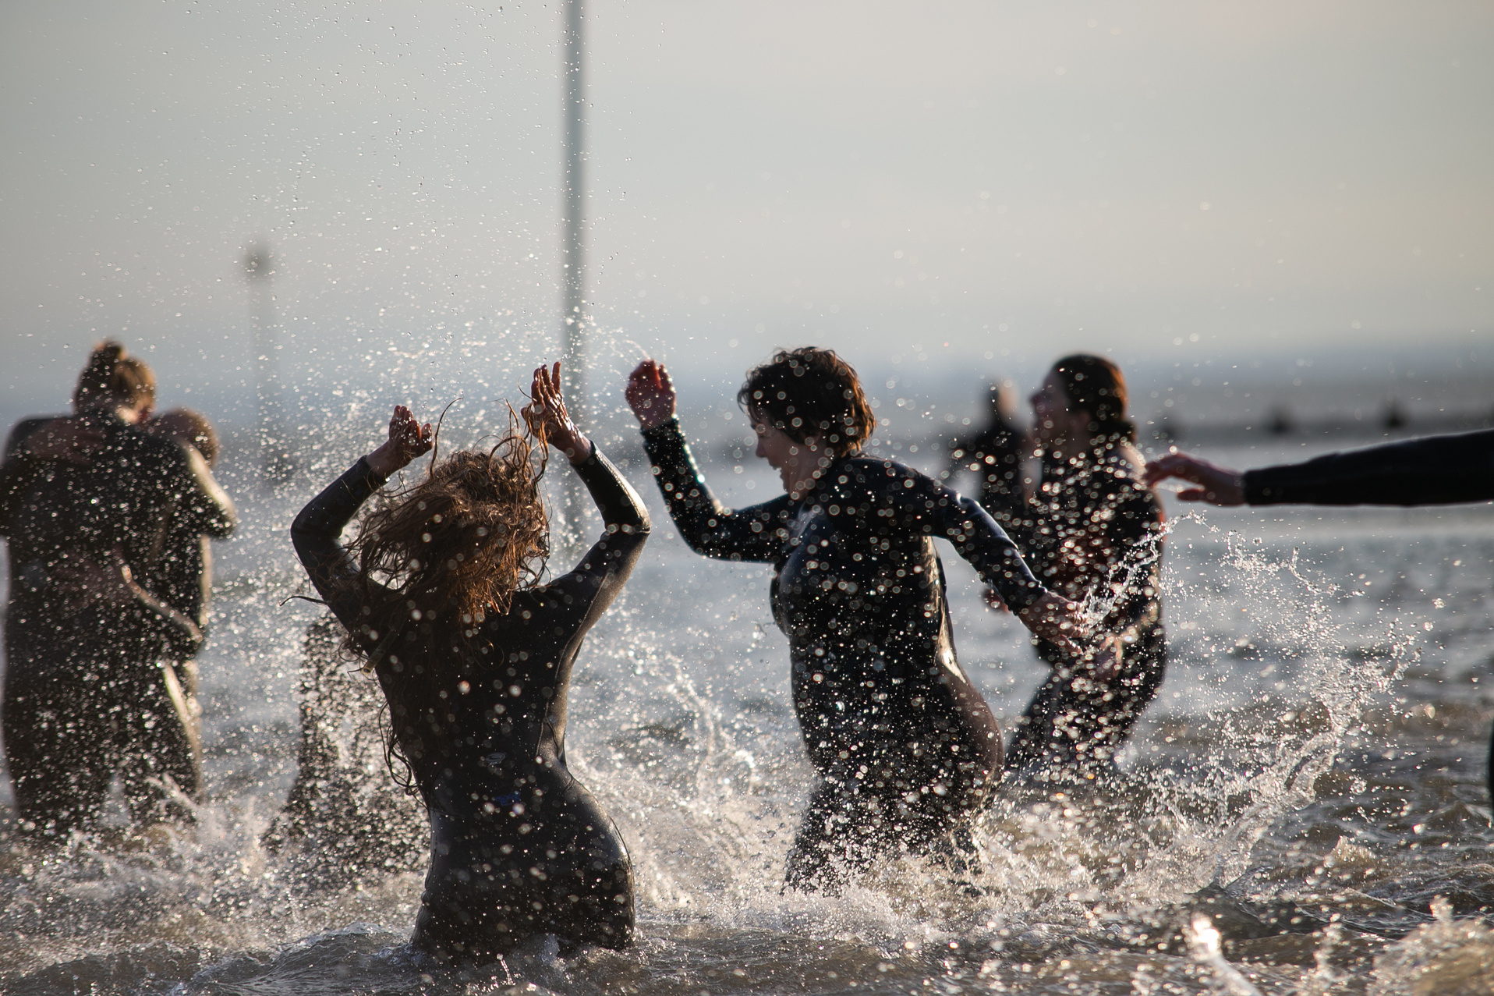

is an arts organisation working at the intersection of art and social change.
​
The way we work deeply within communities and on a national and international scale makes us unusual. We currently have sites in Liverpool (since 2004), Peterborough (since 2012) and Southend-on-Sea (since 2007). We were invited to these places by local authorities, Arts Council England and other partners who shared our belief in art’s importance for community building.
Image credit: SILT by Arbonauts, commissioned for Estuary 2021, photo: Nina Photography

Slide 3
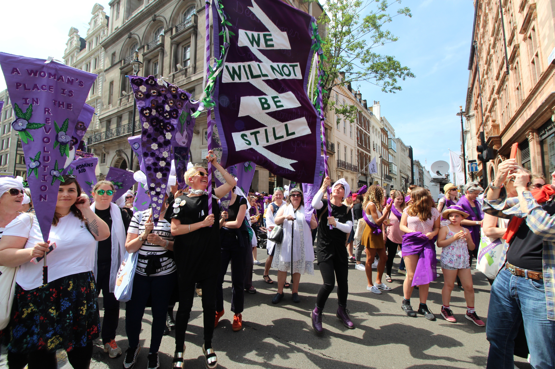
Our work
Image credit: Processions (2018), photo: Ruth Campbell

Slide 4
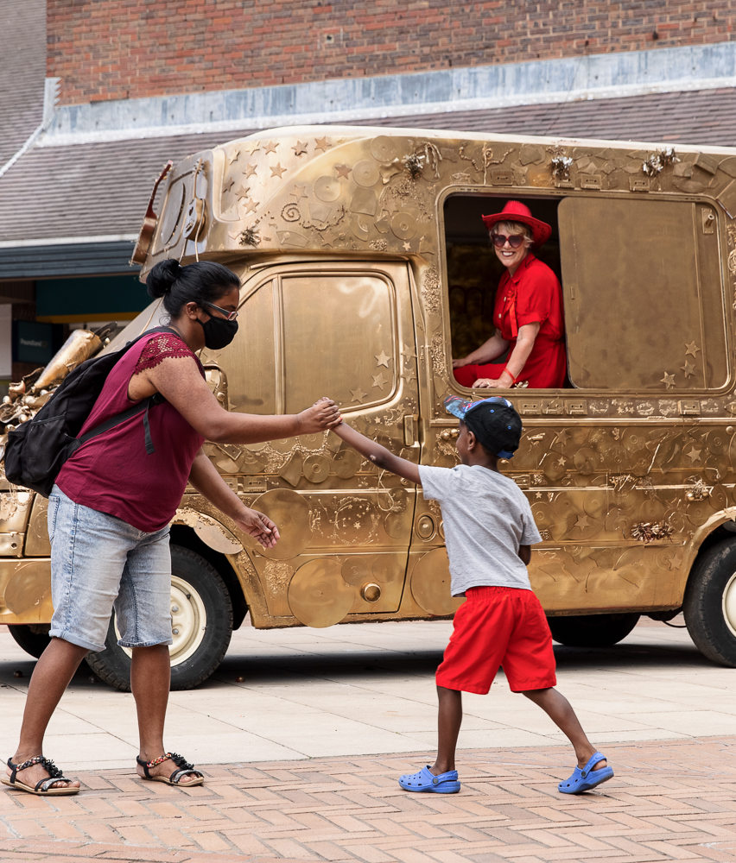
The Unlonely City
A 10-year arts programme disrupting loneliness, nurturing moments of solidarity, surprise and laughter in Liverpool, Peterborough Southend.
It is an experiment.
Image credit: Sadie Hennessey Golden Years Estuary Festival. Photo: Rob Harris.

Slide 5
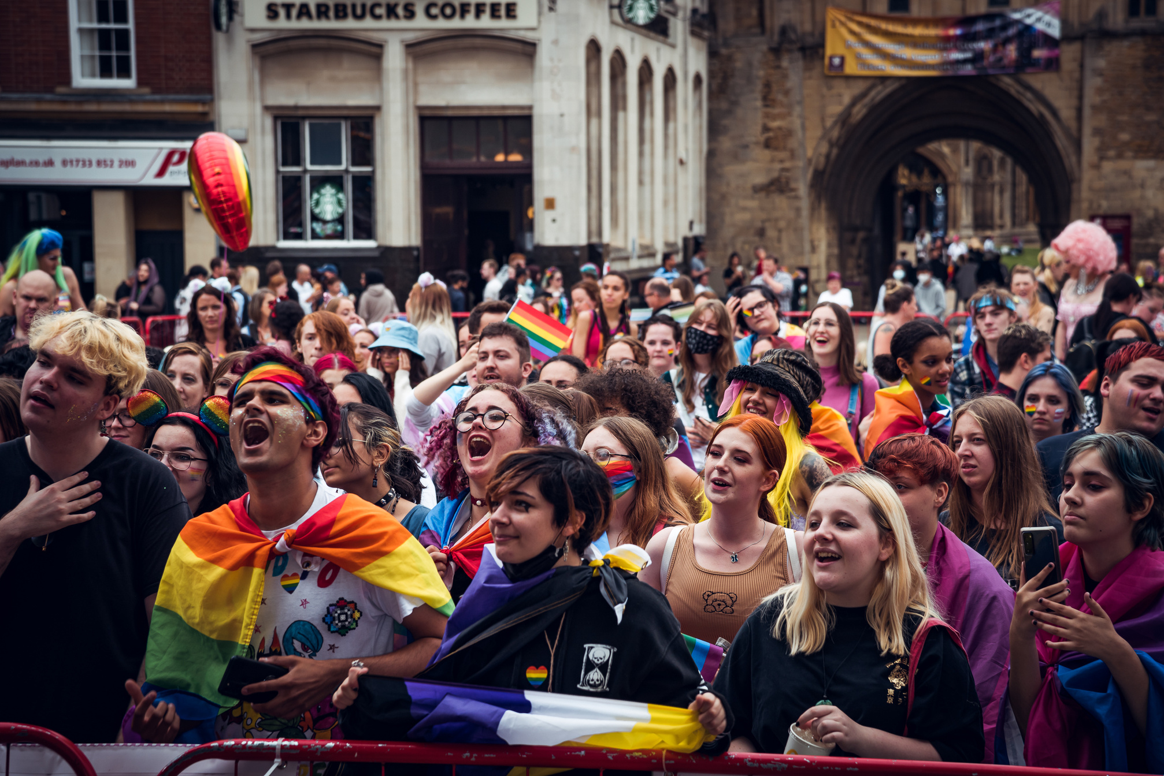
Assemblies
Artists will dream up a structure for citizens assemblies or a new kind of gathering to gain knowledge about the ways people feel close to others and themselves, and the ways they feel alone in the city. Using this learning, the artist will create an artwork that shows how feelings of, and attitudes towards, loneliness change over time in our places.
Image credit: Peterborough Pride (2021), photo: Jess Lund

Slide 6

Community decision-makers will make key decisions about the artistic commissions, projects and perhaps even new organisations to tackle the most pressing concerns around loneliness in each city.

Slide 7
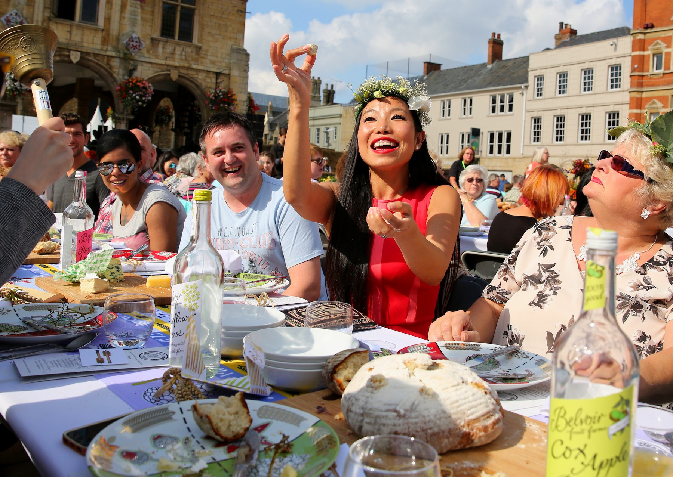
Mass participation
Image credit: Harvest – 70×7 The Meal (2016), photo: Chris Porsz

Slide 8
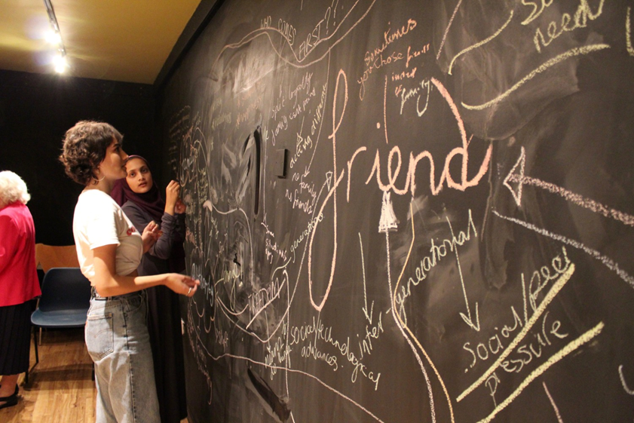
As We Gather
Beautiful conversations between strangers who live in the same city.
“A sense of lingering like the feeling of those conversations you have by the front door, when one of you is about to leave and you stay there for ages, and it means the most because it wasn’t meant to be a special moment but it really was and now it's gone and you’ve hugged goodbye and closed the front door and one of you walks away smiling and the other pauses behind the front door savoring the moment.” Luca Rutherford, artist
Image credit: Decorum (2018), photo: Ruth Campbell

Slide 9
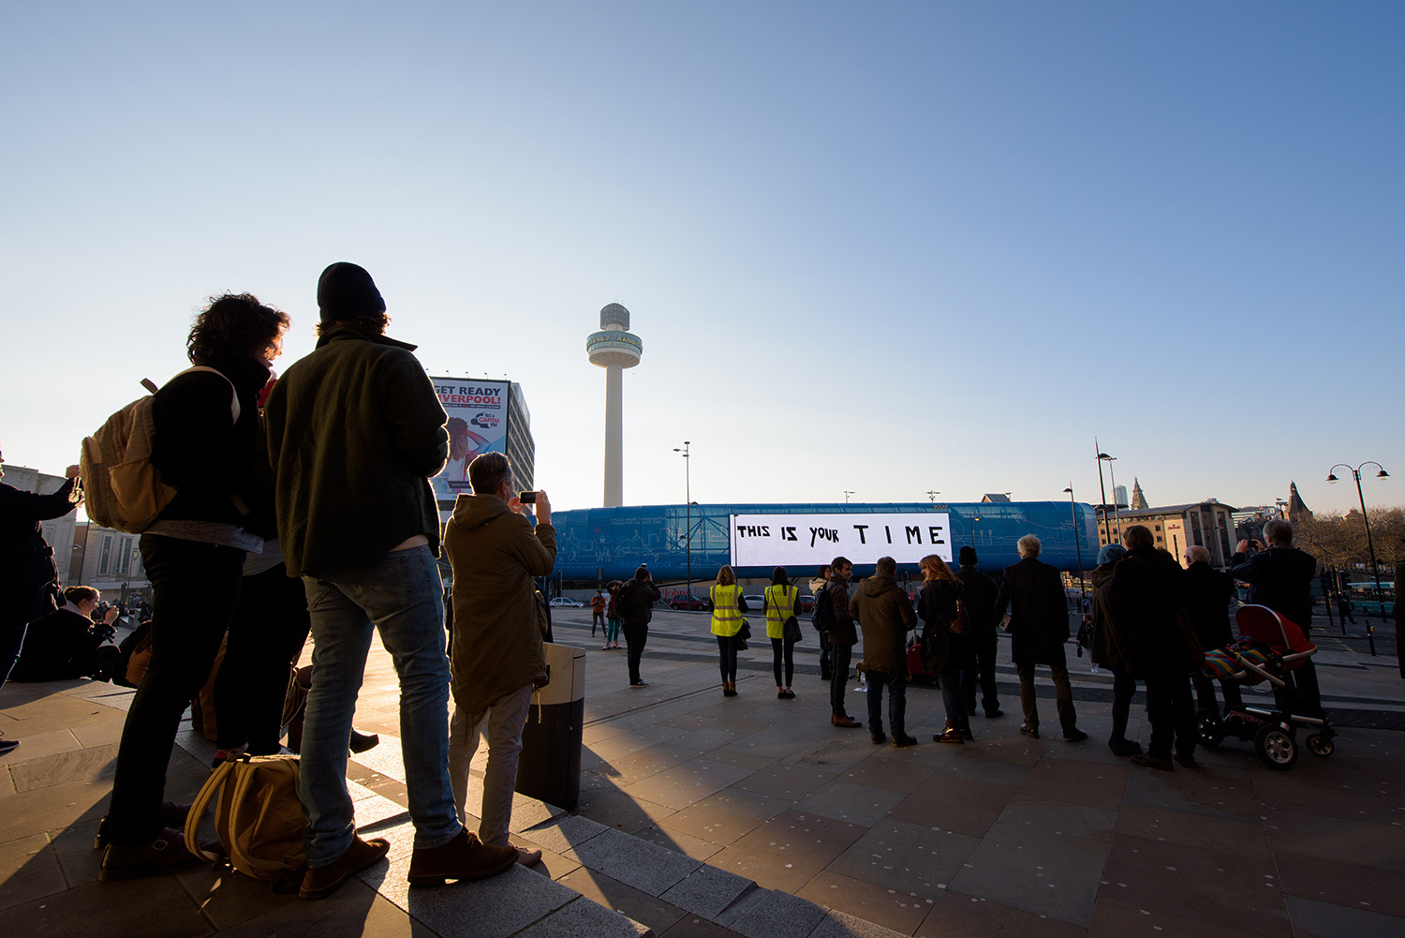
Susie Thornberry
Artistic Director & CEO
Image credit: FOUR WORDS, Liverpool Provocations, artist Alan Dunn

