Slide 1
Beyond the Game: Understanding Loneliness in Sport
Dr Patricia Jackman
Associate Professor in Sport and Exercise Psychology

Slide 2
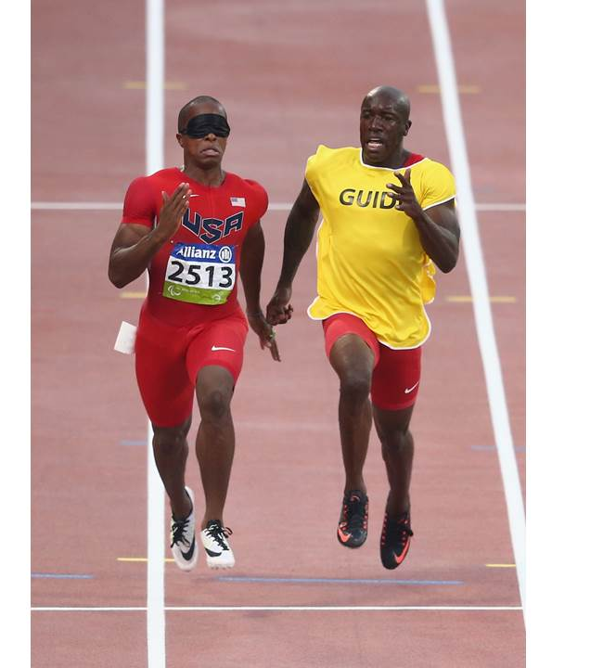
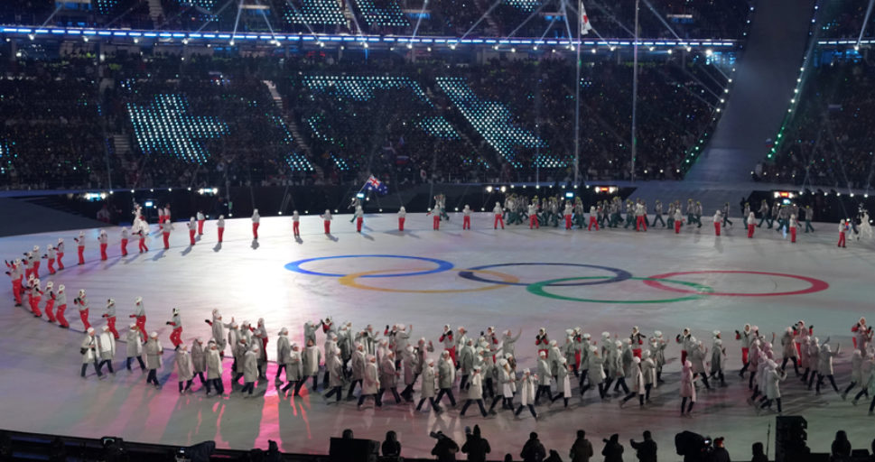
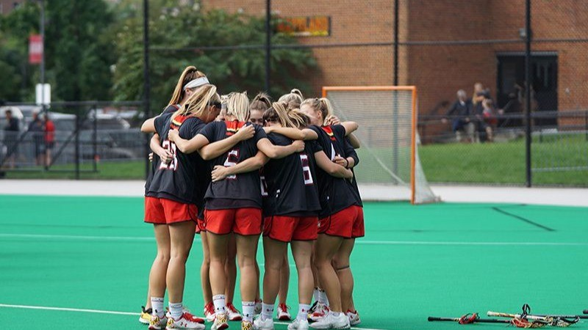
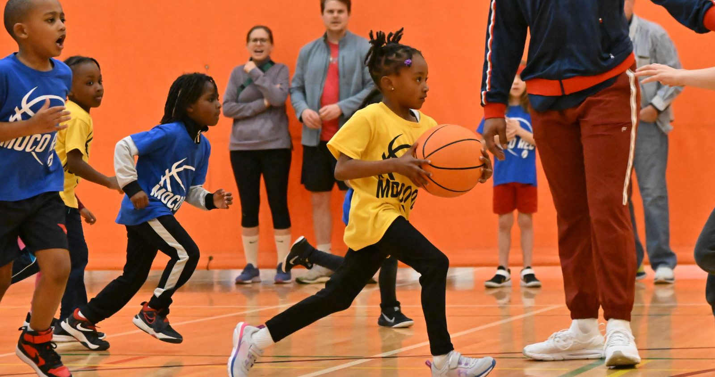
Sport
A place of connection and belonging?

Slide 3
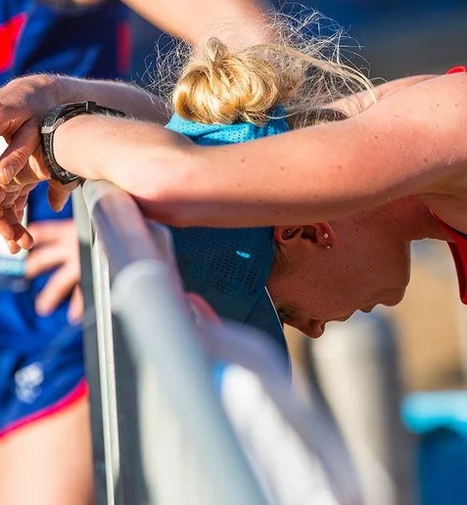
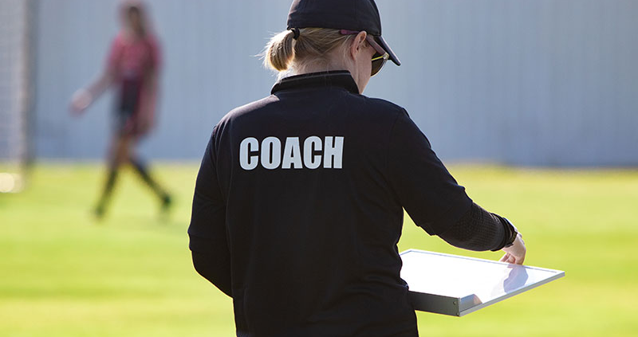
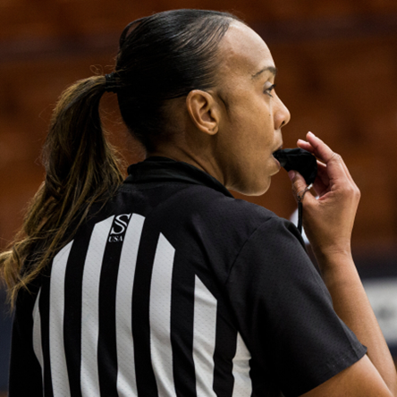
Or a lonely place (for some)?

Slide 4
Loneliness in Sport: Surely Not?
“The lowest point of all came when I started to self-harm…It is not something I am proud of today. What more can I say? I was lonely. I was lost. I was scared. I didn’t know who I was any more.” (Kelly Smith, England Footballer)
"You feel lonely when it's gone…When I retired, I felt I had no direction in life. For three years I wanted to forget who I was. I was depressed.“ (Karl Fogarty, World Superbike Champion)
More than 80% of our research was judged to be internationally
excellent or world-leading in the latest Research Excellence Framework

Slide 5
More than 80% of our research was judged to be internationally
excellent or world-leading in the latest Research Excellence Framework

Slide 6
Aim and Research Questions?
Aim: to systematically review, synthesise, and appraise research on loneliness in sport.
What are the characteristics of studies conducted?;
What methods have been used?;
How is loneliness conceptualised and described in sport?;
What loneliness measures have been used?;
What risk factors, protective factors, and outcomes are associated with loneliness in sport?;
What are the characteristics and effects of interventions targeting loneliness in sport?
More than 80% of our research was judged to be internationally
excellent or world-leading in the latest Research Excellence Framework

Slide 7
194
outputs up to September 2024
Loneliness was a primary outcome of focus in only 20.62% of studies
More than 80% of our research was judged to be internationally
excellent or world-leading in the latest Research Excellence Framework

Slide 8
88,516 participants (>98% athletes)
Mainly multi-sport (k = 69) or soccer (k = 28)
12.4% of studies collected data during the Covid-19 pandemic
Europe (k = 75) or North America (k = 62)
More than 80% of our research was judged to be internationally
excellent or world-leading in the latest Research Excellence Framework

Slide 9
Methods
No published interventions targeting loneliness in sport
More than 80% of our research was judged to be internationally
excellent or world-leading in the latest Research Excellence Framework

Slide 10
How Do Sportspeople Describe Loneliness?
Social loneliness
Loss of social networks/friends
Feeling alone and without support
Lack of friends
Feeling of social isolation
Emotional loneliness
Lack of warm and loving close relationships
Not feeling close to anyone
Feeling alienated or disconnected
More than 80% of our research was judged to be internationally
excellent or world-leading in the latest Research Excellence Framework

Slide 11
How Prevalent is Intense/Severe Loneliness in Athletes?
More than 80% of our research was judged to be internationally
excellent or world-leading in the latest Research Excellence Framework

Slide 12
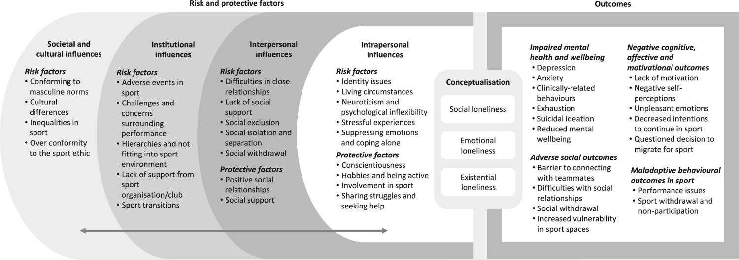
What Factors Influence Loneliness? A Socio-Ecological Model
More than 80% of our research was judged to be internationally
excellent or world-leading in the latest Research Excellence Framework

Slide 13
Why Should We Worry About Loneliness in Sportspeople?
Mental ill-health and ill-being
Depression
Anxiety
Gambling and substance use
Exhaustion
Suicidal ideation
Poor mental wellbeing
Cognitive, affective and motivational effects
Lack of motivation
Lower intentions to continue
Negative self-perceptions
Unpleasant emotions
Behavioural outcomes
Reduced performance
Withdrawal from sport
Adverse social consequences
Disconnected from teammates
Difficulties with social relationships
Social withdrawal
Vulnerability in sport spaces
More than 80% of our research was judged to be internationally
excellent or world-leading in the latest Research Excellence Framework

Slide 14
Risk Factor: The Socio-Cultural Landscape
Conforming to masculine norms
Cultural differences
Over conformity to the sport ethic
Inequalities in sport
“The reason It’s so lonely is we put those walls up...and nobody can know that I’m feeling, you know, concerned about my performance, that I’m insecure about this or that because football in a sense is ultimate meritocracy and such a manly thing that you just you always feel like you gotta be on, you know?” (McGraw et al., 2018, p. 413)
More than 80% of our research was judged to be internationally
excellent or world-leading in the latest Research Excellence Framework

Slide 15
Risk Factor: Institutional Aspects
Adverse events in sport
Lack of support from sport organisation/club
Hierarchies and not fitting into sport environment
Lack of support from sport
Challenges and concerns surrounding performance
“Now my teammates think I am not worthy of being part of this team. I just want to fit again like I did at Commonwealth Games. The silence is killing me. I feel so alone. I only have myself to blame for my performance and their silent treatment”. (McMahon et al., 2019, p. 293)
More than 80% of our research was judged to be internationally
excellent or world-leading in the latest Research Excellence Framework

Slide 16
Risk Factor: Negative Interpersonal Relationships
Difficulties in close relationships
Lack of social support
Social isolation and separation
Social exclusion
Social withdrawal
“We were out for a team dinner… everyone was talking to each other having a good time but I just felt alone… no one really said anything to me. I got the impression that my teammates didn't want me there because usually I'm laughing with them and just treated as one of the boys.” (Battaglia et al., 2018, p. 43)
More than 80% of our research was judged to be internationally
excellent or world-leading in the latest Research Excellence Framework

Slide 17
Risk Factor: Individual Traits and Coping Strategies
Identity issues
Living circumstances
Neuroticism and psychological inflexibility
Stressful experiences
Suppressing emotions and coping alone
“You just feel so separated from the rest of the world. I kinda felt like I couldn’t really share with anyone. I don’t know why, but I always feel like people are against me for some reason . if I like say something, for some reason I think it will be used against me.” (Tamminen et al., 2013, p. 31)
More than 80% of our research was judged to be internationally
excellent or world-leading in the latest Research Excellence Framework

Slide 18
Protective Factor: Positive Interpersonal Relationships
Positive social relationships
Social support
“‘Having around people who support you like family and friends, is really comforting and helps you to feel not alone’ …‘I felt a total support from my family to continue my rehab, they strongly believed in me and in my efforts’.” (Conti et al., 2019, p. 5)
More than 80% of our research was judged to be internationally
excellent or world-leading in the latest Research Excellence Framework

Slide 19
Protective Factor: Individual Attributes, Coping strategies and Actions
Conscientiousness
Hobbies and being active
Involvement in sport
Sharing struggles and seeking help
“When she tells me about the pressure, about her perfectionism, about always striving to be better and better, I think, ‘Oh that! Yes that. You felt that too?’ It wasn’t just me! I want to cry when I realize when I am not alone.” (McGannon & McMahon, 2019, p. 47)
More than 80% of our research was judged to be internationally
excellent or world-leading in the latest Research Excellence Framework

Slide 20
Applied Implications
Tripartite approach to preventing loneliness
Nurture socially supportive relationships and ensure people’s behaviours do not exclude, isolate, segregate, discriminate, or cause harm
Organisations and staff should be aware of precipitating events for loneliness
Reflect on dominant norms and narratives in sport that might contribute to loneliness and consider alternatives that emphasise health and interpersonal dimensions
Consider loneliness within policy and education initiatives related to mental health in sport (e.g., awareness of antecedents and outcomes)
More than 80% of our research was judged to be internationally
excellent or world-leading in the latest Research Excellence Framework

Slide 21
Future Research
Context-specific, trans-contextual (in-sport and out-of-sport loneliness), and multifaceted measurement (beyond frequency–intensity, duration, and emotional burden)
Generate idiosyncratic and nuanced understandings of what loneliness means to sportspeople, how they make sense of it, and how such experiences are navigated
Explore and foreground institutional and socio-cultural influences on loneliness in sport, as well as protective factors
Understand “what works” in sport-based interventions targeting loneliness
Co-produce and evaluate participant-centred resources and interventions that can help mitigate against the occurrence and negative implications of loneliness in and through sport (tripartite approaches)
Increase awareness of need for consideration of loneliness within mental health research in sport, from grassroots to elite sport
More than 80% of our research was judged to be internationally
excellent or world-leading in the latest Research Excellence Framework

Slide 22
Trish Jackman
Trish Jackman
pjackman@lincoln.ac.uk

