Slide 1






Loneliness & the Veteran Community
Mark & Teri Humphries and Richard Gettings

Slide 2
A rough plan for this webinar;
Introductions; Meet Mark & Teri Humphries
A conversation with Mark & Teri
An academic input
The role and power of holistic activities
Wheelchair Rugby / Community Cycling / Art Therapy / Photography
Veterans in Focus Portrait Project
The postcode lottery of Veteran care in the UK
Promising developments; A call to action!

Slide 3
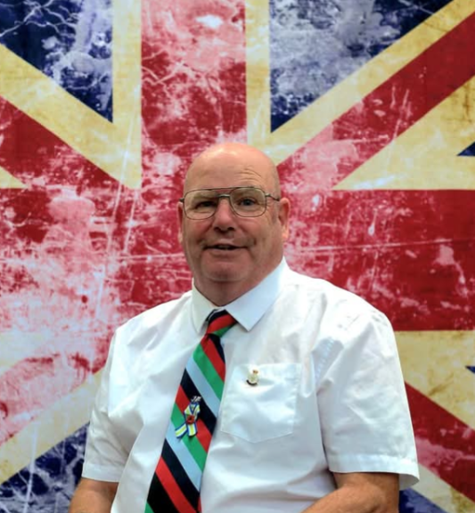
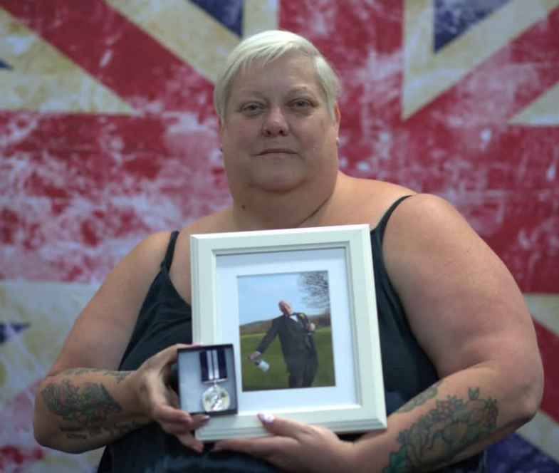
(A conversation piece between Richard, Mark & Teri)
Meet Mark & Teri Humphries and hear about trauma, PTSD and loneliness from the lived experience perspective of two incredible people who really know...

Slide 4







The academic bit....

Slide 5
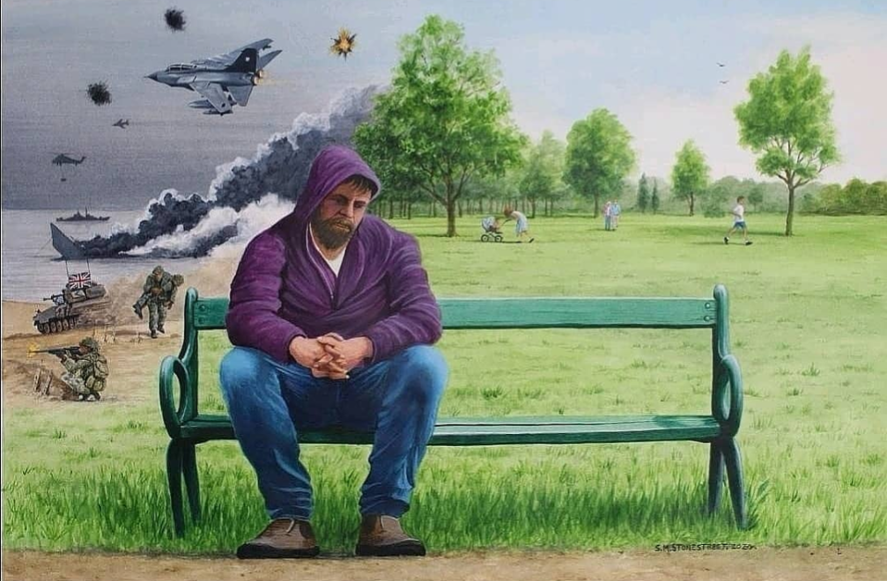
‘The Thousand yard Stare’ by Steve Stonestreet

Slide 6
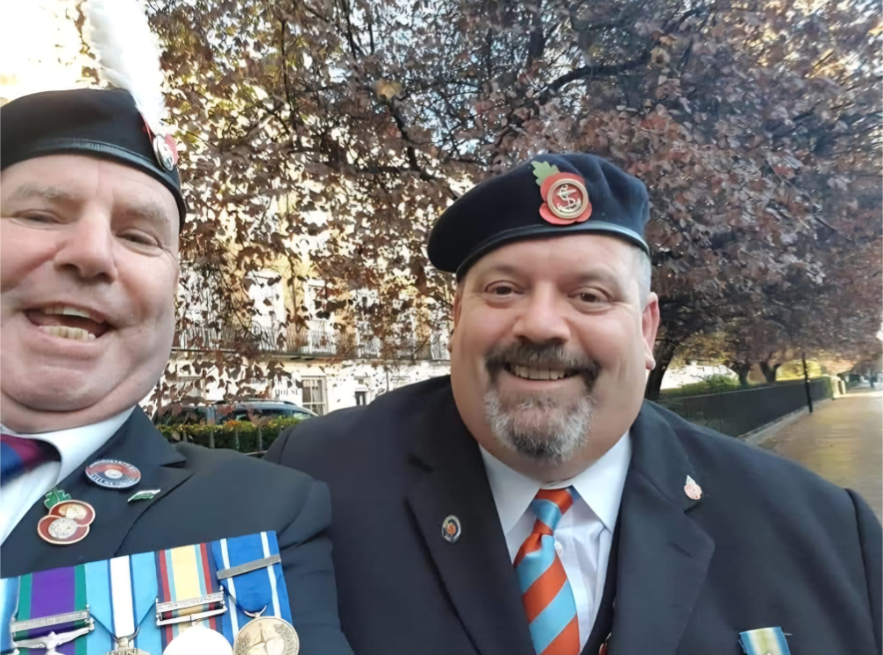

Slide 7
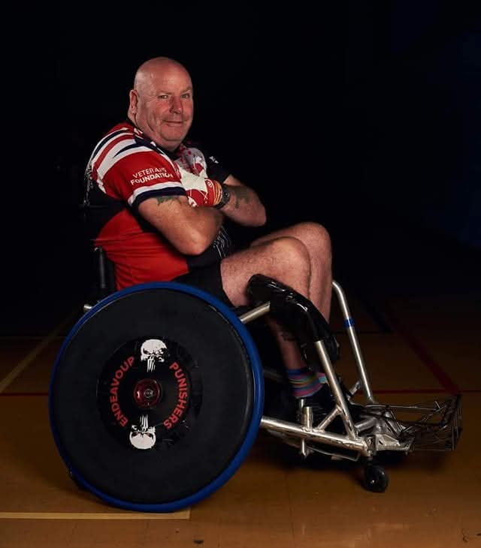
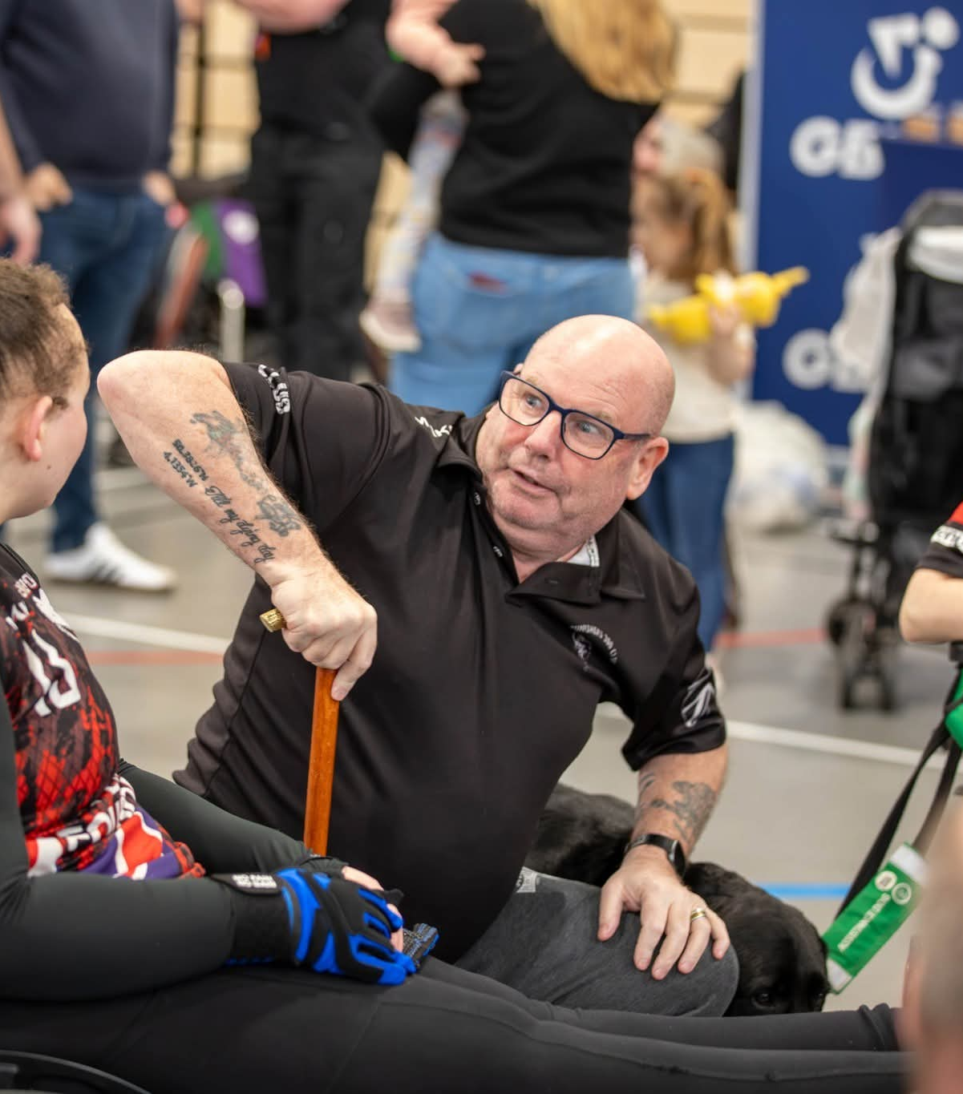
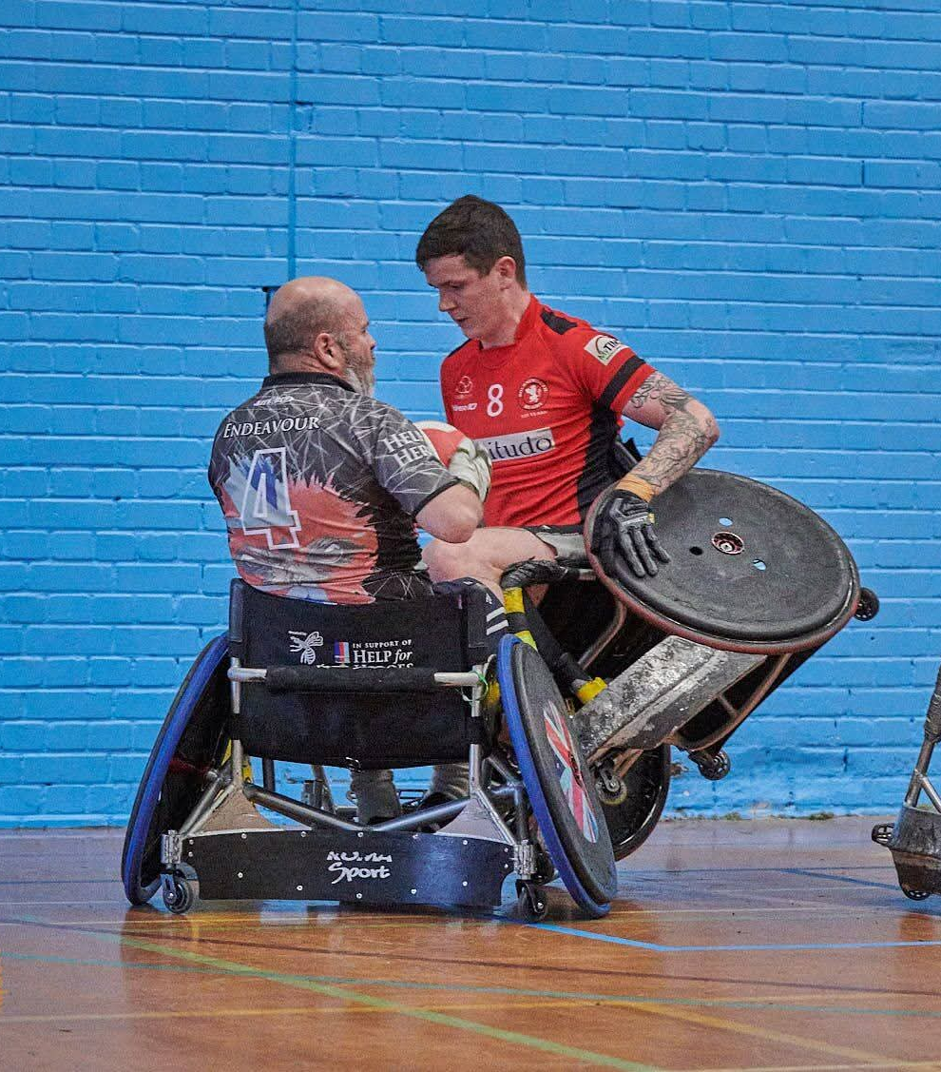
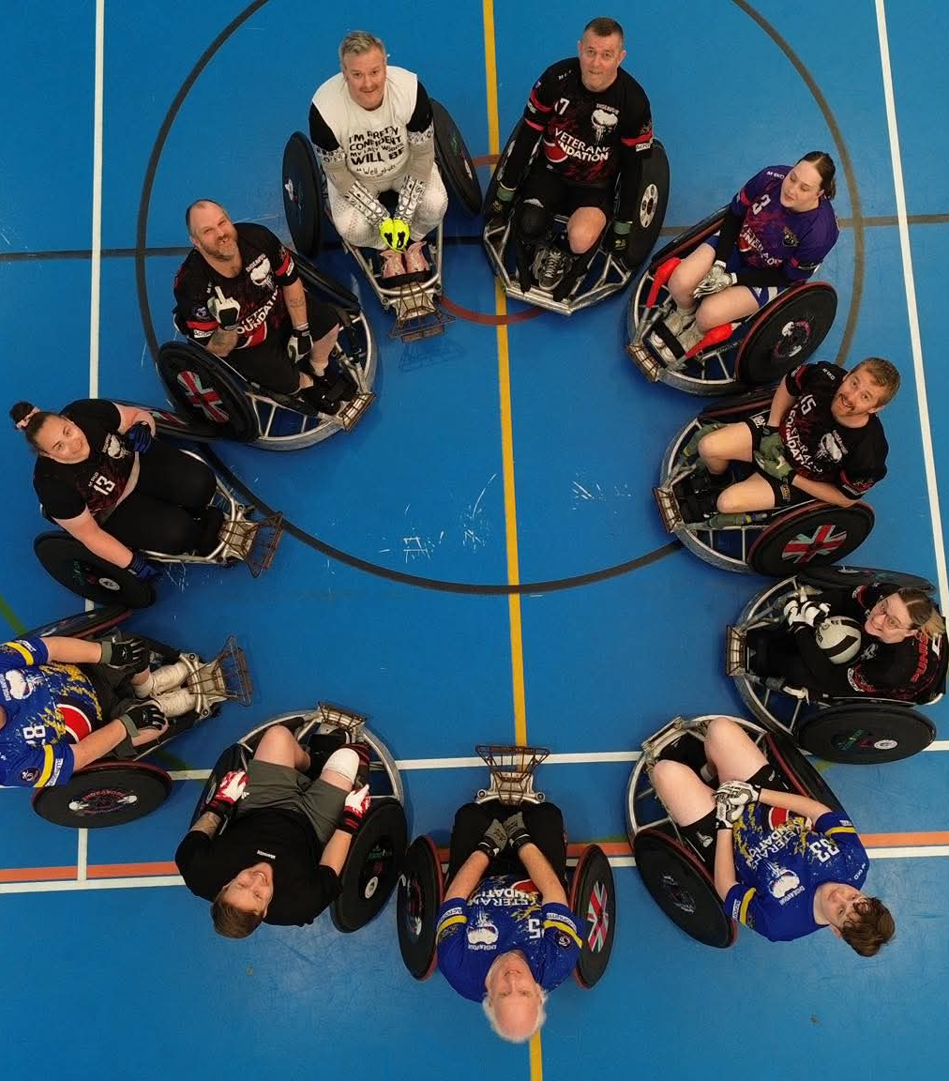
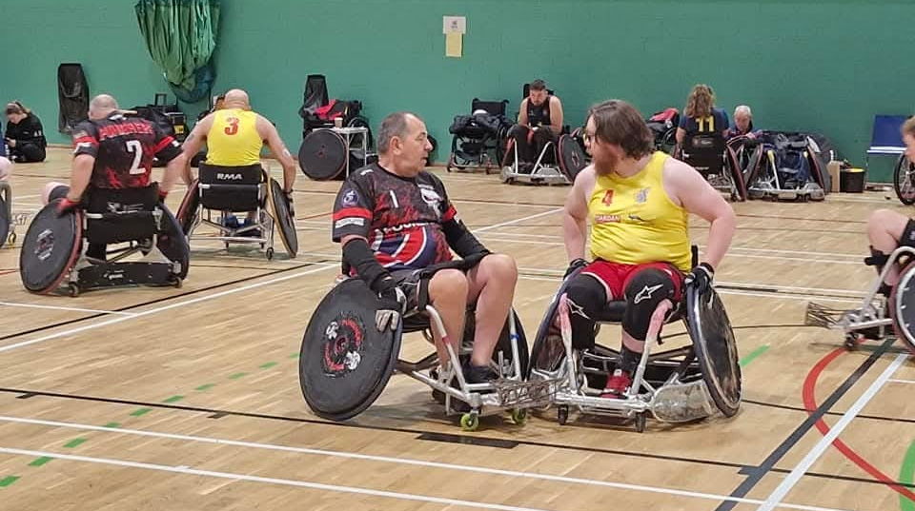

The role, and power, of holistic activities..
How & why?
Wheelchair rugby
Community cycling
Art therapy
Photography

Slide 8
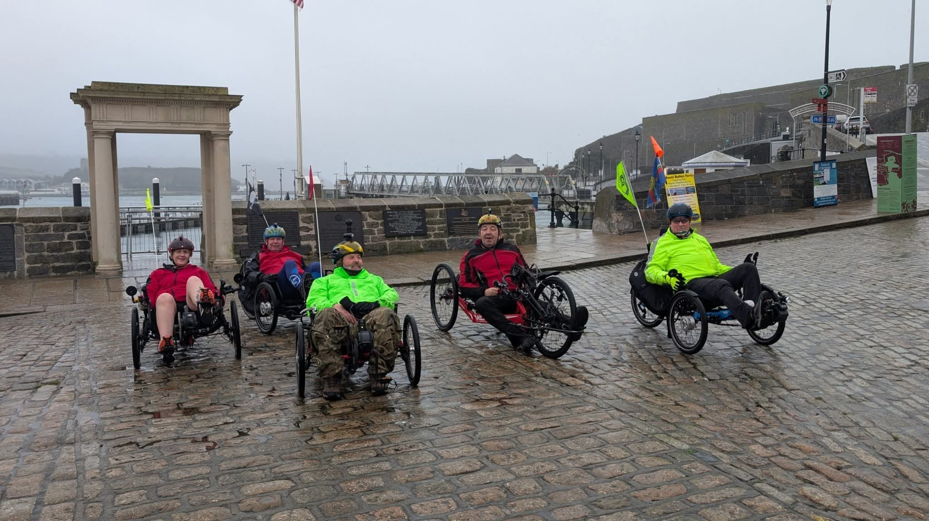
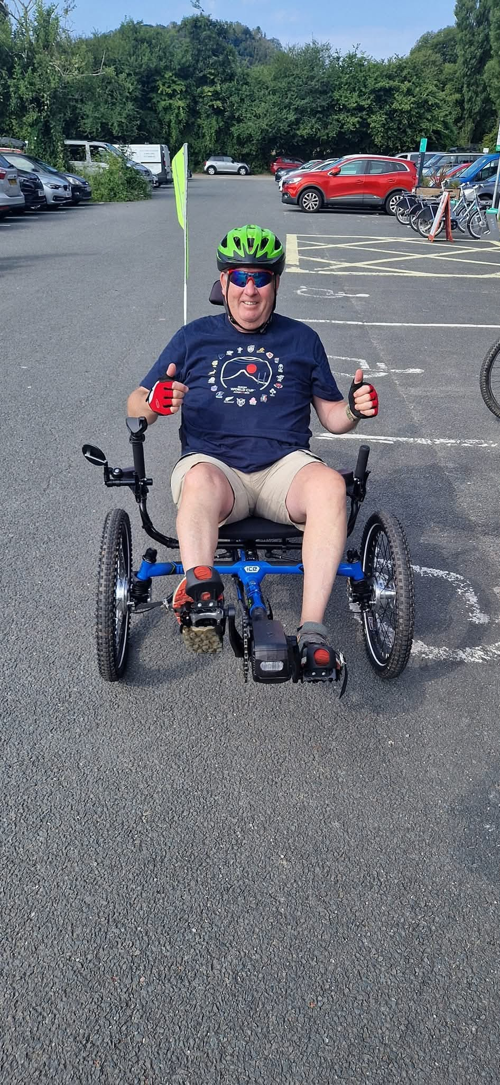
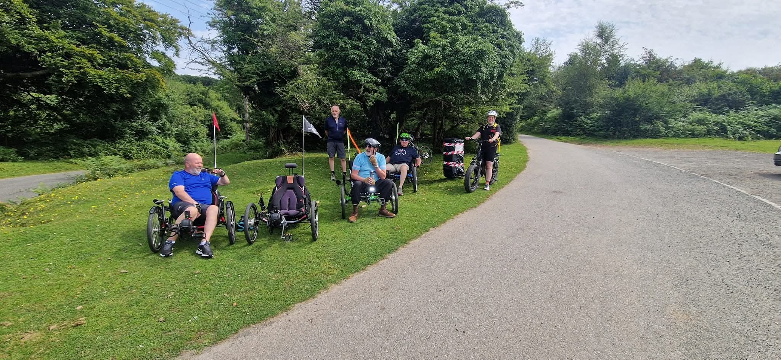
Community
Cycling

Slide 9
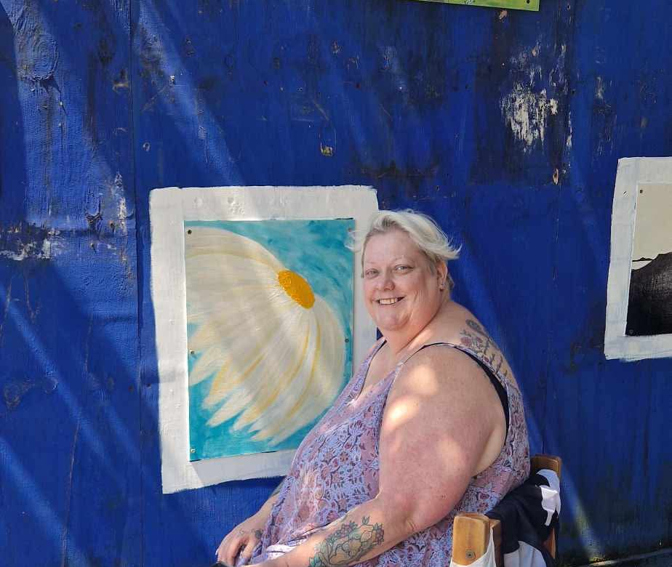
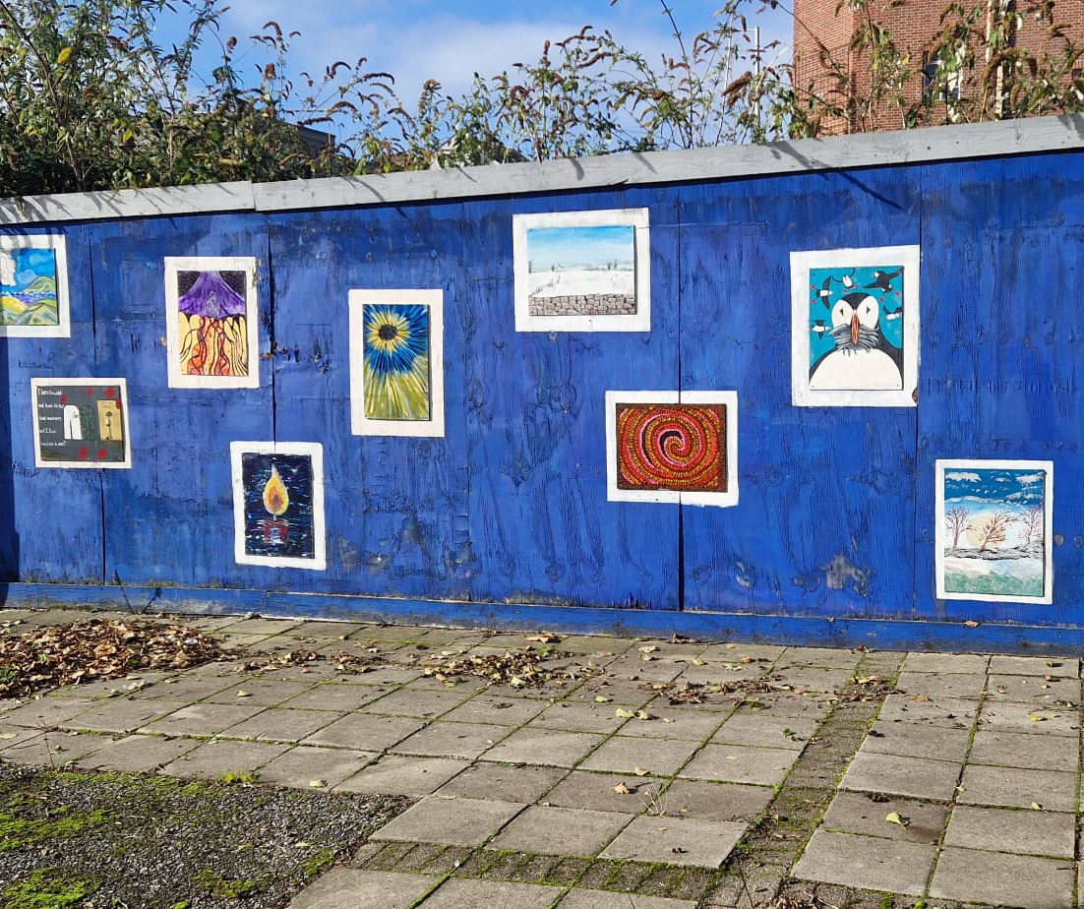
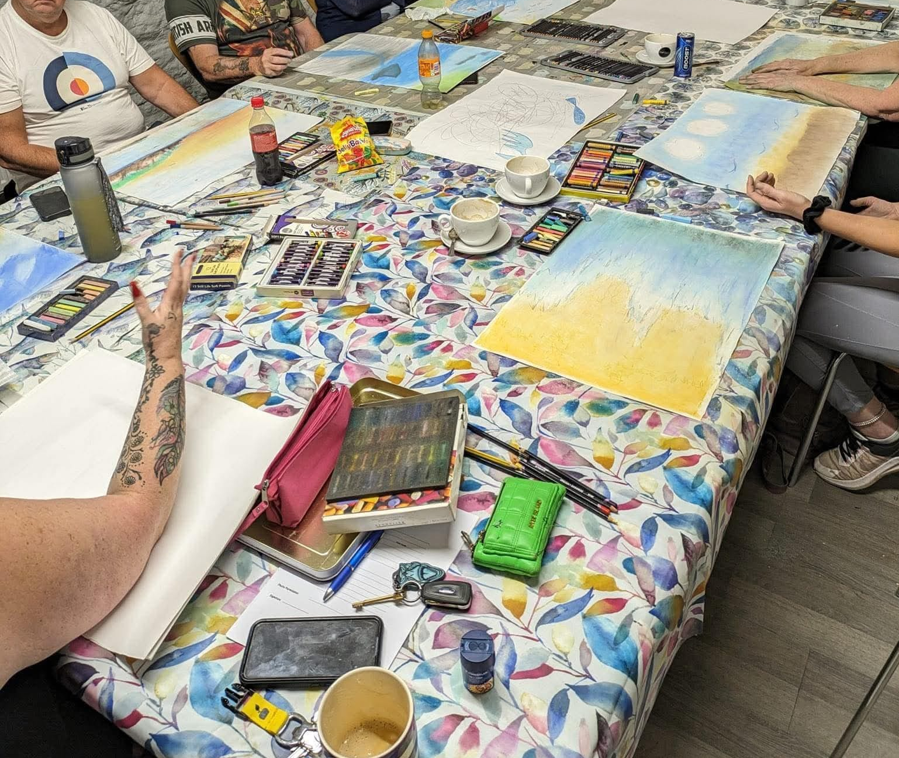
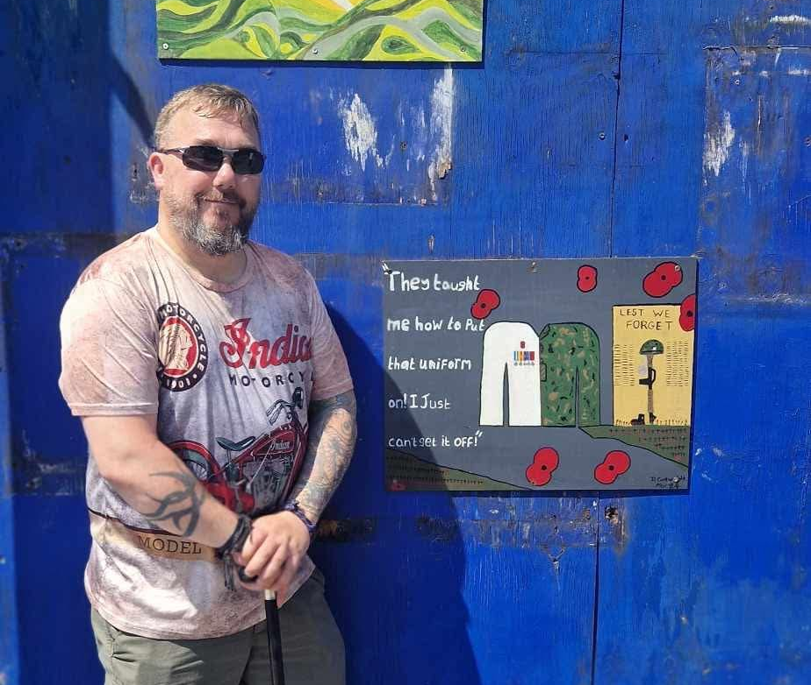
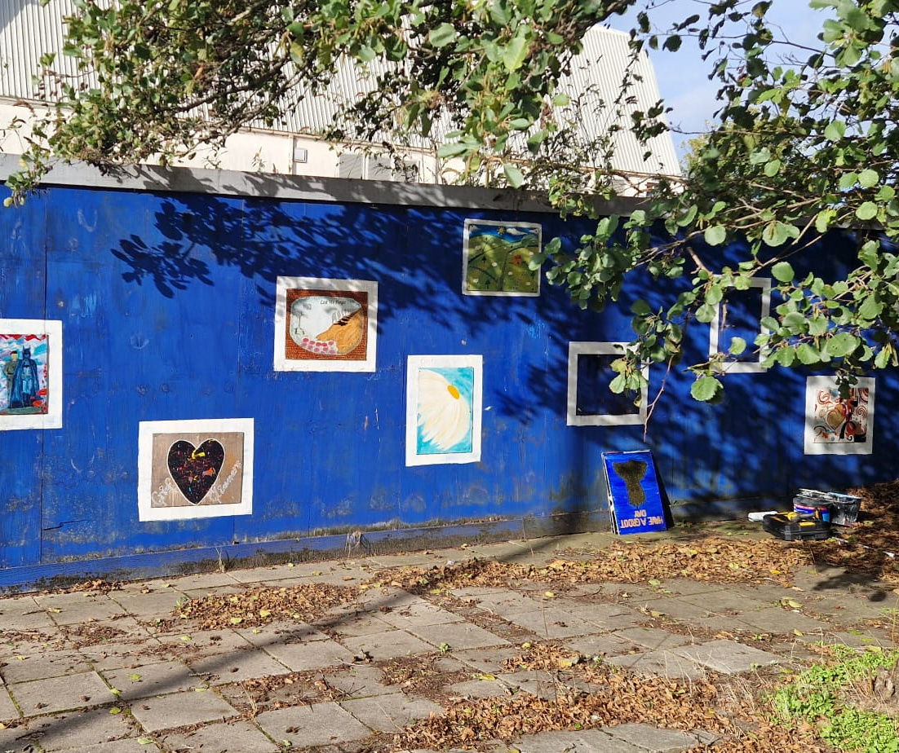
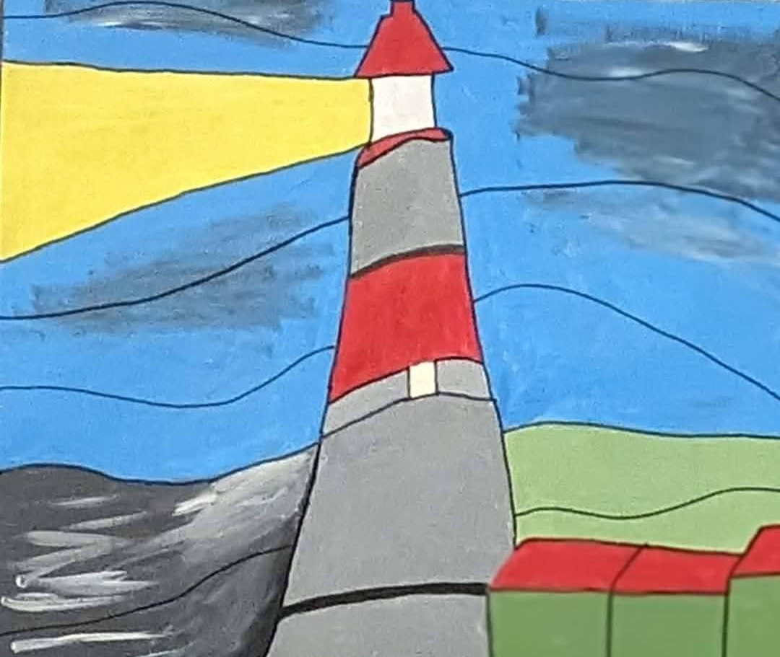
Art therapy

Slide 10
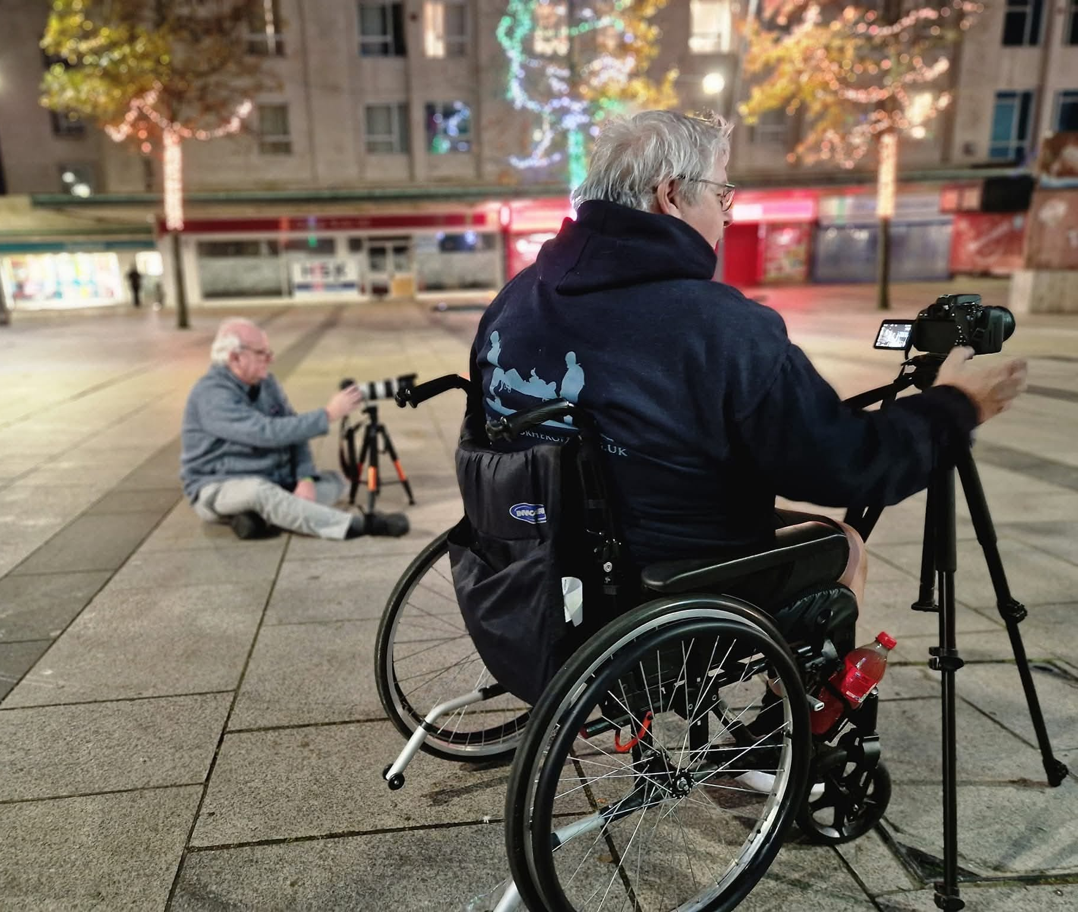
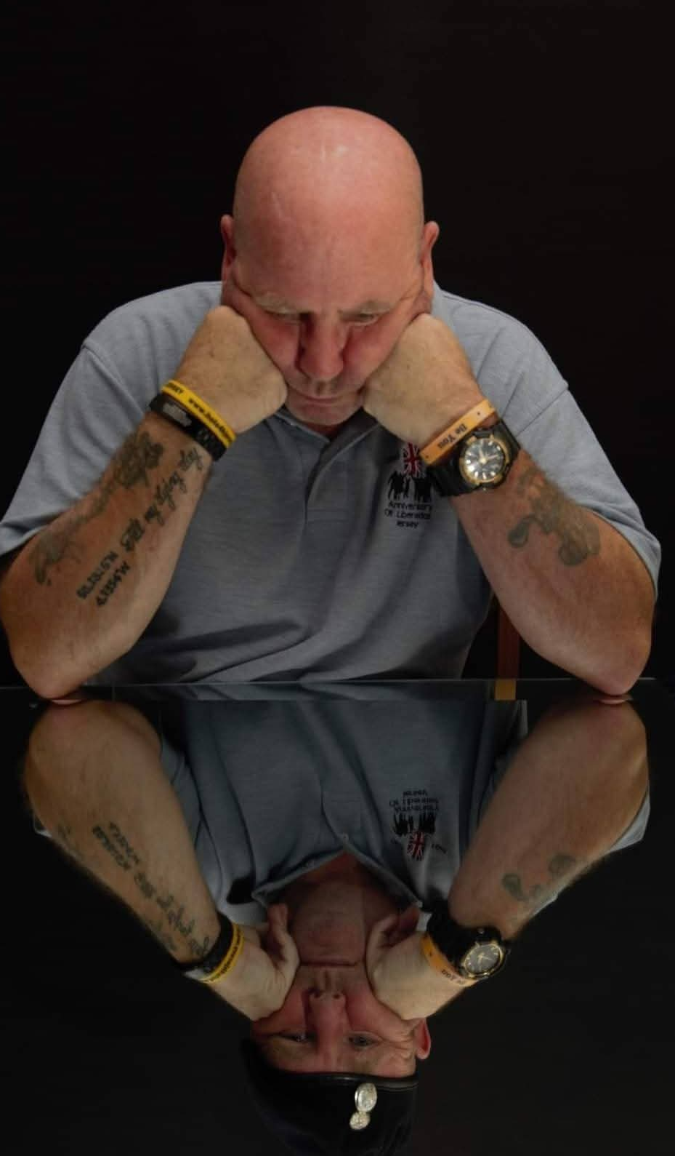
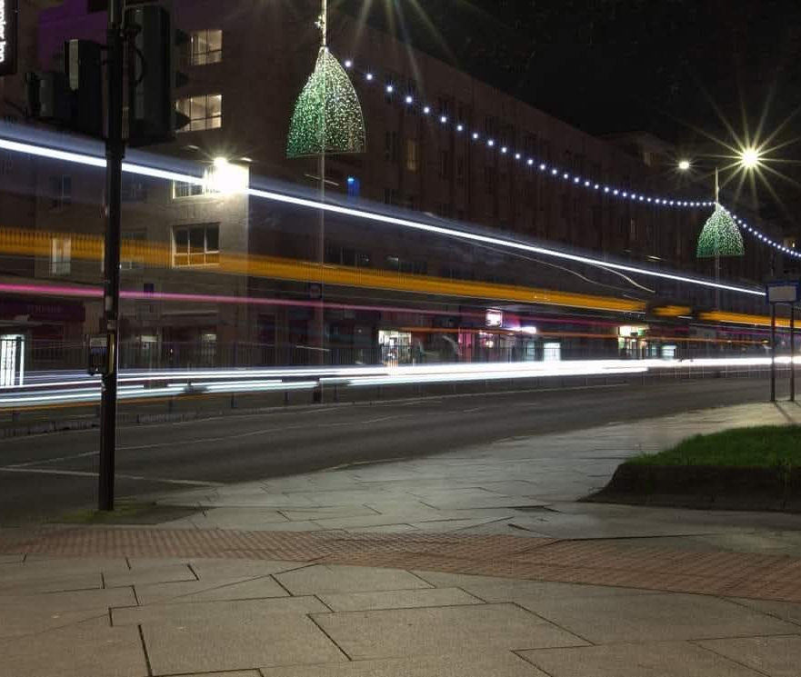
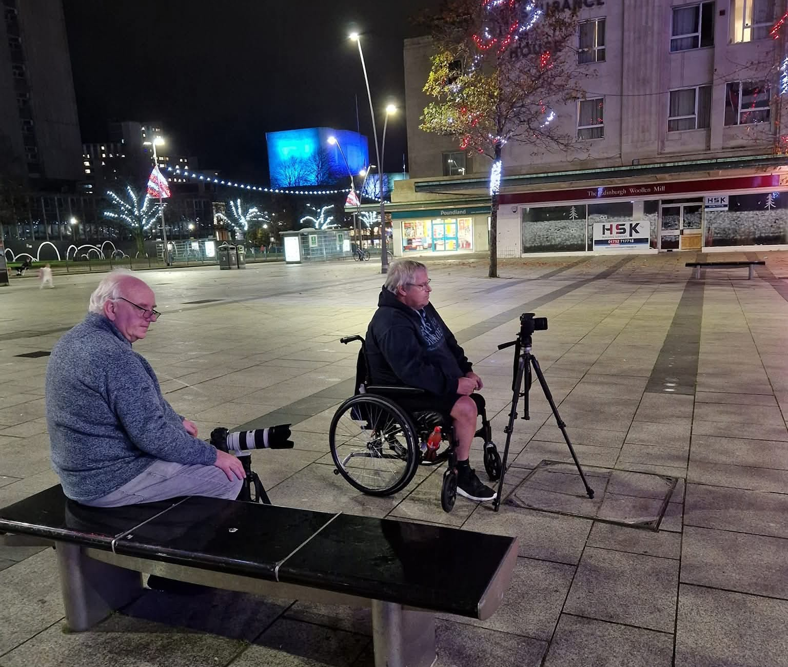
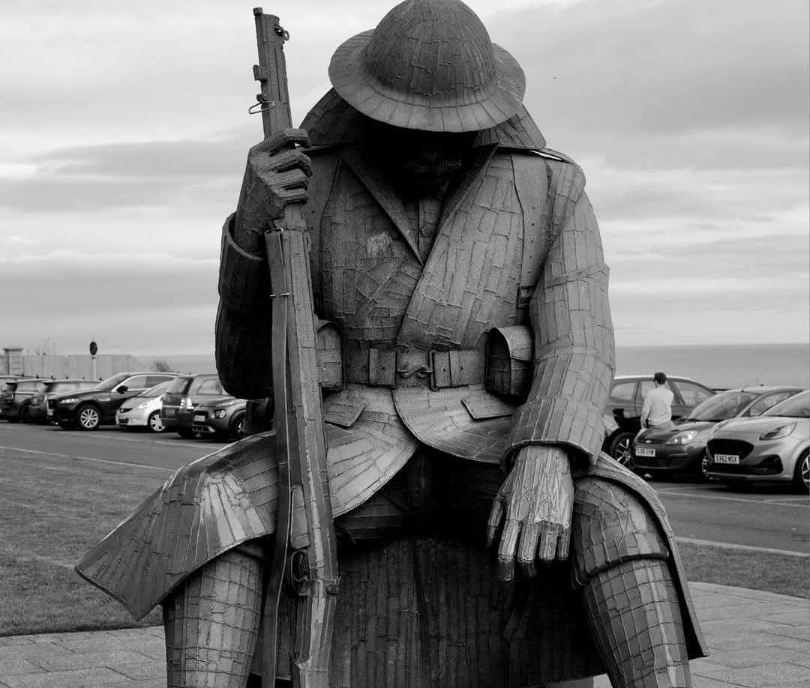
Photography

Slide 11
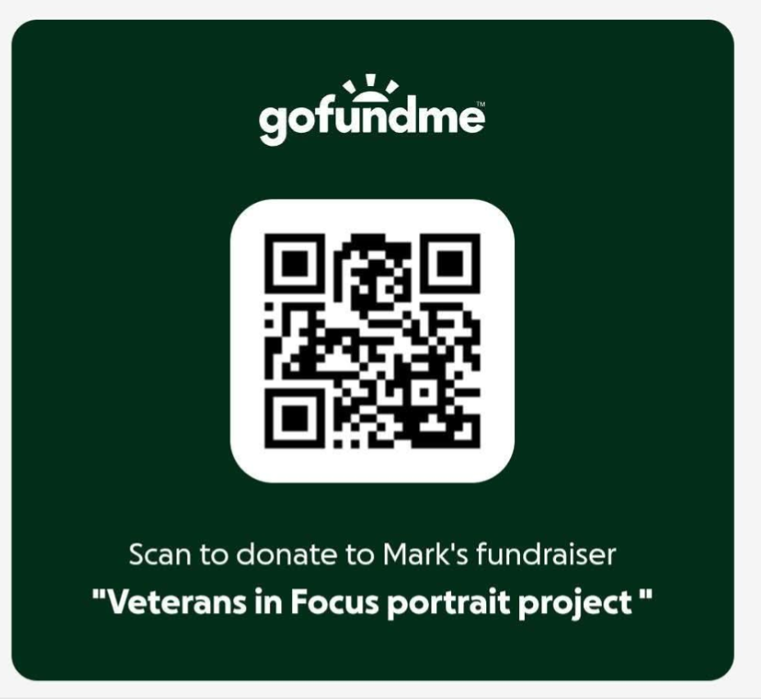
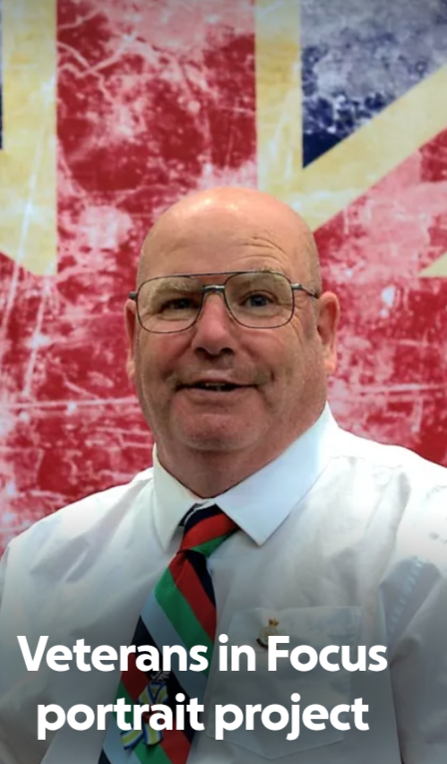
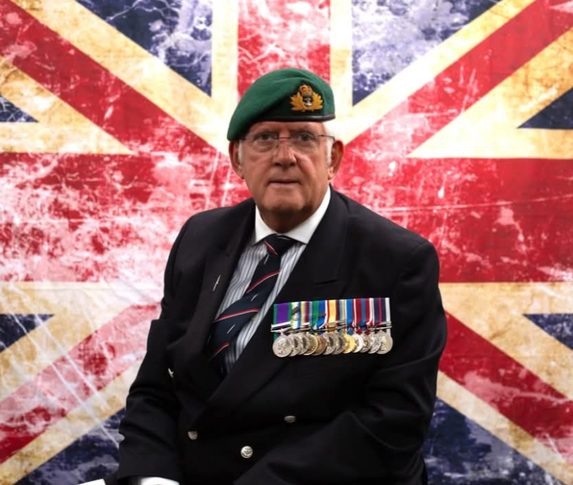
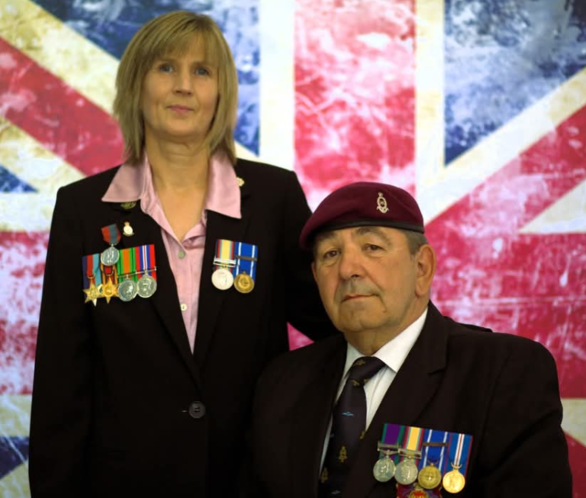

Slide 12

The postcode lottery of Veteran care & support

Slide 13


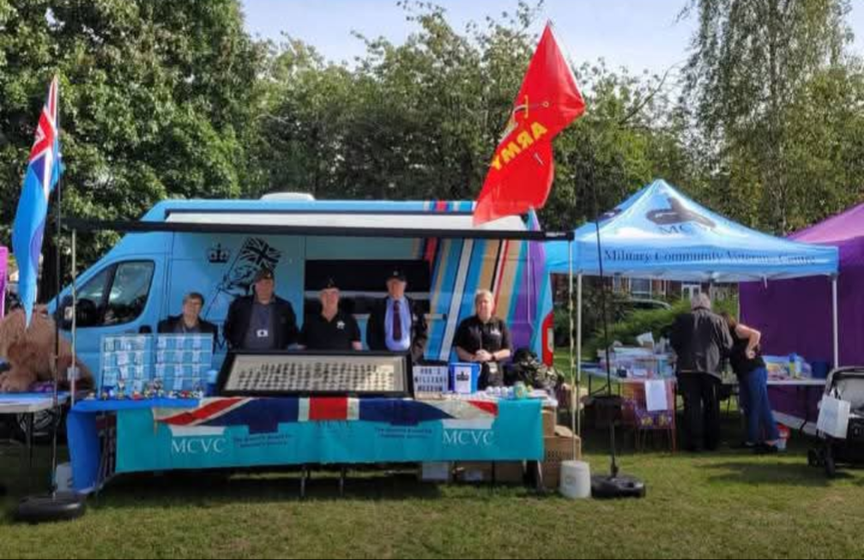
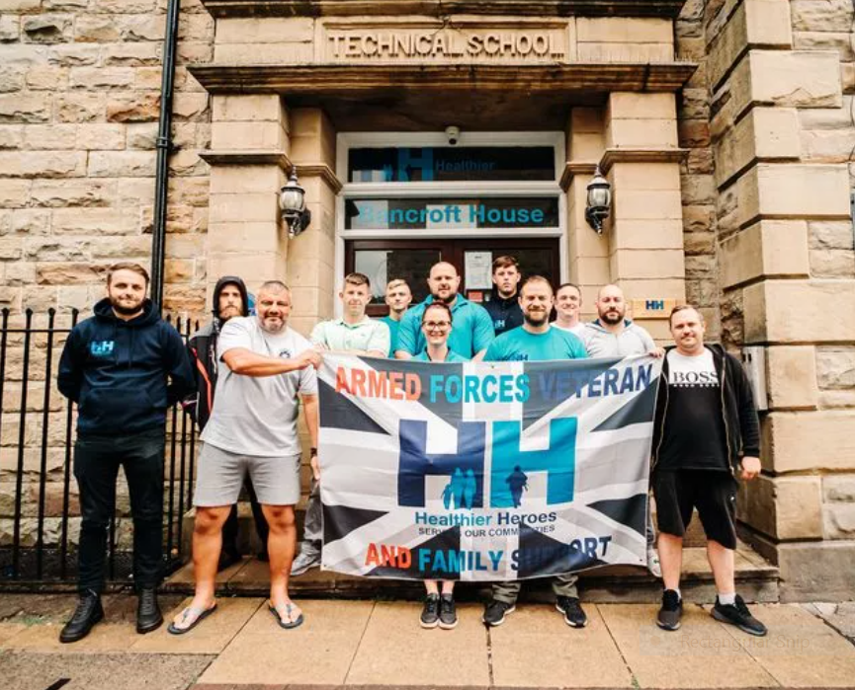
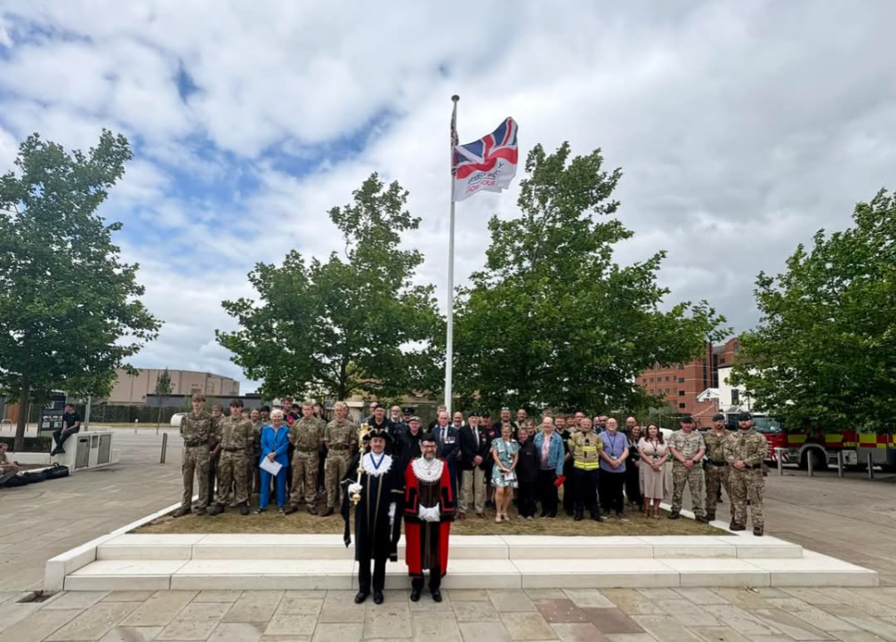
Collaboration, hard work & promising developments...
A call to action; how can you help?

Slide 14
Thank you
Any questions...?

